Slide 2
MISSION
Train selected personnel in the fundamentals of leadership and basic military skills. Instill professional and physical fitness ethics. Evaluate leadership potential. Commission those who qualify as Second Lieutenants in the Total Force.

Slide 3
OFFICER Eligibility
Profile must be accepted by MEPs (if applicable)
GT of 95 to enter program. GT of 110; achieved to attend OCS
Able to obtain a Secret Security Clearance or interim prior to attending OCS
Complete a Commissioning Physical
Attend Basic Training and Advanced Individual Training prior to starting the program

Slide 4
PROGRAM OVERVIEW
Freshman
MS Sem 1
MS 101
Sophomore
MS 201
MS 202
Junior
MS 301
MS 302
Senior
MS 401
MS 402
Report to Unit
BASIC and AIT
Leadership Course or AT
OCS
Commission
AT or Military School

Slide 5
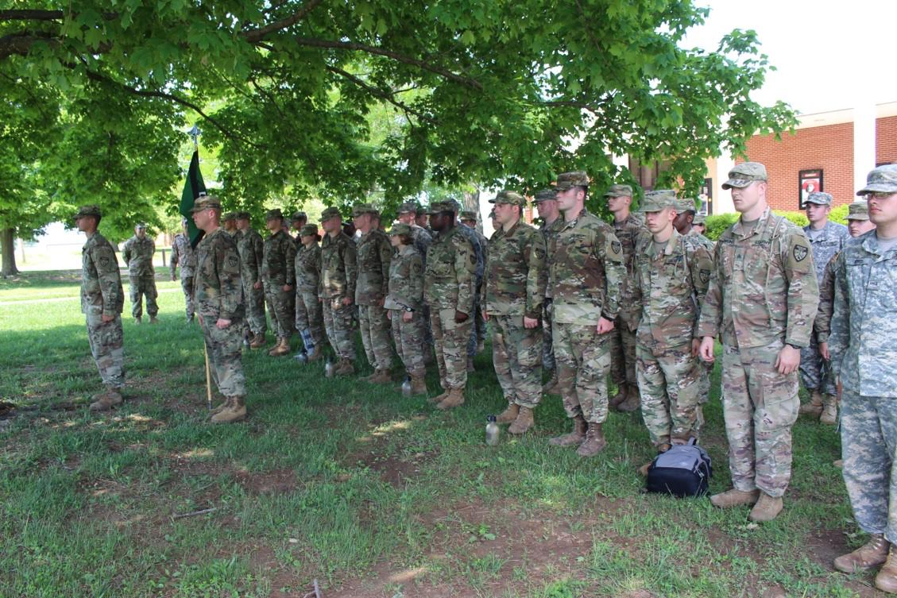
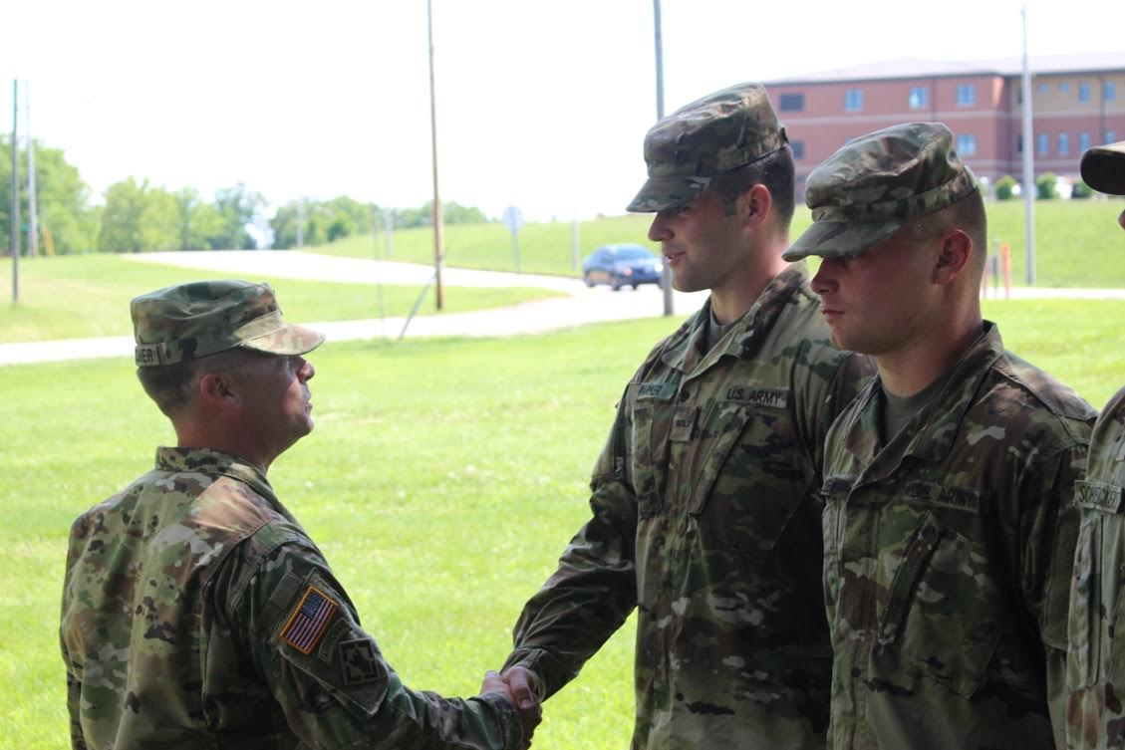
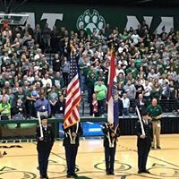
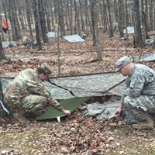
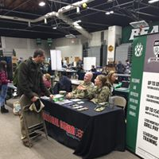

Slide 6
BENEFITS
100% Federal and State Tuition Assistance
Montgomery GI Bill - $368-$790 a month
Monthly Drill Pay which consists of physical training Monday, Wednesday, and Friday- $175-$450
2 week annual training - $1,300-$2,000
Affordable Health Insurance - $50.75 a month
Leadership/Management Training and Experience
Security Clearance

Slide 7
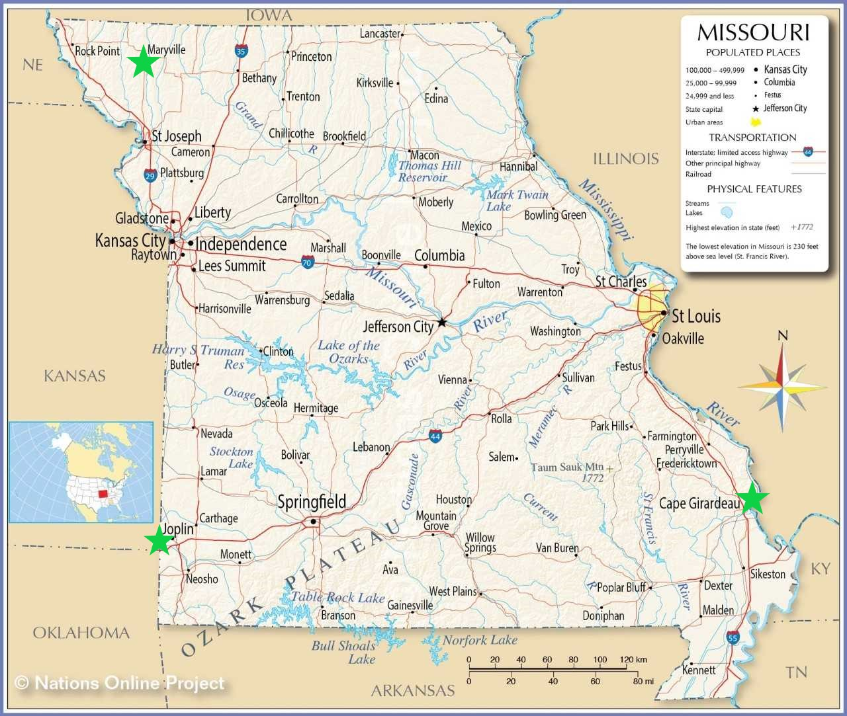
Where We Are

Slide 8
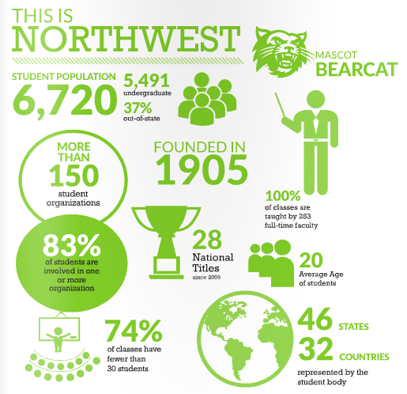

Slide 9
Textbook and laptop programs save students nearly $7,200 over 4 years!

Slide 10
Bearcat Bonuses
FREE Laundry
FREE admission to regular season athletic events
Reduced ticket prices for concerts and other events
Fitness Center & Rec Center included in tuition and fees
FREE tutoring

Slide 11
Questions
CPT Joshua Wilmes
joshuawilmes@nwmissouri.edu
(660) 562-1727
Facebook: Northwest Missouri State University Show-Me GOLD Program
http://www.nwmissouri.edu/showmegold/

