Slide 1

eBooks, eTextbooks and eReaders
Dr. Jon Rickman
Dr. Roger Von Holzen
Paul Klute
http://cite.nwmissouri.edu/presentations

Slide 2
Being considered the best speaker in a computer science department is…
like being known as the tallest of the Seven Dwarfs.
Randy Pausch

Slide 3
The Rise of eBooks
1990s—eBooks commercially available
  Most in PDF format
  Slow growth in sales
2007—release of Amazon.com’s Kindle
  240,000 sold in 2008*

Slide 4
Advantages of eBooks
Searchable text and hyperlinks
Multiple books on a single eBook reader
Non-permanent highlighting and annotation
Adjustable font size
Embedded animated images or multimedia clips
Automatic opening to the last read page
Lower cost per book (after purchase of reader)
Automatic text-to-speech possible
Continuous availability of books--no going out of print date
Self-published eBooks
Less environmental impact
Source: Wikipedia.org

Slide 5
Disadvantages of eBooks
Fragility of eBook readers
Limited battery life of eBook readers
Increased chance of loss of eBook readers
Lack of availability of eBooks
Piracy potential with eBooks
Loss of “book” experience
Lack of sharing and reselling of eBooks
Source: Wikipedia.org

Slide 6
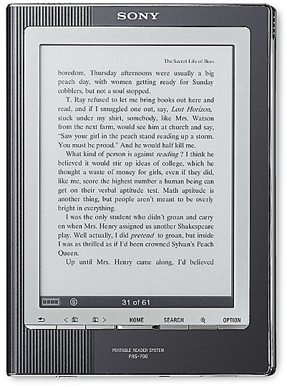
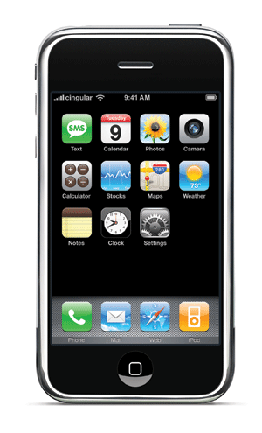


eReaders available
Kindle
iPhones from Apple
Sony Reader
eBook Reader
Plastic Logic
Personal computers

Slide 7
Kindle
Employees E Ink technology
  almost paper-like
  easy to read even in bright sunshine
  allows for high contrast and high resolution, with a near 180° viewing angle
  Black/white only and no animation/video
Has note taking and highlighting capability
November 2008—release of Kindle 2.0
  Projected 2009 sales of more than 500,000
  $359.00 price
Amazon eBook price: up to $9.99 each
Kindle app for iPhone *

Slide 8

Sony Reader
Device has 6-inch display
Utilizes E Ink technology
Text can be changed between three different sizes
One touch buttons to move backward and forward
through book pages
Black/white only and no animation/video
2008 Model* PRS-700
  Search feature
  Built-in LED reading light
  $350 price*

Slide 9
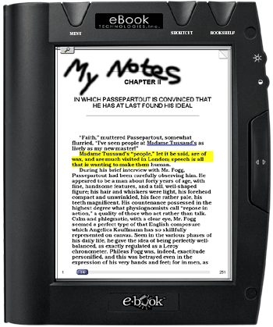
eBook
Liquid-crystal display
  Harder to read in bright light and at
  angle
  Greater power demand—less battery
  life
Color and animation/video capability
Search capability
Has Tablet PC capabilities with stylus
  Highlighting
  Drawning/writing
$150 price*

Slide 10
Plastic Logic Reader
Features an 8.5 x 11-inch area of display
  Thinner than a pad of paper
  Lighter than many business periodicals
Supports a full range of business document formats
  Microsoft Word, Excel and PowerPoint, and Adobe PDFs
  Newspapers, periodicals and books
Uses a gesture-based user interface
Can connect to information either wired or wirelessly
Stores thousands of documents on the device
Incorporates E Ink technology
Features low power consumption and long battery life
Black/white only and no animation/video
CNN Video
Plastic Logic Video

Slide 11
eBooks vs. eTextbooks
eBooks
  Functional without color for most content
  No need for animation or video
  No need for Internet access for hyperlinks
  Primarily associated with pleasure reading
eTextbooks
  Color required for many subject areas
  Pedagogical enhancements critical
    Need for animation and video
    Need for inclusion of hyperlinks*

Slide 12

Notebooks as eTextbook Readers
Integrates textbooks with other software and services including email and web access
Most schools already employ staff and/or students to assist users
Delivery of eTextbooks to the students is extremely efficient*

Slide 13
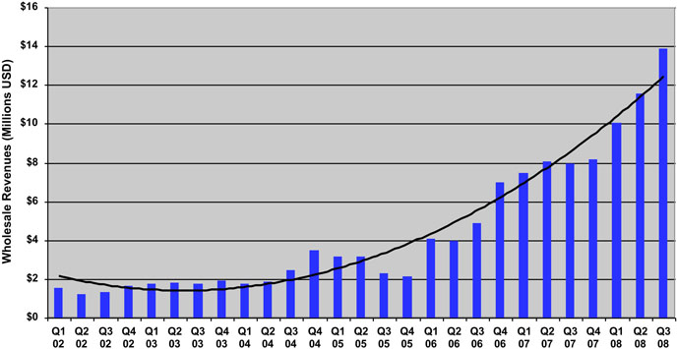
Wholesale eTextbook Sales
Source: www.openbook.com

Slide 14
Sample Cost Comparisons
Pilot Course Title | Cost of Traditional Textbook | Approx. Cost of eTextbook
Fundamentals of Business Finance* | $168.00 | $72.25 (VitalSource)
Human Resources Management* | $130.00 | $68.75 (VitalSource)
Intercultural Communication* | $95.00 | $51.48 (Coursemart – 180 day subscription)
Management Information Systems* | $140.00 | $71.49 (Coursemart – 180 day subscription)
Introduction to Psychology | $121.00 | $62.95 (Coursemart – 180 day subscription)

Slide 15
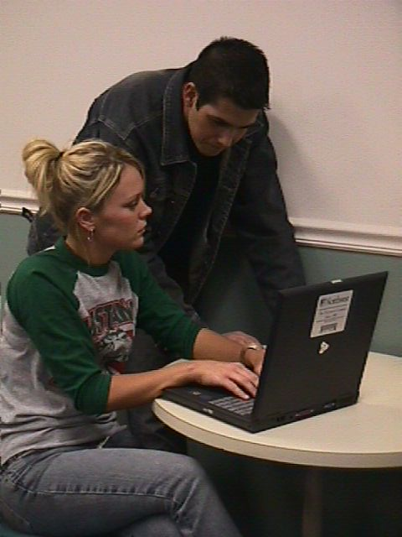
Northwest Pilot Study
A Northwest goal is to ensure that graduates have strong computer competencies
Northwest has provided textbooks to students for over 100 years
Northwest provides a notebook computer to every full-time student
Northwest’s eTextbook initiative is the natural next step forward for its Electronic Campus*

Slide 16

Notebooks and Textbooks
2008
Marketing
Survey
Northwest students and graduates value the cost savings of the rental programs

Slide 17
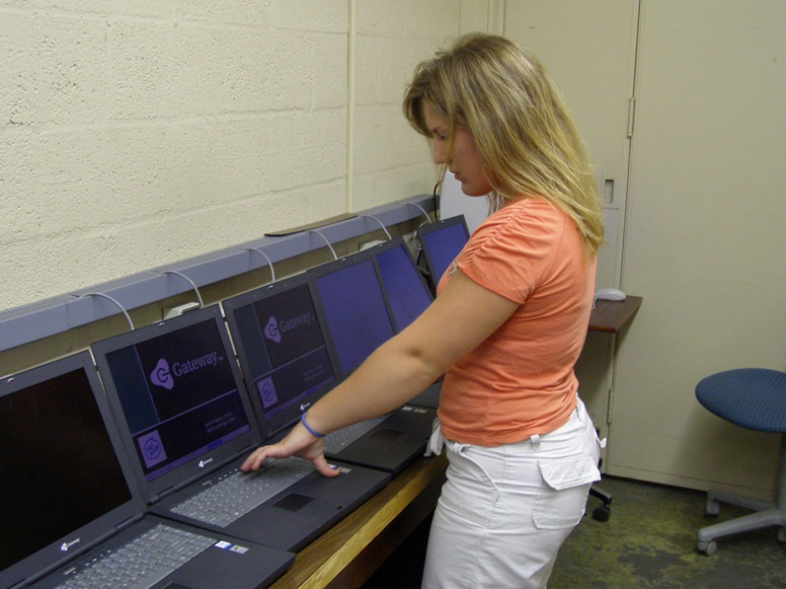
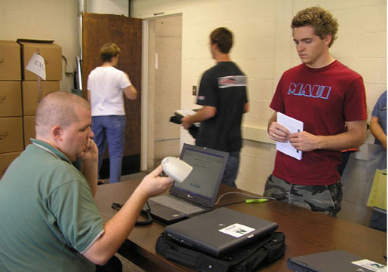
Costs for Notebooks and Textbooks
Most notebook universities require students to purchase a notebook computer
A smaller number of schools lease computers and charge students about $700 to $1000 per year
Northwest charges students about $300 per year for a notebook computer
Most college students have to purchase textbooks at a cost of about $1,000 per year
Northwest charges about $180 per year ($6/sch) for students to rent their textbooks*

Slide 18
Phase I--eReaders
http://www.nwmissouri.edu/services/eTextbooks

Slide 19


Testing the Sony Reader
Negotiated reduced price
  $250 per reader ($299 retail)
eTextbooks were first downloaded from the publisher web site to the student’s notebook
eTextbooks were transfered to the Sony Reader via a USB connection
Reader is recharged through the USB connection to the notebook
Possible to install Sony library software to purchase and manage eTextbooks and eBooks from The eBook Store from Sony*

Slide 20
eTextbook Across the Curriculum
The Electronic Campus 2008
Student / Class Enroll
Faculty / Class Assign
Room / Class Assign
Textbook / Class Assign
Student / Notebook Assign
Student Notebook / eTextbooks Load
Administrative
Systems
Student
Notebook
eTextbooks
Campus
Network
My
Text
Book
Textbook
Publishers
eBook Reader
Jon Rickman August 19, 2008

Slide 21
Phase I Findings
There are multiple components to a textbook, including graphs and images, with all having separate copyrights
The formatting of content for eReaders can require weeks to complete
For campus-wide deployment there are currently not enough eReader-compatible eTextbooks
Most eTextbooks are available only through notebook computers and/or web access
PDF formatted textbooks have restrictive and slow navigation options*

Slide 22
Phase I Findings
Students have a high affinity for handheld electronic devices
Students like the idea of not having to carry 20 or 30 pounds of textbooks in their backpacks
Keyword searching and annotating are very important features for students and faculty
The enthusiasm quickly waned for eReaders without the needed search and annotation features
Students found the eReaders were attention getters but were not attention keepers*

Slide 23
Phase II—Notebooks and eTextbooks

Slide 24
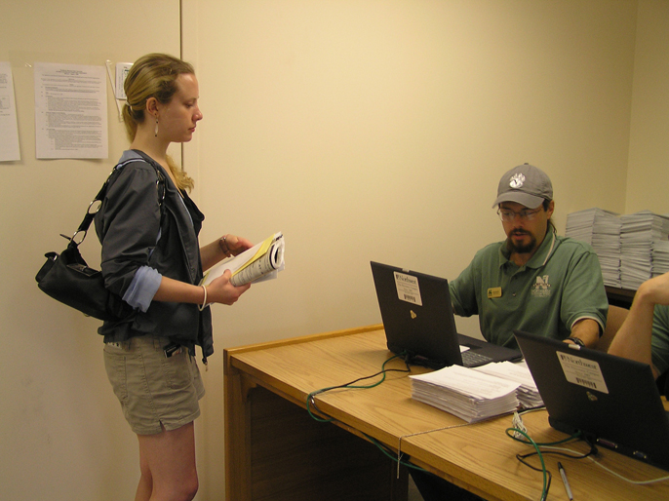
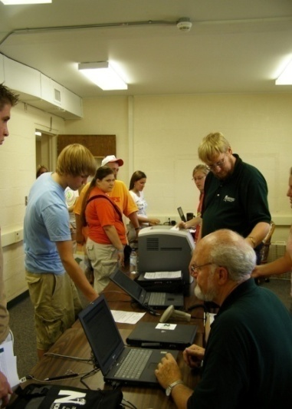

Northwest Notebook Check-out and eTextbook Loading
Students pick up their notebook prior to the first week of classes
Their ID card is scanned along with the bar code on the notebook for inventory
Students are given eTextbook access codes*

Slide 25
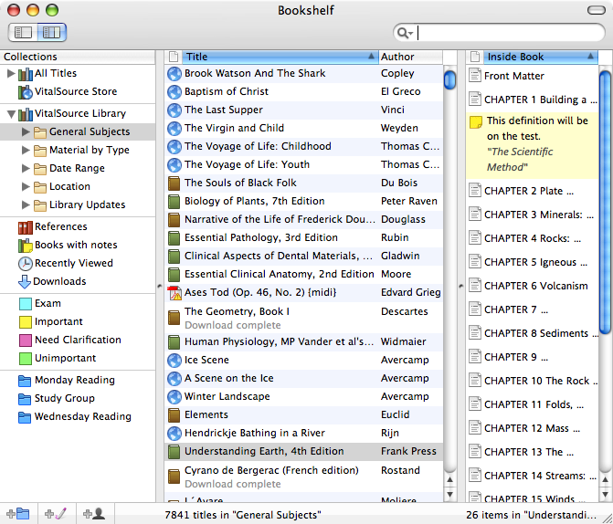
VitalSource Bookshelf
Promotes one standard on campus and not multiple standards
eTextbook web connection on campus software loadset
Bookshelf files are download to the student’s computer
Students may:
  customize their page views
  search single books or any group of books
  highlight and take searchable notes
  print and copy-and-paste with bibliographic support*
Video

Slide 26
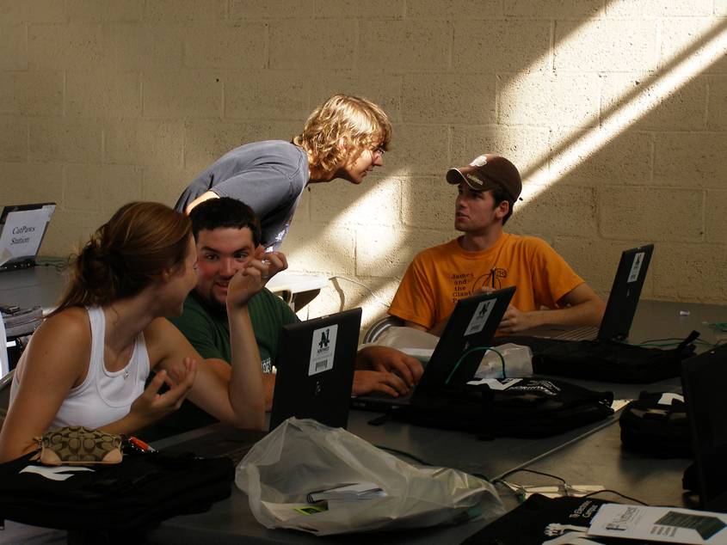
Northwest Support Procedures
The Electronic Campus Support Center is open for any hardware/software repair
Assist students to download and activate VitalSource Bookshelf
Assist students to download eTextbooks*

Slide 27
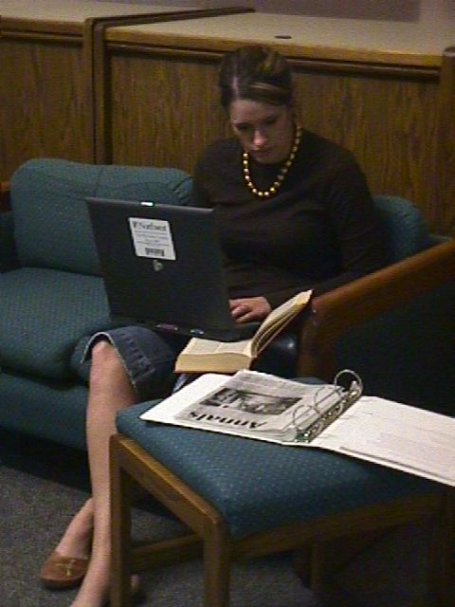
Phase II Pilot
Goal: evaluate eTextbooks designed for use on student notebooks
Phase II will be completed during the spring semester of 2009
Concentrated on the deployment of eTextbooks provided by five publishers
Eleven of a possible 19 academic departments volunteered to participate
  Twenty classes, across the 11 departments, were selected to use eTextbooks
  Approximately 500 students were involved in Phase II*

Slide 28
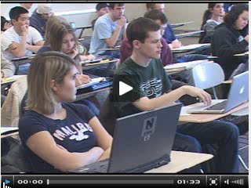
Northwest eTextbook Initiative

Slide 29
Phase II Findings
The delivery of eTextbooks to students via their notebook computers was a simple and very efficient process
Students were able to complete the downloading of eTextbooks with little assistance from university support staff
Several publishers were able to provide enhanced eTextbooks with quizzes and shared notes
The need for standardized reading features appeared useful as some students used multiple eTextbooks
Students could continue to see the potential for carrying backpacks that weighted less
Some eTextbook features, if used in the classroom, need additional Wi-Fi connectivity*

Slide 30


Advantages of eTextbooks
Facilitates integrated learning resources for the student
Conveys lower costs into lower charges to students
Textbook publishers have shown a substantial commitment to research in order to develop a new vision for eTextbooks*

Slide 31


Options to Ensure Students have Notebooks and Software
The university may mandate students have notebooks through an off campus or a bookstore acquisition
The university may lease notebooks and rent them to students through fees
The university may purchase notebooks and rent them to students through fees*

Slide 32

Conclusions
Northwest provides a notebook to every full-time student
Northwest provides textbooks
eTextbooks will replace traditional textbooks as they are available and found acceptable by students
Faculty will continue to select eTextbooks and textbooks based on their content*

Slide 33

Jon Rickman: Information Systems rickman@nwmissouri.edu
Roger Von Holzen: Director—CITE rvh@nwmissouri.edu
http://cite.nwmissouri.edu/presentations

Slide 34

Plastic Logic Reader

Slide 35
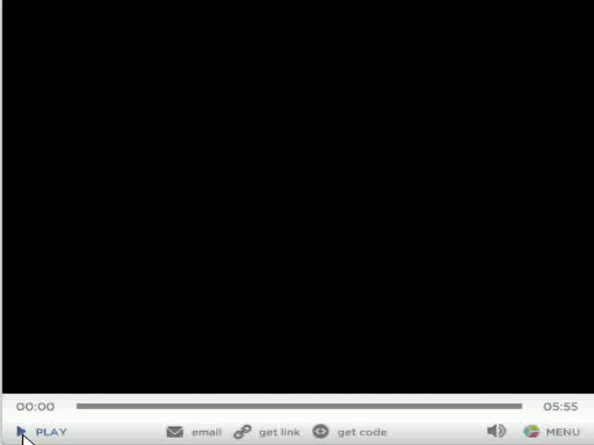
Plastic Logic Reader

