Slide 1
Intern Manager

Slide 2
About the Project
Career Services requested for Web Application for Students to allow them to maintain Internship Applications.​
This application has 3 roles:
Student
Faculty
Administrator
The main aim of this project is to develop user-friendly platform which stores student's internship application, helps them with the enrollment process. After student applies, the faculty is notified for approval. The student can also track the status of an application. The administrator of the application is provided with Quick Identification of the intern information on their Dashboard based on their Majors and Location.

Slide 3
Development Tools
Backend : NodeJS
Frontend : VueJS
Database : MySQL
Framework : Adonis Framework

Slide 4
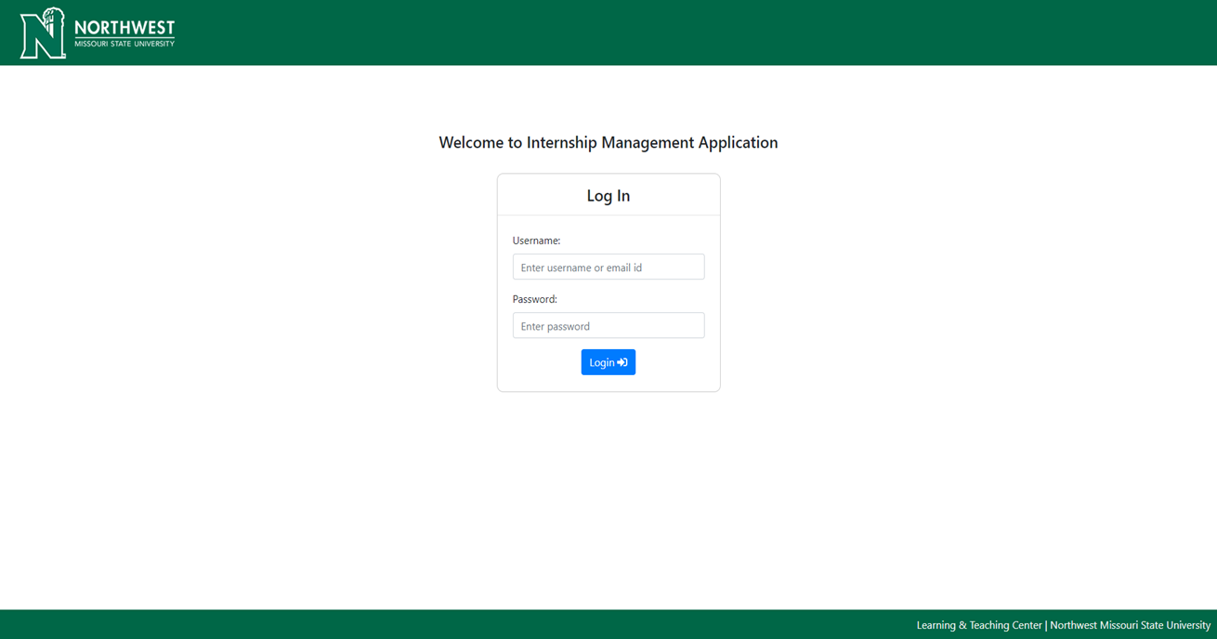
Login
Preview

Slide 5
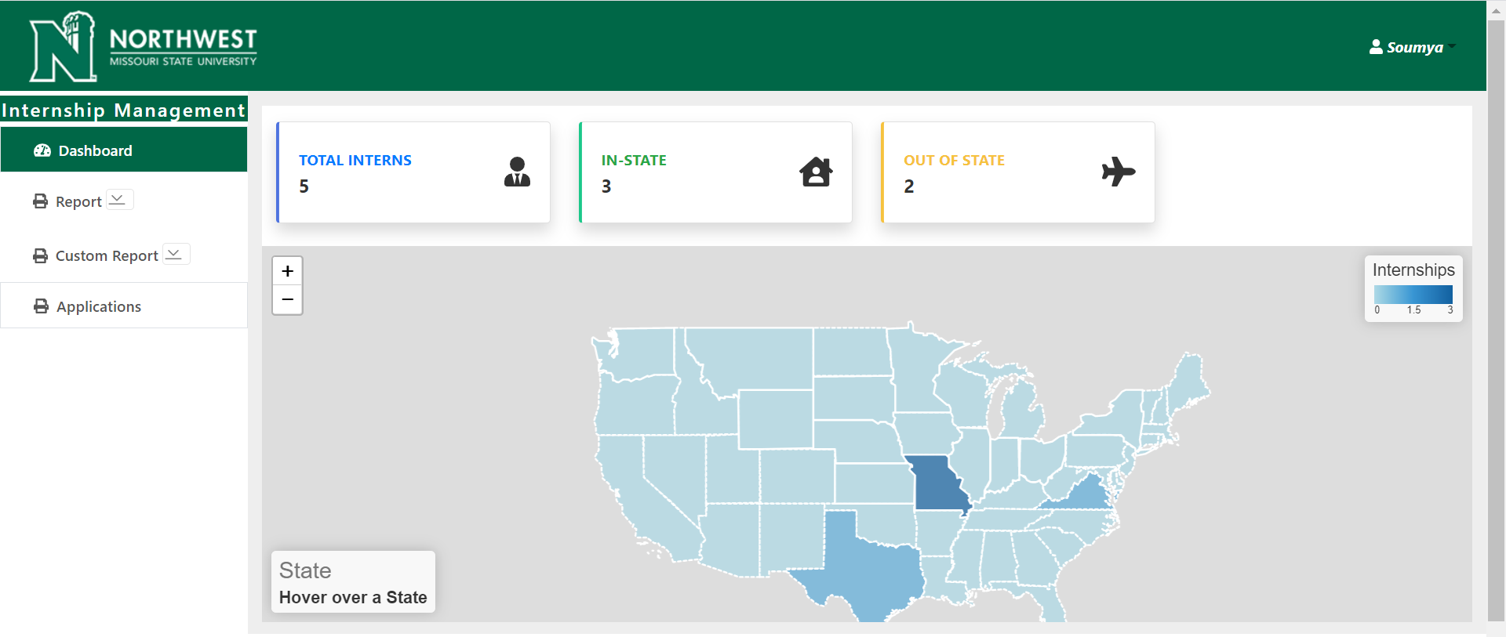
Admin View

Slide 6
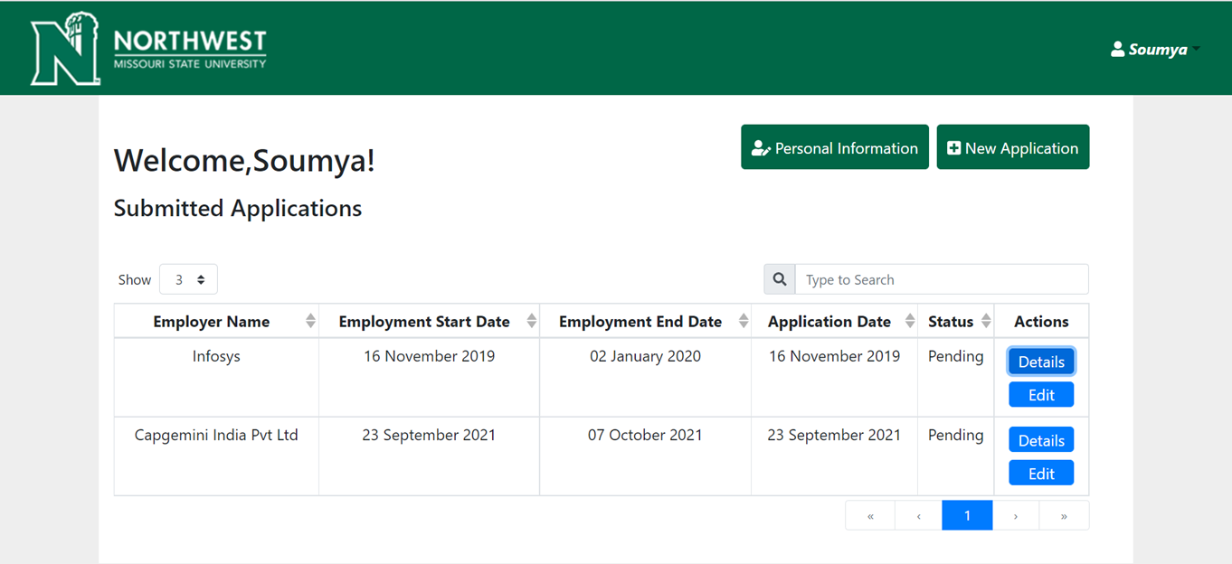
Student View - Dashboard
Preview

Slide 7
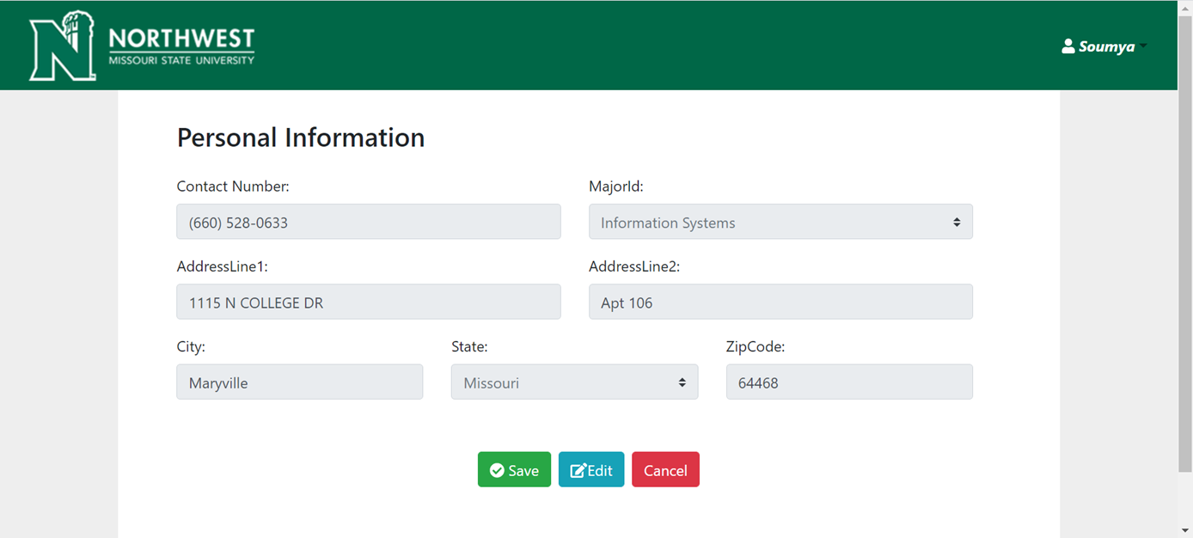
Student View- Personal Information Tab
Preview

Slide 8
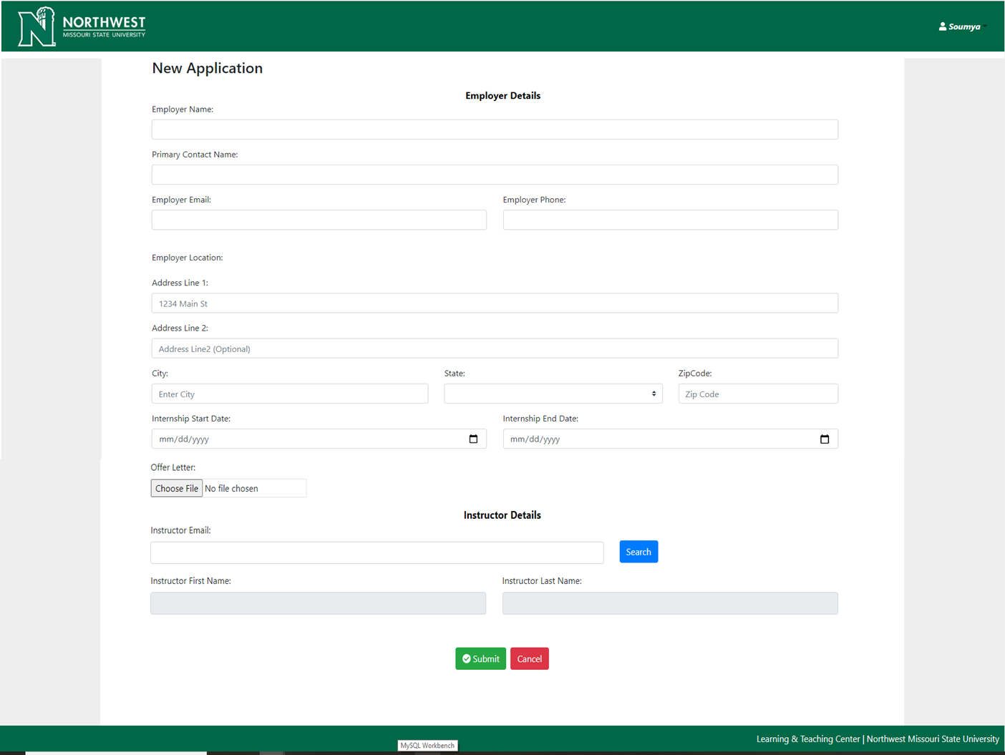
Student View- New Application Tab

Slide 9
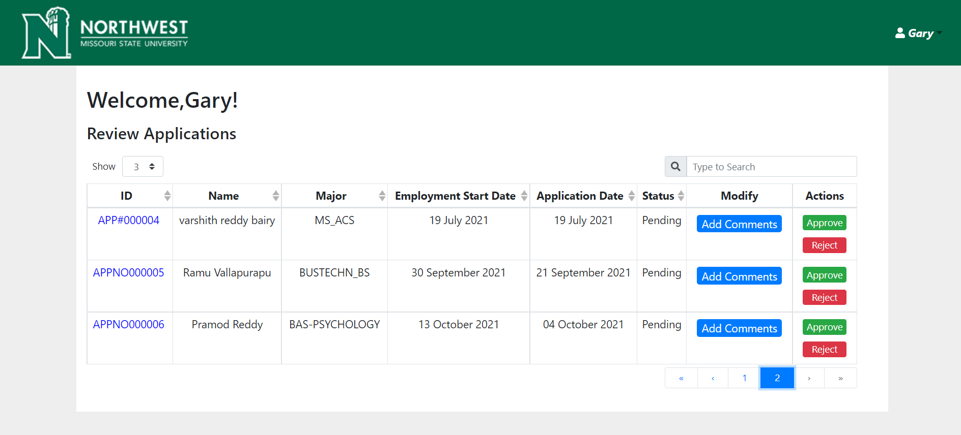
Faculty View

