Slide 1
CITATION GENERATOR

Slide 2
B.D Owen’s Library needs a Citation Manager for its Students/Faculty/Staff and other users which can allow them to create APA, MLA and other Citations
The main objective of this project is to build an application which allows registered users to create, copy, export, edit, interchange formats and organize citations in different formats and allows non-registered users to create, copy, export, edit and interchange formats of citations ​Only an authenticated user can organize the generated citations into folders​. The generated citation can be made visible to the public to the non-authenticated user. However, an authenticated user can create and add citations to folders.
Some of the features include:
Generate and Clone Citations
Save to Folders
Clone & Export Citations
Delete Citations
Sort & Filter Generated Citations
In Text Citations

Slide 3
Some of the currently supported types in APA style are :
Articles
Books/ Ebooks
Web Pages
Govt/Legal
Media
Unpublished
Stats/Figures

Slide 4
Development Tools
Backend : .NET
Frontend : VueJS
Database : MySQL
Framework : Entity Framework

Slide 5
Login
Preview

Slide 6
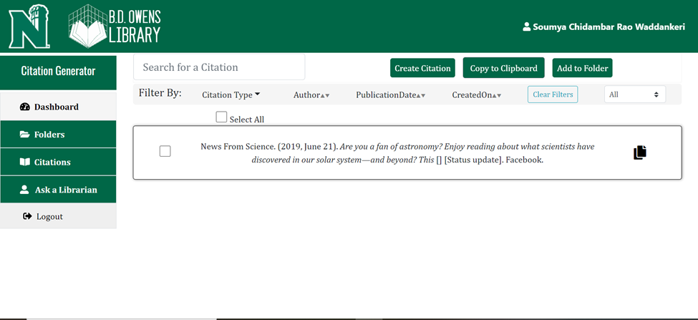
Dashboard
Preview

Slide 7
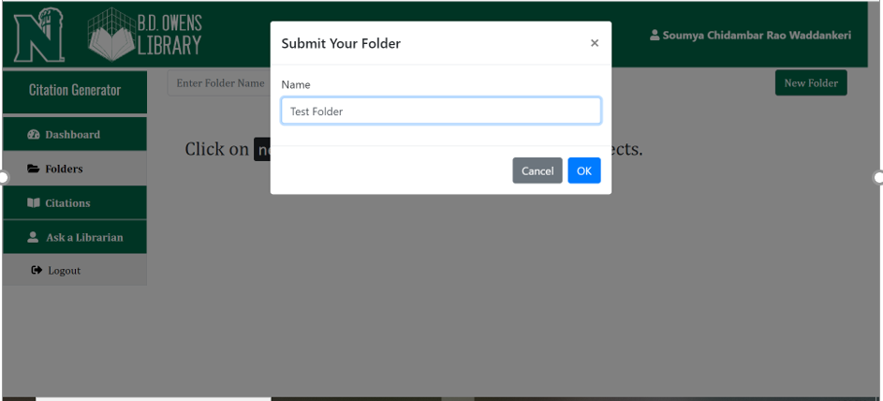
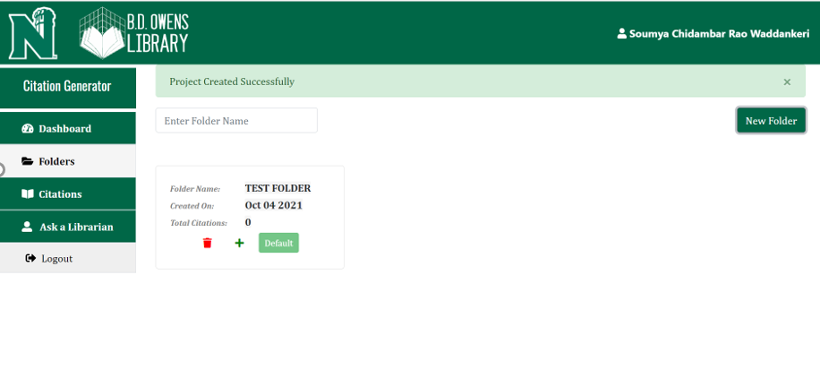
Create Folder
Preview

Slide 8
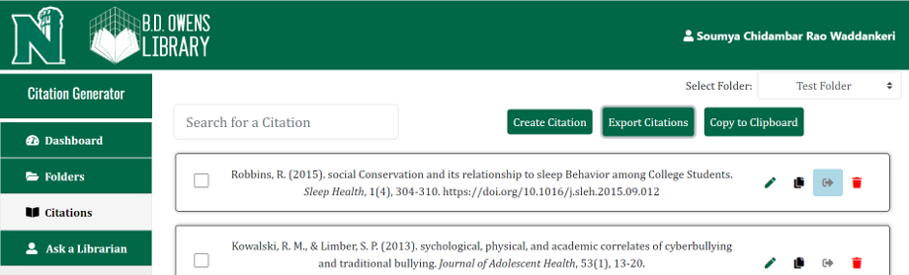
Create Citation
Preview

