Slide 1
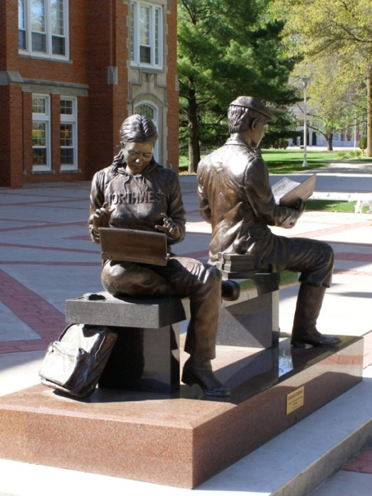
A University eBook and eReader Pilot Study
Dr. Roger Von Holzen
Dr. Jon Rickman
http://cite.nwmissouri.edu/presentations

Slide 2
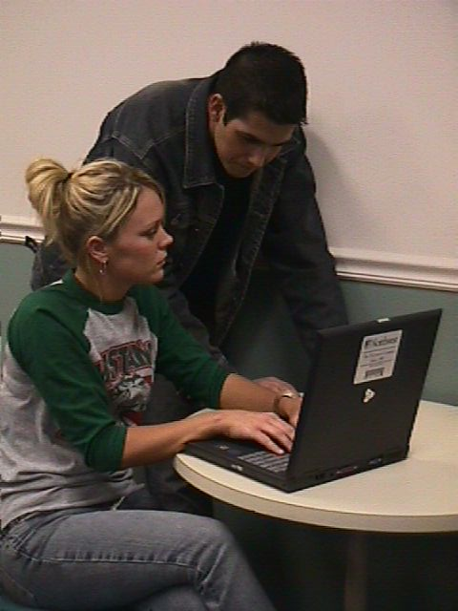
Introduction
A Northwest goal is to ensure that graduates have strong computer competencies
Northwest has provided textbooks to students for over 100 years
Northwest provides a laptop computer to every full-time student
Northwest’s eTextbook initiative is the natural next step forward for its Electronic Campus*

Slide 3

Laptops and Textbooks
2008
Marketing
Survey
Northwest students and graduates value the cost savings of the rental programs

Slide 4
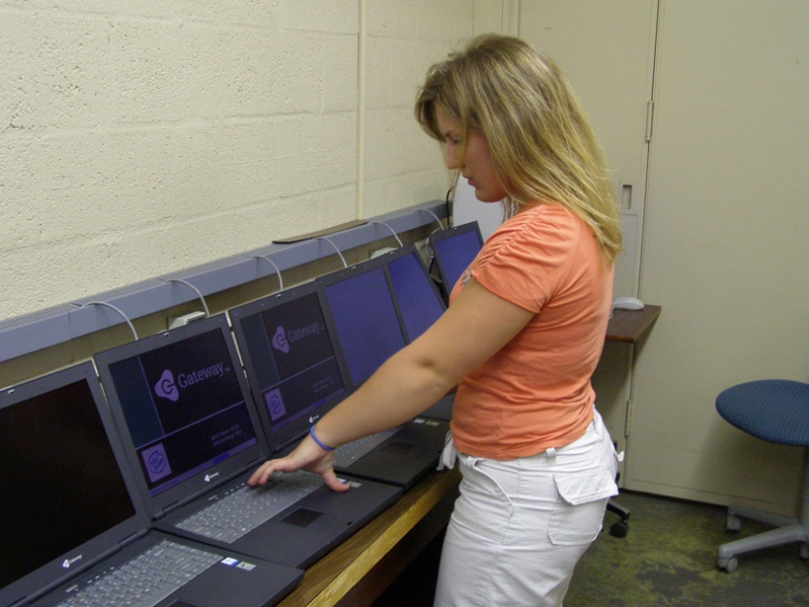
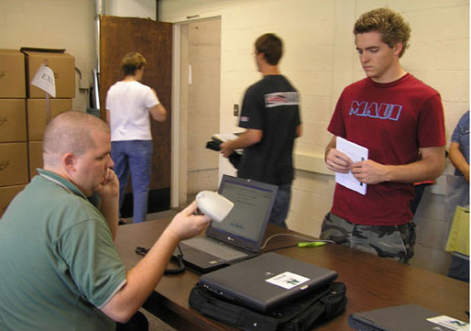
Costs for Laptops and Textbooks
Most Notebook Universities require students to purchase a notebook computer
A smaller number of schools lease computers and charge students about $700 to $1000 per year
Northwest charges students about $300 per year for a notebook computer
Most college students have to purchase textbooks at a cost of about $1,000 per year
Northwest charges about $180 per year ($6/sch) for students to rent their textbooks*

Slide 5
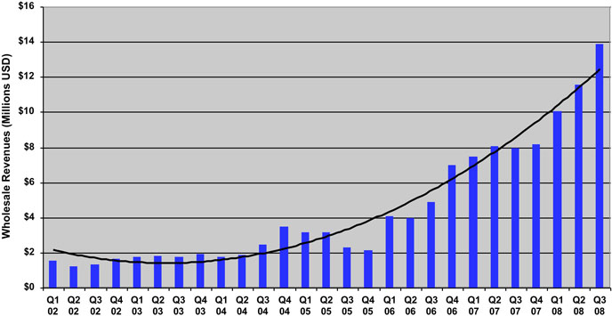
Wholesale eTextbook Sales
Source: www.openbook.com

Slide 6
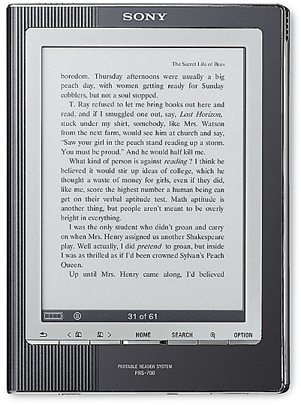
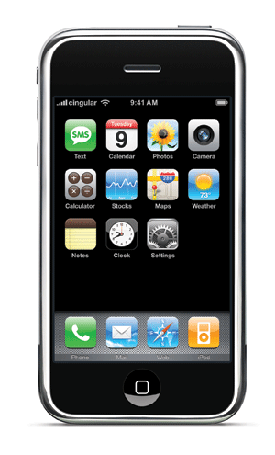

eReaders available
Kindle from Amazon.com
Sony Reader
Plastic Logic
iPhones from Apple
Personal computers

Slide 7
Plastic Logic Reader
Features an 8.5 x 11-inch area of display
Thinner than a pad of paper
Lighter than many business periodicals
Supports a full range of business document formats
Microsoft Word, Excel and PowerPoint, and Adobe PDFs
Newspapers, periodicals and books
Uses a gesture-based user interface
Can connect to information either wired or wirelessly
Stores thousands of documents on the device
Incorporates E Ink technology for great readability
Features low power consumption and long battery life
Black/white only and no animation/video
CNN Video
Plastic Logic Video

Slide 8

Phase I: Using a Sony Reader
Device has 6-inch display
Utilizes E Ink technology
almost paper-like
easy to read even in bright sunshine
allows for high contrast and high resolution, with a near 180° viewing angle.
Text can be changed between three different sizes
One touch buttons to move backward and forward through book pages
Able to conduct keyword searches

Slide 9
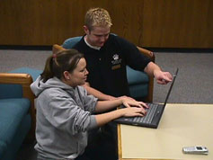
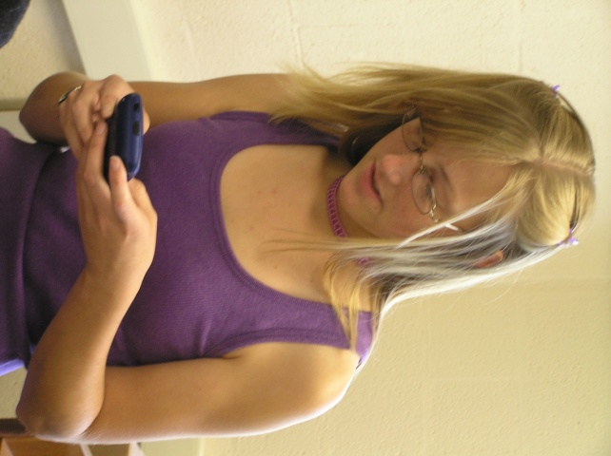
Loading a Sony Reader
eTextbooks are first downloaded from the publisher web site to the student’s laptop
Transfer eTextbooks to the Sony Reader via a USB connection
Reader is recharged through the USB connection to the laptop
Possible to install Sony library software to purchase and manage eTextbooks and eBooks from The eBook Store from Sony*

Slide 10
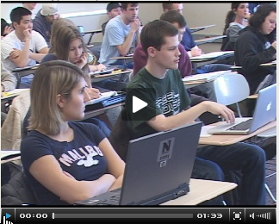
Northwest eTextbook Initiative

Slide 11
Reading Across the Curriculum The Electronic Campus 2008
Student / Class Enroll
Faculty / Class Assign
Room / Class Assign
Textbook / Class Assign
Student / Notebook Assign
Student Notebook / eTextbooks Load
Administrative
Systems
Student
Notebook
eTextbooks
Campus
Network
My
Text
Book
Textbook
Publishers
eBook Reader
Jon Rickman August 19, 2008

Slide 12
Phase I Findings
There are multiple components to a textbook, including graphs and images, with all having separate copyrights
The formatting for eReaders can require weeks to complete
For campus-wide deployment there are currently not enough eReader-compatible eTextbooks
Most eTextbooks are available only through laptop computers and/or web access
PDF formatted textbooks have restrictive and slow navigation options*

Slide 13
Phase I Findings
Students have a high affinity for handheld electronic devices
Students like the idea of not having to carry 20 or 30 pounds of textbooks in their backpacks
Keyword searching and annotating are very important features for students and faculty
The enthusiasm quickly waned for eReaders without the needed search and annotation features
Students found the eReaders were attention getters but were not attention keepers*

Slide 14
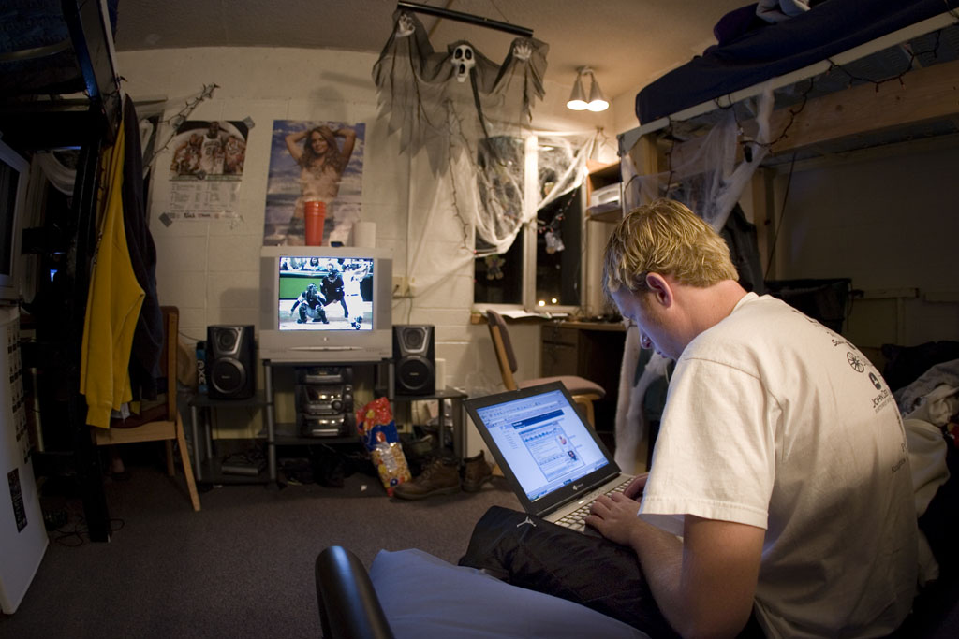
Laptops as eTextbook Readers
Integrates textbooks with other software and services including email and web access
Most schools already employ staff and/or students to assist users
Delivery of eTextbooks to the students is extremely efficient*

Slide 15
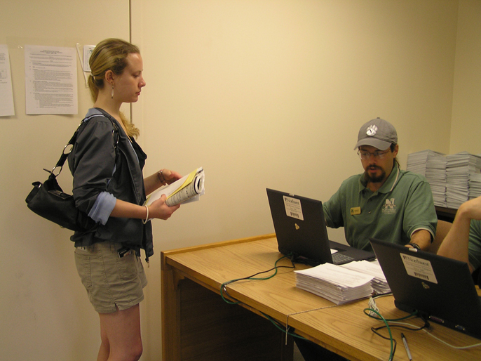
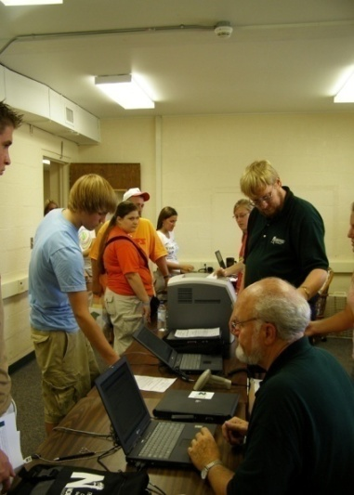
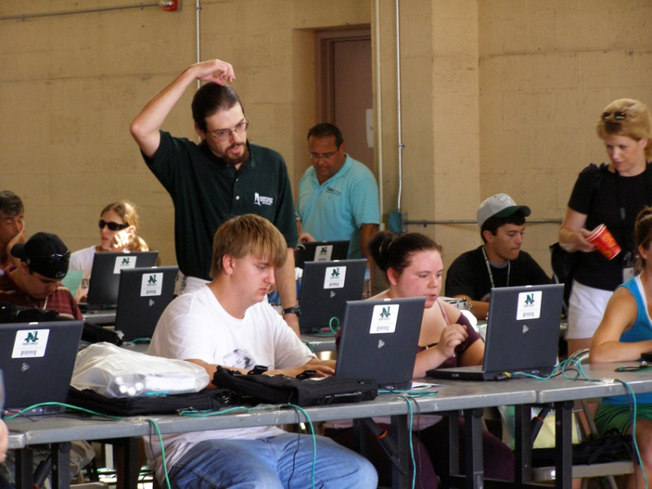
Northwest Notebook Check-out and eTextbook Loading
Students pick up their notebook prior to the first week of classes
Their ID card is scanned along with the bar code on the notebook for inventory
Students are given eTextbook access codes*

Slide 16
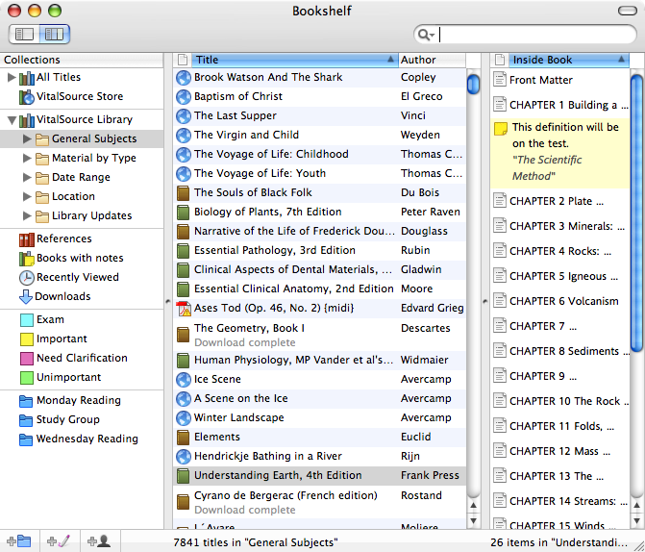
VitalSource Bookshelf
Promotes one standard on campus and not multiple standards
eTextbook web connection on campus software loadset
Bookshelf files are download to the student’s computer
Students may:
customize their page views
search single books or any group of books
highlight and take searchable notes
print and copy-and-paste with bibliographic support*
Video

Slide 17
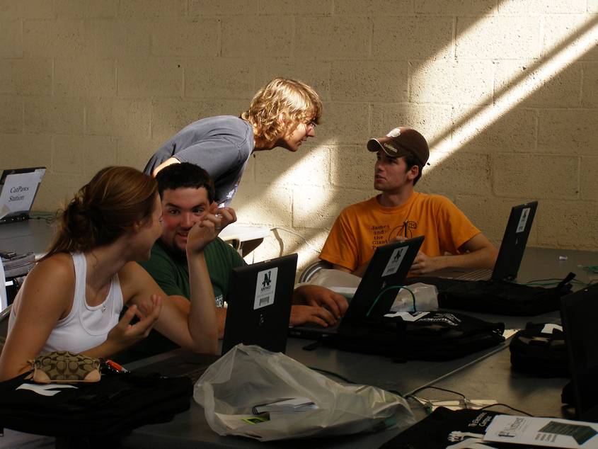
Northwest Support Procedures
The Electronic Campus Support Center is open for any hardware/software repair
Assist students to download and activate VitalSource Bookshelf
Assist students to download eTextbooks*

Slide 18
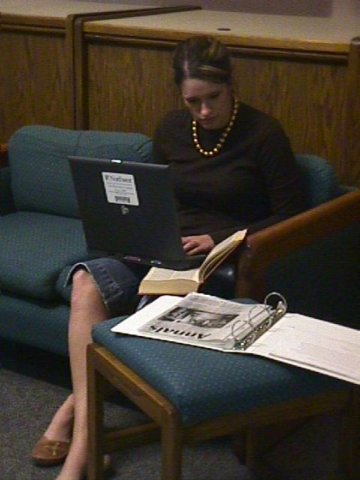
Phase II
Goal: evaluate eTextbooks designed for use on student laptops
Phase II will be completed during the spring semester of 2009
Concentrated on the deployment of eTextbooks provided by five publishers
Eleven of a possible 19 academic departments volunteered to participate
Twenty classes, across the 11 departments, were selected to use eTextbooks
Approximately 500 students were involved in Phase II*

Slide 19
Sample Cost Comparisons
Pilot Course Title | Cost of Traditional Textbook | Approx. Cost of eTextbook
Fundamentals of Business Finance* | $168.00 | $72.25 (VitalSource)
Human Resources Management* | $130.00 | $68.75 (VitalSource)
Intercultural Communication* | $95.00 | $51.48 (Coursemart – 180 day subscription)
Management Information Systems* | $140.00 | $71.49 (Coursemart – 180 day subscription)
Introduction to Psychology | $121.00 | $62.95 (Coursemart – 180 day subscription)

Slide 20
Phase II Findings
The delivery of eTextbooks to students via their laptop computers was a simple and very efficient process
Students were able to complete the downloading of eTextbooks with little assistance from university support staff
Several publishers were able to provide enhanced eTextbooks with quizzes and shared notes
The need for standardized reading features appeared useful as some students used multiple eTextbooks
Students could continue to see the potential for carrying backpacks that weighted less
Some eTextbook features, if used in the classroom, need additional Wi-Fi connectivity*

Slide 21


Advantages of eTextbooks
Facilitates integrated learning resources for the student
Conveys lower costs into lower charges to students
Textbook publishers have shown a substantial commitment to research in order to develop a new vision for eTextbooks*

Slide 22


Options to Ensure Students have Notebooks and Software
The university may mandate students have notebooks through an off campus or a bookstore acquisition
The university may lease notebooks and rent them to students through fees
The university may purchase notebooks and rent them to students through fees*

Slide 23

Conclusions
Northwest provides a laptop to every full-time student
Northwest provides textbooks
eTextbooks will replace traditional textbooks as they are available and found acceptable by students
Faculty will continue to select eTextbooks and textbooks based on their content*

Slide 24

Jon Rickman: Information Systems richman@nwmissouri.edu
Roger Von Holzen: Director—CITE
rvh@nwmissouri.edu
http://cite.nwmissouri.edu/presentations

Slide 25

Plastic Logic Reader

Slide 26
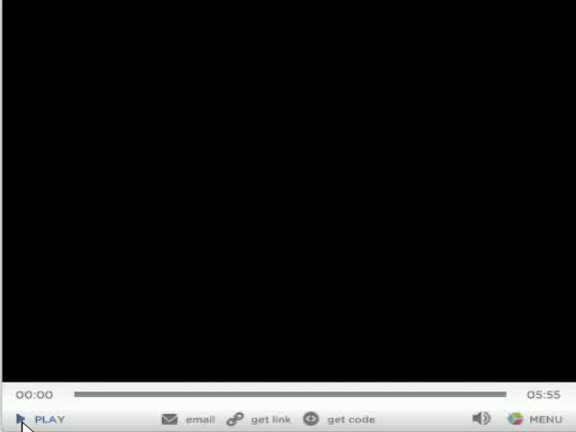
Plastic Logic Reader

