Slide 1

Effective and Practical Use of eTextbooks
Dr. Roger Von Holzen
Northwest Missouri State University
http://cite.nwmissouri.edu/presentations/

Slide 2
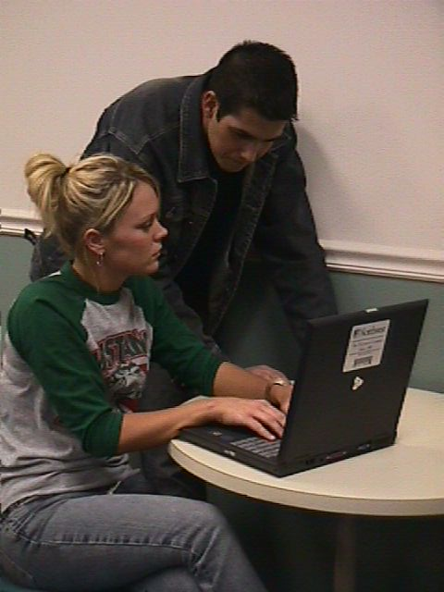
Presenter’s Environment
Northwest’s enrolls almost 7,000 students
A Northwest goal is to ensure that graduates have strong computer competencies
Northwest has provided textbooks to students for over 100 years
Northwest’s Electronic Campus provides a notebook computer to every student
Northwest’s eTextbook option was the natural next step forward for its Electronic Campus*

Slide 3

Notebook Computers and Textbooks
2008 campus
marketing
survey confirmed:
Students and graduates value the cost savings of the notebook and textbook rental programs

Slide 4
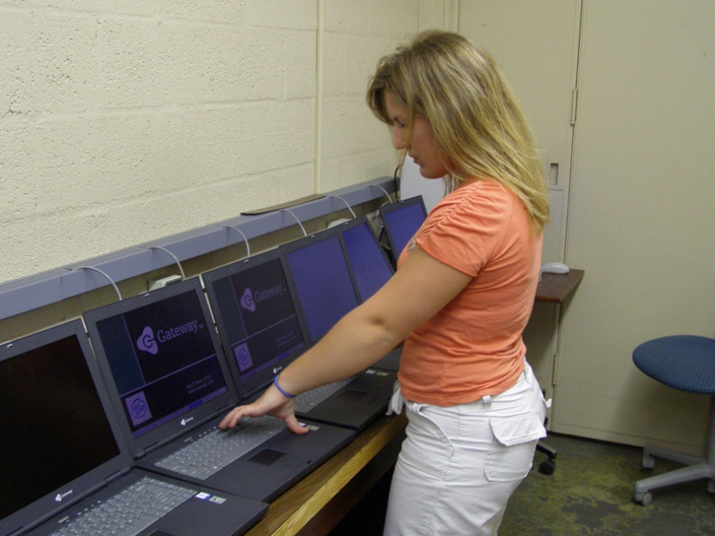
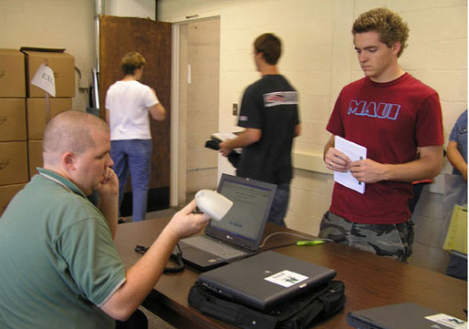
Costs for Notebook Computers and Textbooks
Northwest charges students about $360 per year for a wireless notebook computer
It’s all about the cost per read
  Rentals can get up to 15 or more reads per textbook
  Reselling used textbooks can get up to 5 or more reads per book
Northwest charges about $180 per year ($6/sch) for students to rent their textbooks*

Slide 5

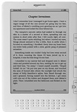
eBooks and eReaders
Constantly in the news
Kindle from Amazon.com
  Kindle: $299 plus shipping
  Kindle DX: $489 plus shipping
  Conducting pilot study with 6 universities
    Princeton, Case Western Reserve, Pace,
    Arizona State, University of Virginia, and
    Reed College*

Slide 6
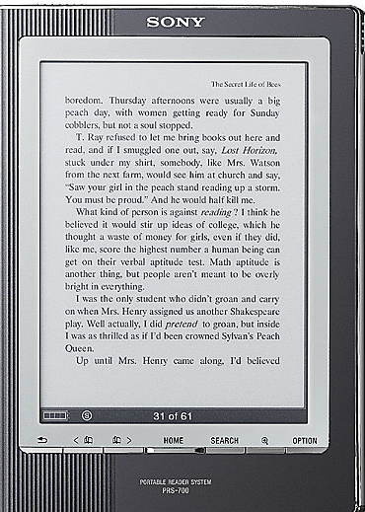
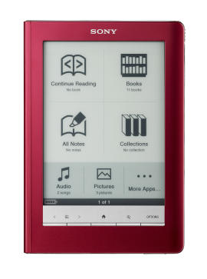
eBooks and eReaders
Sony’s original Reader
  About $250 with quantity purchase
  Also available through retail markets
  such as Target and Best Buy
New models
  PRS-300 to retail for $199
  PRS-600 to retail for $299
Will begin selling digital books only
in the ePub format*

Slide 7
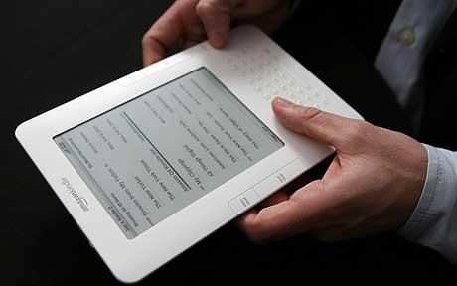
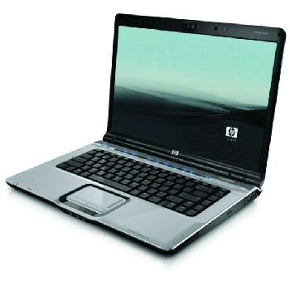
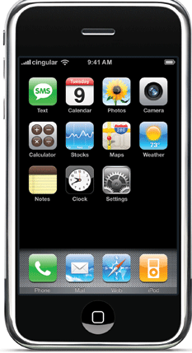
eBooks and eReaders
Plastic Logic
Personal computers
iPhones from Apple
  New reader app from CourseSmart
  that draws on 7,000 college texts from
  a dozen major publishers
  AlgebraPrep app from Pearson Higher
  Education
    Tutorials and mini-tests
    $2.99 download from iTunes store*

Slide 8

Using a Sony Reader
Device has 6-inch display
Utilizes E Ink technology
  almost paper-like
  easy to read even in bright sunshine
  allows for high contrast and high resolution, with a near 180° viewing angle.
Text can be changed between three different sizes
One touch buttons to move
backward and forward
through book pages*

Slide 9
Phase I—eReaders

Slide 10
Northwest’s eTextbook Project
Initiated by President Hubbard after acquiring a Kindle for personal use
Proposed to faculty in August 2009
  Over 20 faculty members volunteered to participate in project
Pilot project encompassed three phases
  Phase I—use of eReaders
  Phase II—use of notebook computers
  Phase III—full integration of eTextbooks and electronic learning resources*

Slide 11


Loading a Sony Reader
eTextbooks are first downloaded from the publisher web site to the student’s notebook computers
Transfer eTextbooks to the Sony Reader via the USB connection
Reader is recharged through the USB connection to the notebook computer
Possible to install Sony library software to purchase and manage eTextbooks and eBooks from The eBook Store from Sony*

Slide 12
Phase I Findings
There are multiple components to a textbook, including graphs and images, with all having separate copyrights
The formatting of content for eReaders can require weeks to complete
For campus-wide deployment there are currently not enough eReader-compatible eTextbooks
Most eTextbooks are available only through notebook computers and/or web access
PDF formatted textbooks have restrictive and slow navigation options*

Slide 13
Phase I Findings
Students have a high affinity for handheld electronic devices
Students like the idea of not having to carry 20 or 30 pounds of textbooks in their backpacks
Keyword searching and annotating are very important features for students and faculty
The enthusiasm quickly waned for eReaders without the needed search and annotation features
Students found the eReaders were attention getters but were not attention keepers*

Slide 14
Phase I Findings
eReaders work best for pleasure reading
Incorporates E Ink technology for great readability
Features low power consumption and long battery life
Black/white only
Students want ePub-formatted books
No Flash animation or video
No interactivity possible with online resources and course sites*

Slide 15
Phase II—Notebook Computers

Slide 16
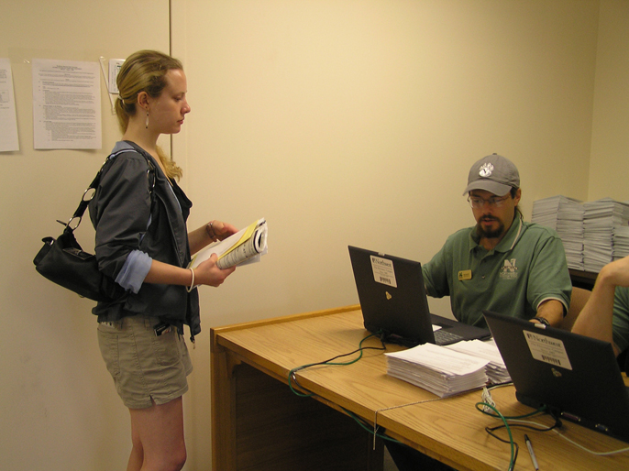
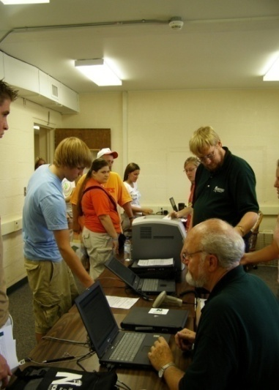
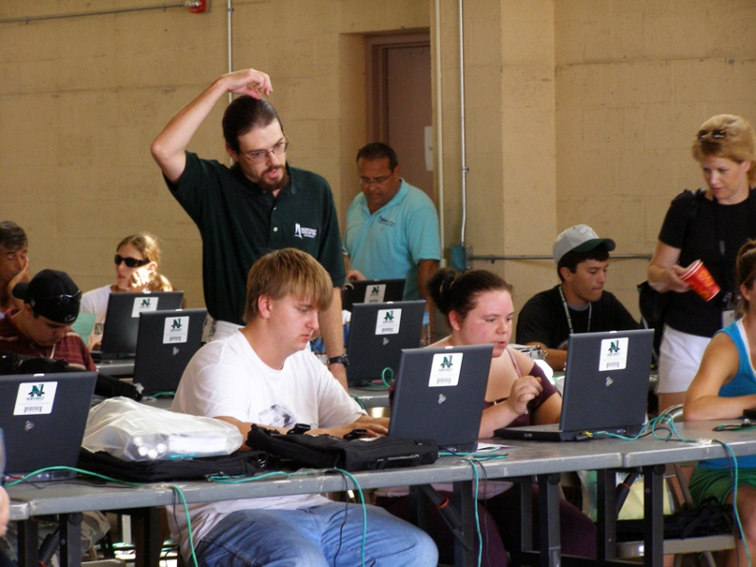
Northwest Notebook Check-out and eTextbook Loading
Students pick up their notebook computers prior to the first week of classes
Students are given eTextbook access codes
The Electronic Campus Support Center available for hardware/software repair
Assist students to download and activate VitalSource Bookshelf
Assist students to download eTextbooks*

Slide 17
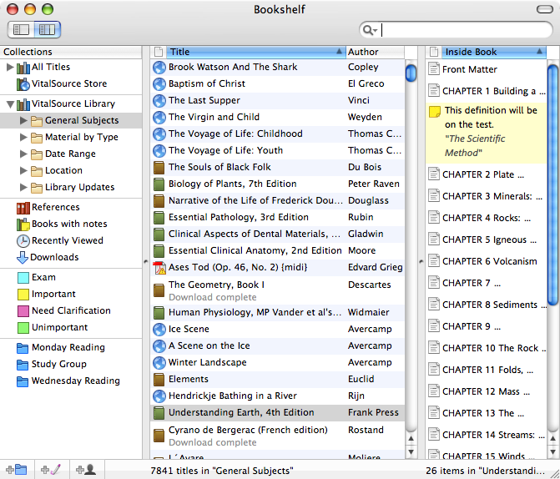
VitalSource Bookshelf
Promotes one standard on campus and not multiple standards
eTextbook web connection on campus software loadset
Bookshelf files are download to the student’s computer
Can be integrated with single sign-on with course management system
Students may:
  customize their page views
  search single books or any group of books
  Highlight, take and share searchable notes
  print and copy-and-paste with bibliographic support*

Slide 18
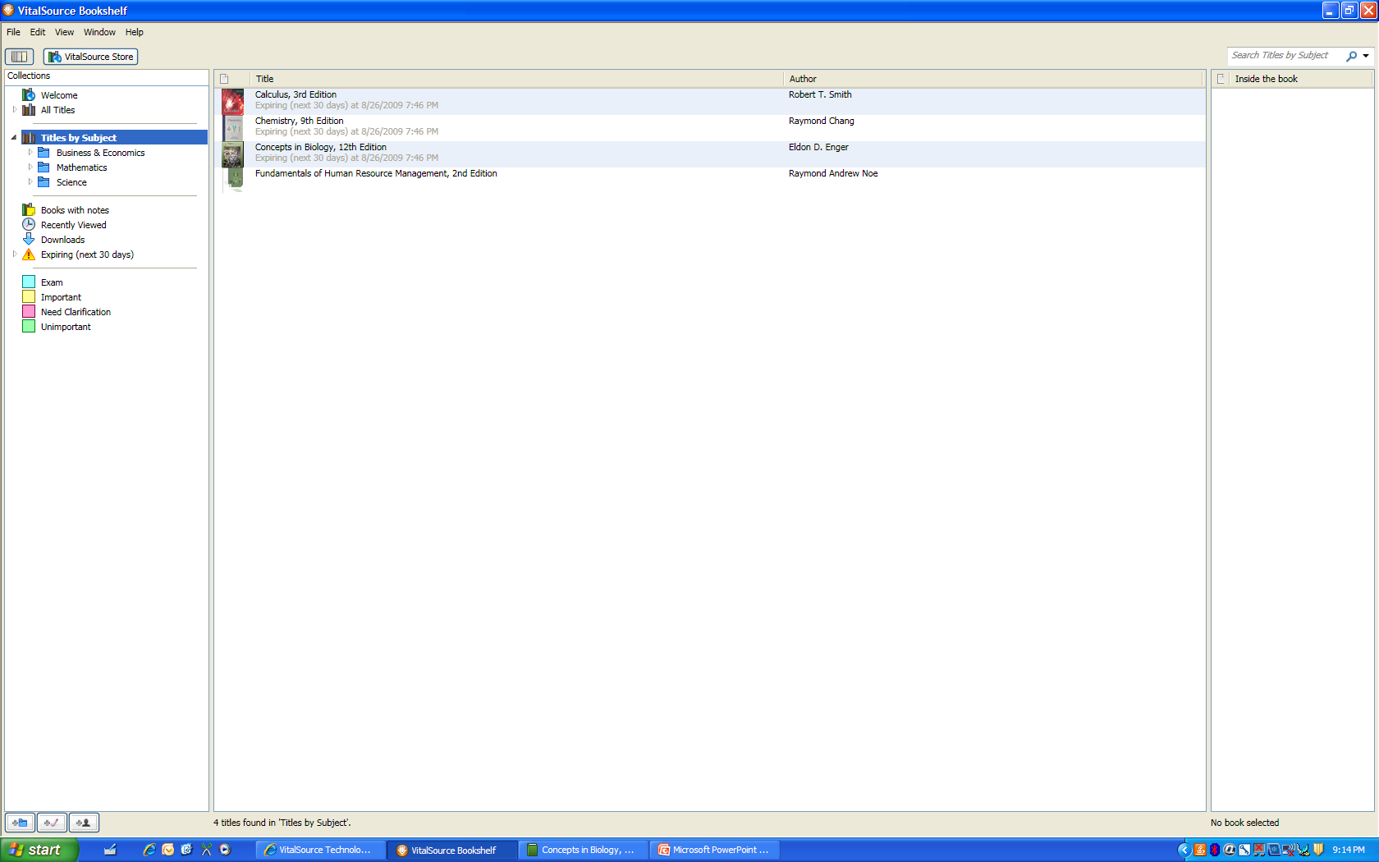

Slide 19
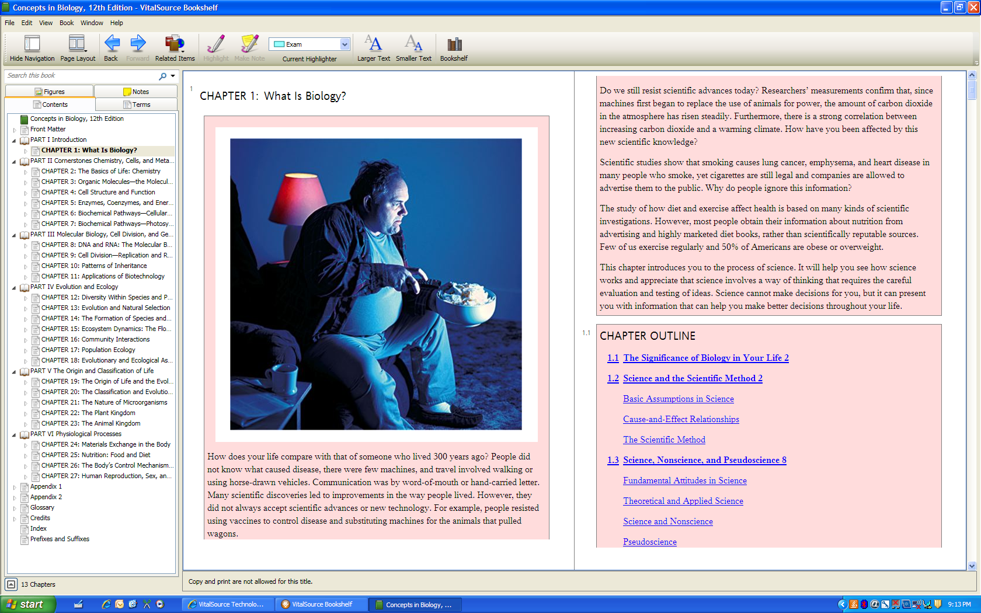

Slide 20
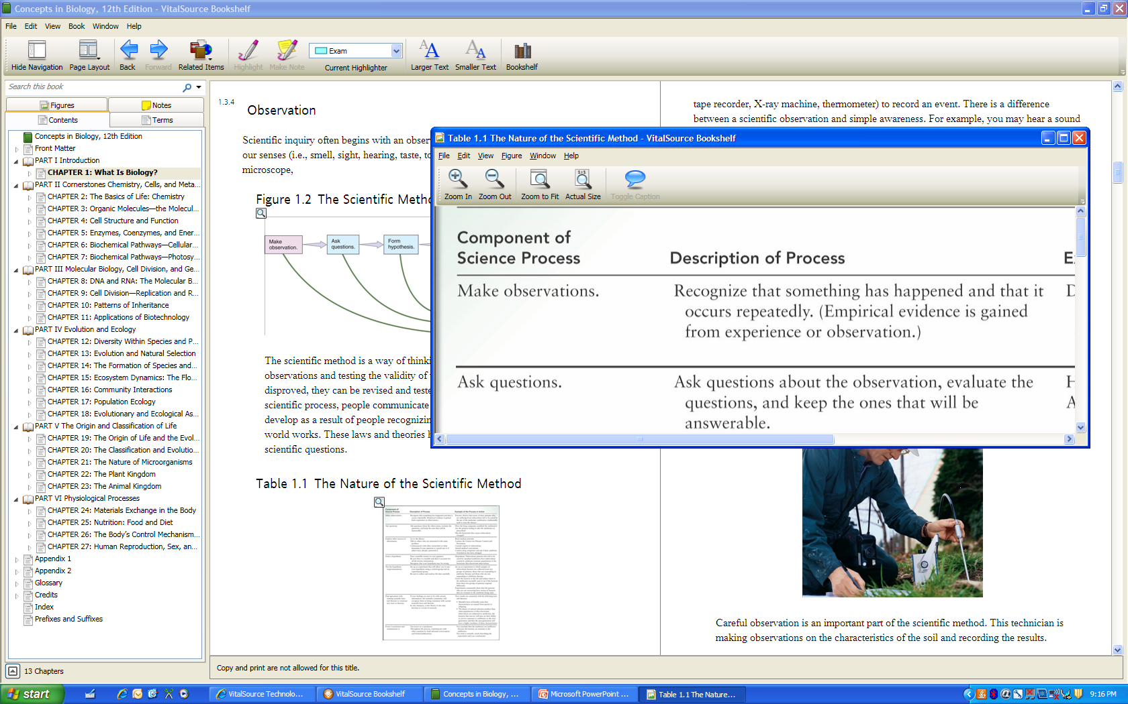

Slide 21
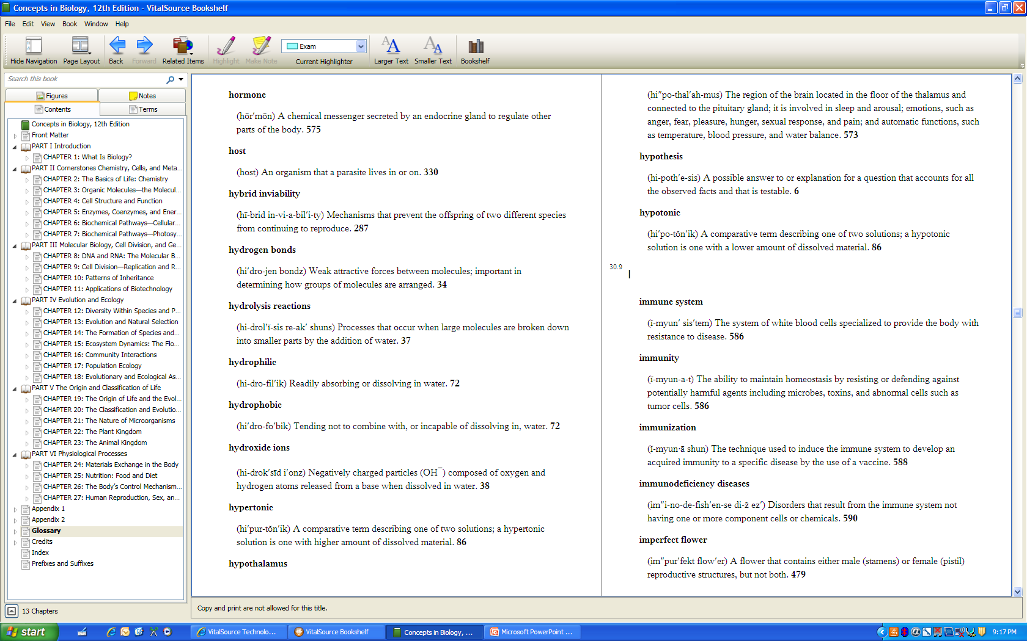

Slide 22
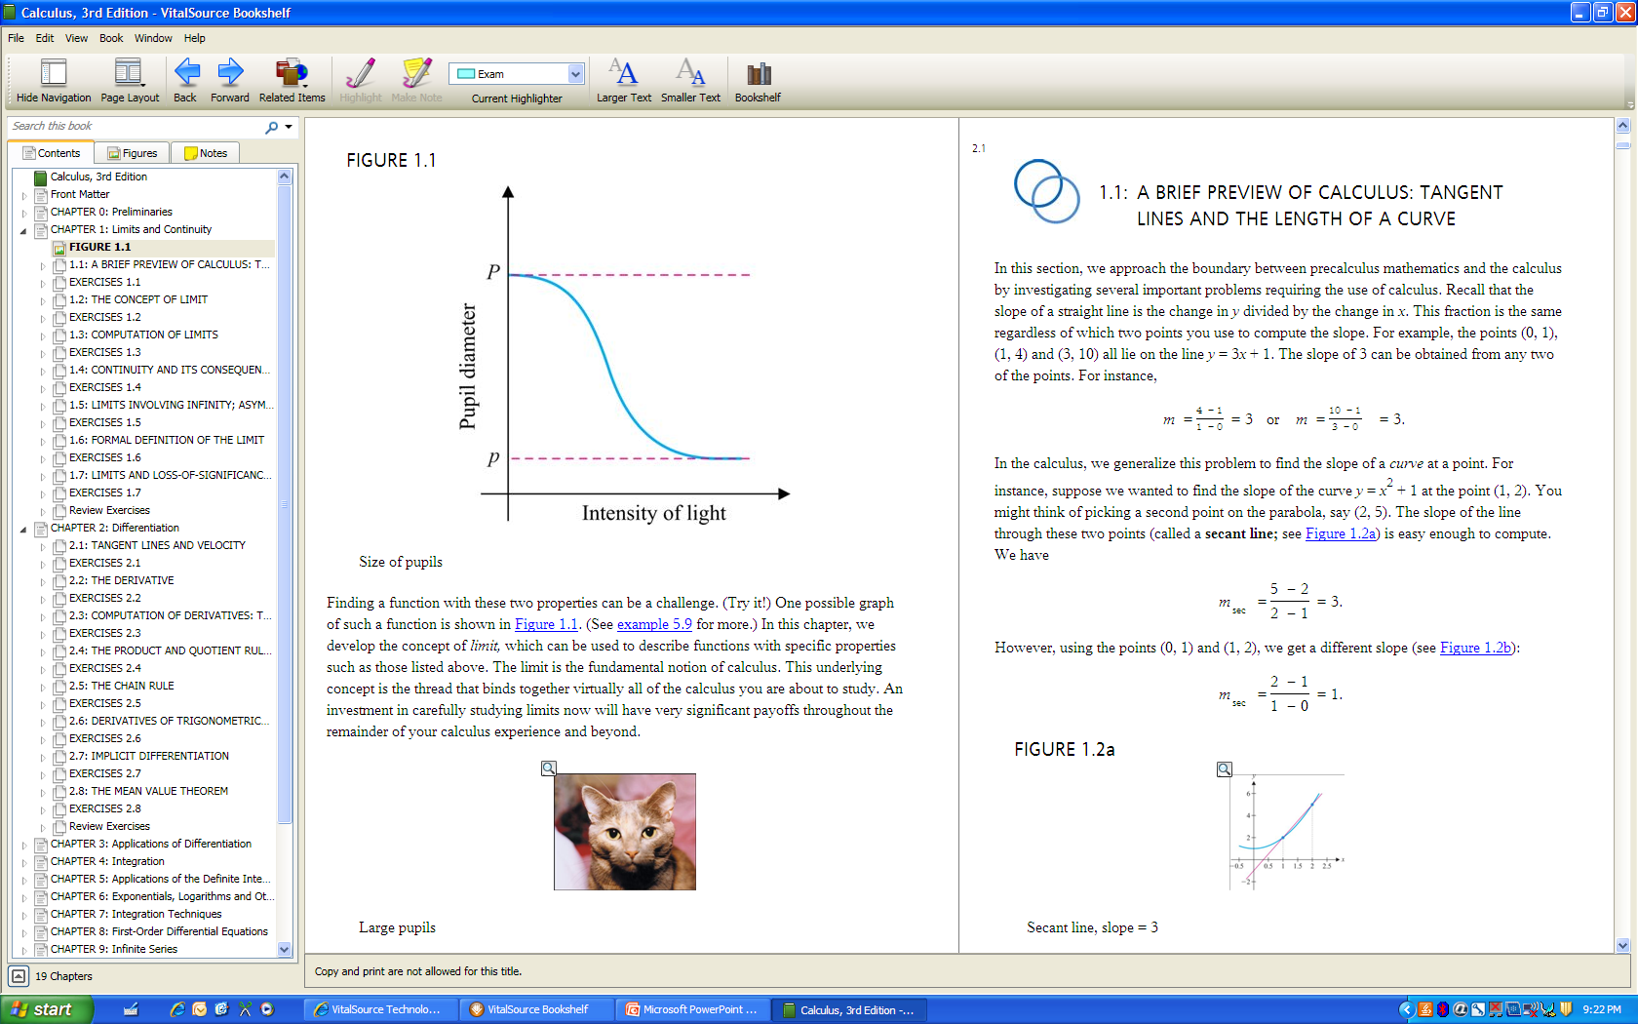

Slide 23
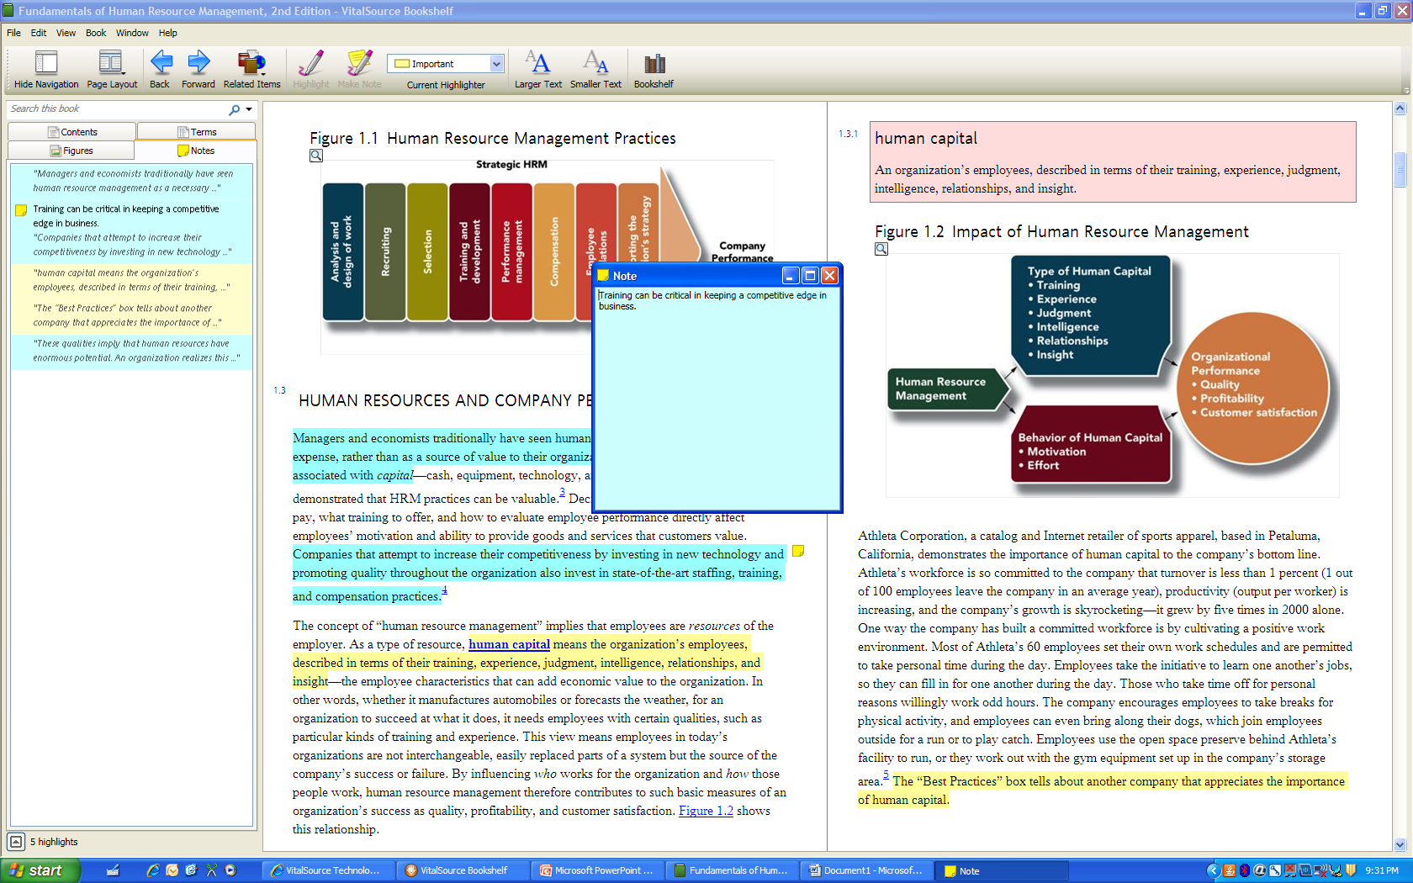

Slide 24
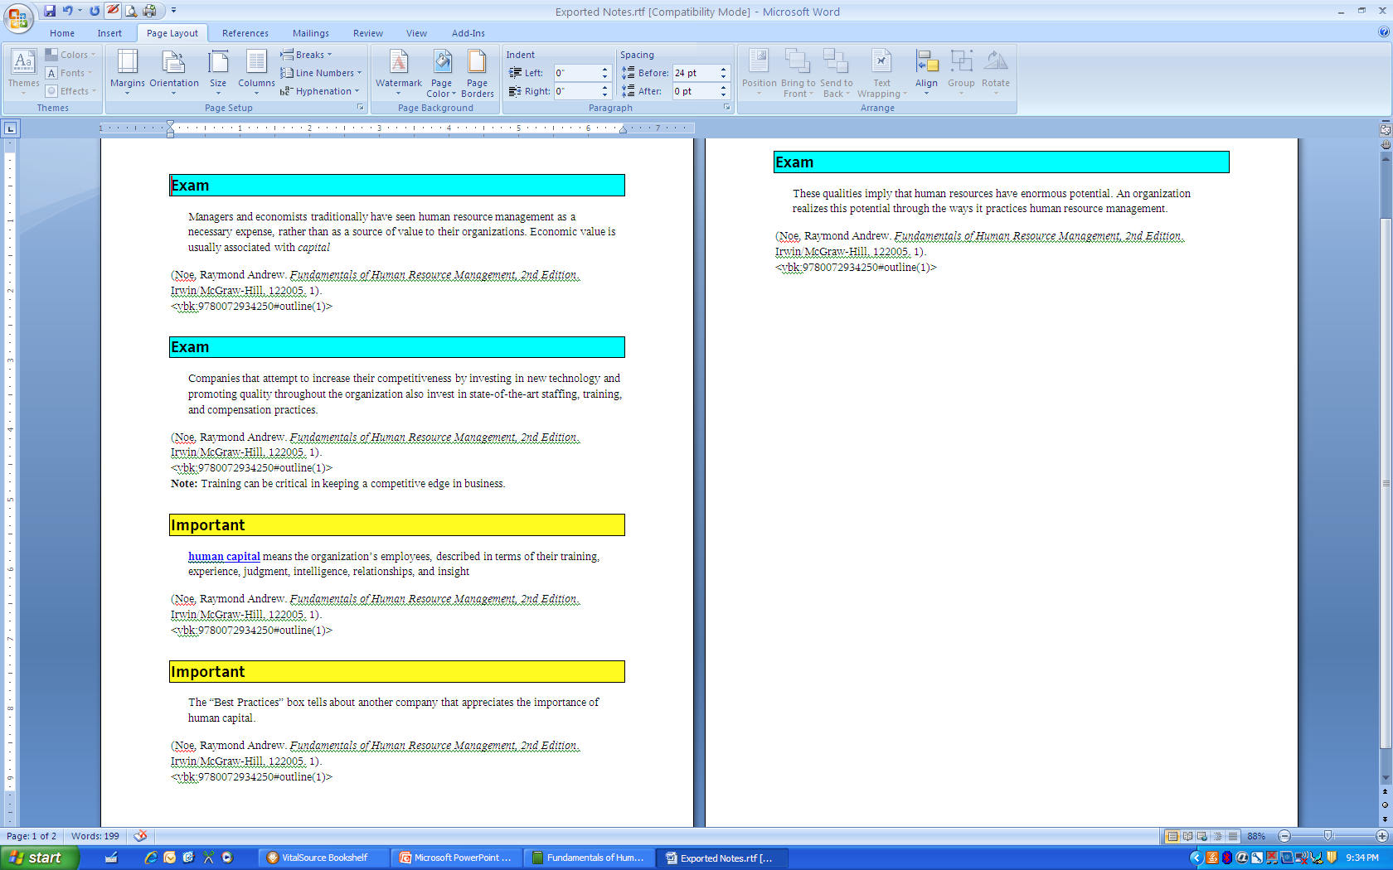

Slide 25

Phase II Deployment
Goal: evaluate eTextbooks designed for use on student notebook computers
Phase II was completed during the spring semester of 2009
Concentrated on the deployment of eTextbooks provided by five publishers
Eleven of a possible 19 academic departments volunteered to participate
  Twenty classes, across the 11 departments, were selected to use eTextbooks
  Approximately 500 students were involved in Phase II*

Slide 26
Sample Cost Comparisons
Pilot Course Title | Cost of Traditional Textbook | Approx. Cost of eTextbook
Fundamentals of Business Finance* | $168.00 | $72.25 (VitalSource)
Human Resources Management* | $130.00 | $68.75 (VitalSource)
Intercultural Communication* | $95.00 | $51.48 (CourseSmart – 180 day subscription)
Management Information Systems* | $140.00 | $71.49 (CourseSmart – 180 day subscription)
Introduction to Psychology | $121.00 | $62.95 (CourseSmart – 180 day subscription)

Slide 27
Phase II Findings
The delivery of eTextbooks to students via their notebook computers was a simple and very efficient process
Students were able to complete the downloading of eTextbooks with little assistance from university support staff
Several publishers were able to provide enhanced eTextbooks with quizzes and shared notes
The need for standardized reading features appeared useful as some students used multiple eTextbooks
Students could continue to see the potential for carrying backpacks that weighed less
Some eTextbook features, if used in the classroom, need additional Wi-Fi connectivity*

Slide 28


Advantages of eTextbooks
Facilitates integrated learning resources for the student
  Content provided by publisher can be placed within the CMS
Potential for translating lower costs into lower charges to students
Textbook publishers have shown a substantial commitment to research in order to develop a new vision for eTextbooks*

Slide 29
Phase III—Integration of eTextbooks and Electronic Resources

Slide 30
Enhanced Course Sites
Provide faculty with guidelines as to expectation for eTextbooks and related supplemental electronic materials
No longer accept PDF-formatted eTextbooks
Push to integrate supplemental materials and eTextbook within course management website*

Slide 31
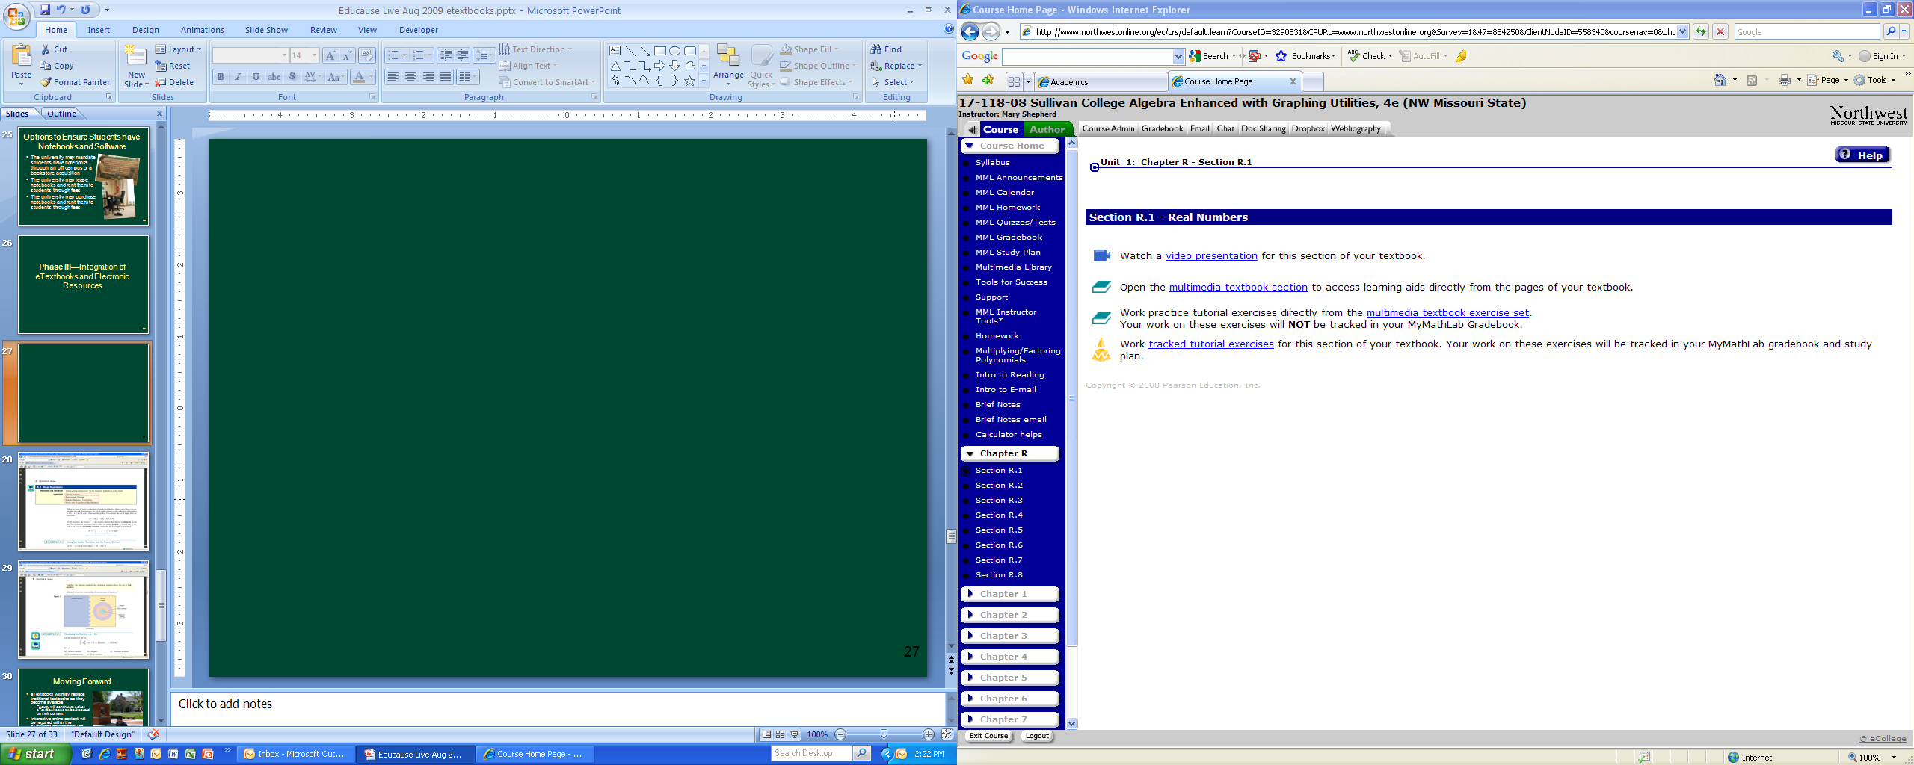

Slide 32
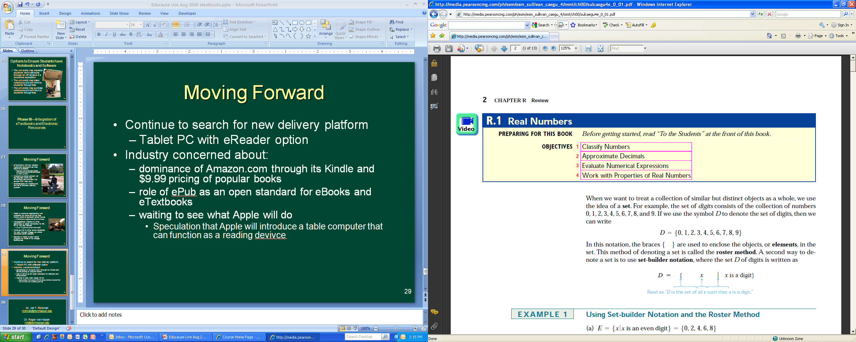

Slide 33
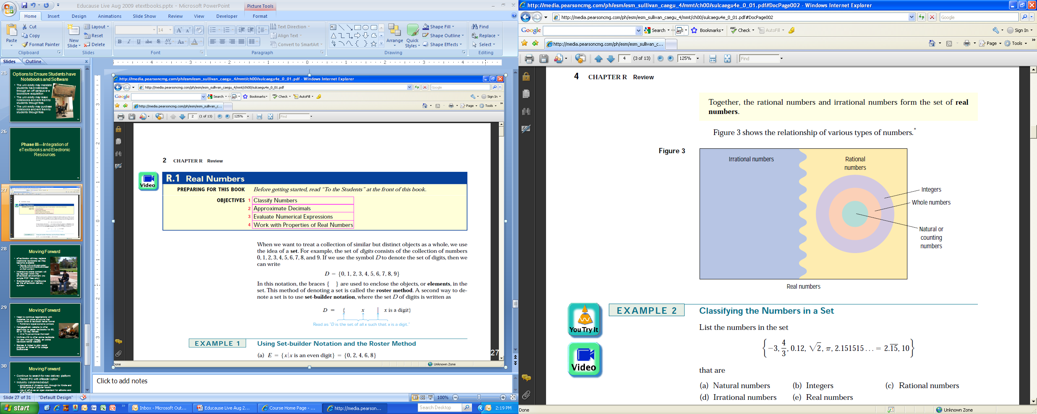

Slide 34

Moving Forward
eTextbooks will/may replace traditional textbooks as they become available
  Faculty will continue to select eTextbooks and textbooks based on their content
Interactive online content will be required within the eTextbook environment (no simple PDF files only)
Standardized on VitalSource as the eTextbook delivery system*

Slide 35
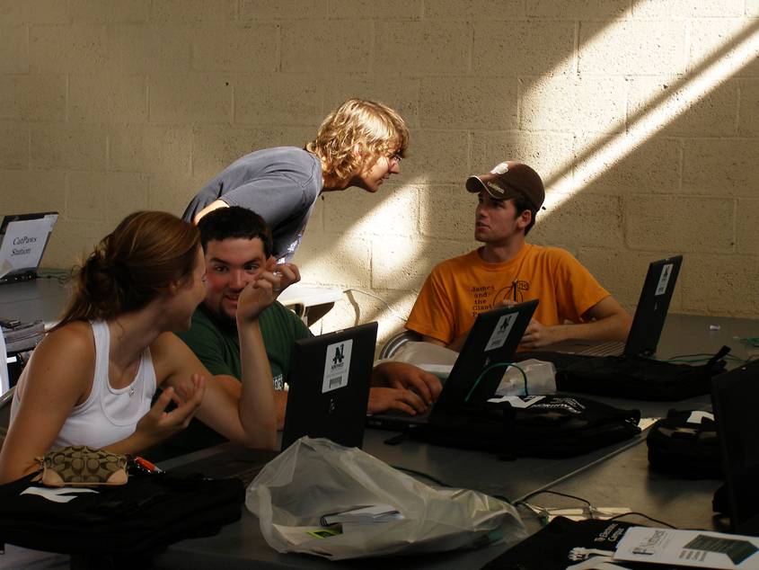
Moving Forward
Need to continue negotiations with publisher for price structure that works within a textbook rental format
  Publishers request exclusive contracts
CengageBrain website offers electronic or paper textbooks for 60, 90 or 130 day rentals
  40 to 70 percent lower than retail
McGraw-Hill offers some textbooks for rent through Chegg, an online textbook-rental website
Barnes & Noble to pilot rental program at three of its college bookstores*

Slide 36
Moving Forward
Continue to search for new delivery platform
  Tablet PC with eReader option
Industry concerned about:
  dominance of Amazon.com through its Kindle and $9.99 pricing of popular books
  role of ePub as an open standard for eBooks and eTextbooks
  waiting to see what Apple will do
    Speculation that Apple will introduce a table computer that can function as a reading device*

Slide 37
Key Points
eReaders currently do not have the functionality to support eTextbooks
eBooks are not the same as eTextbooks
Reads per purchase can be controlled in the eTextbook/eBook environment
  Cost per read is currently higher with eTextbooks vs. paper textbooks
Rental of textbooks and eTextbooks is gaining momentum
The penetration of eTextbooks will be throttled by their lack of innovation*

Slide 38
Dr. Roger Von Holzen
rvh@nwmissouri.edu
Northwest Missouri State University
Maryville, MO
http://cite.nwmissouri.edu/presentations/

