Slide 1
Guidelines for the Creation of Effective Podcasts
Ms. Darla Runyon
Dr. Roger Von Holzen
Center for Information Technology in Education
Northwest Missouri State University
http://cite.nwmissouri.edu/presentations

Slide 2
Invasion of the podcasts
The term “podcasts” is heard everywhere
Used by news broadcasts, faculty, and everyone else
Only about 1% of Internet users indicated downloading podcasts daily
  Quality of podcasts
Will students really listen to hour-long podcasts of course content?*

Slide 3
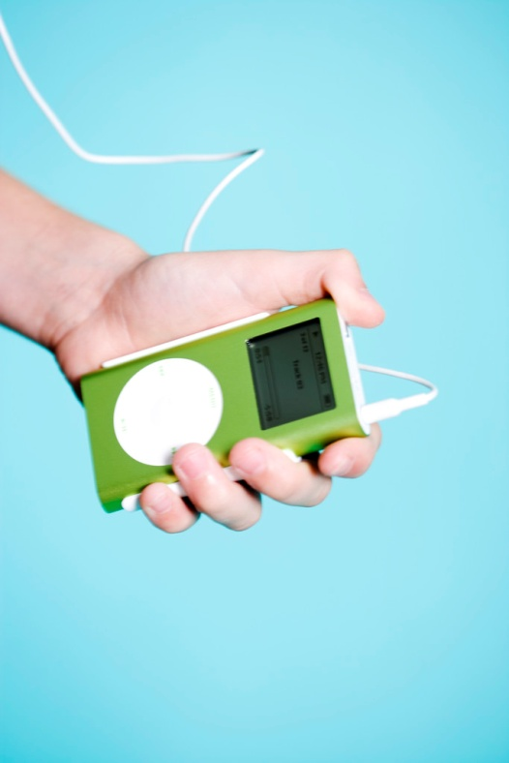
Background Information
Student surveys
  Provides information on what students may find useful
Conduct a pilot test among faculty and students using podcasts*

Slide 4
Getting Started
Establish campus procedure for recording and delivering podcasts
  Faculty technology support centers
    Outline of services
    Process for recording
    Training of faculty
    Support for faculty
  Develop an intellectual property policy
  Guidelines for use of technology*

Slide 5
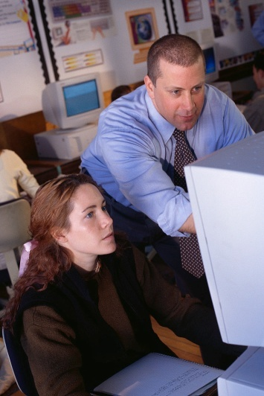
Technology for Podcasting
Technology needs to be in place for
  Classroom use
  Individual use
Software and hardware should be easily accessible for both faculty and students
Provide sufficient hardware capacity to meet storage and access requirements and demands*

Slide 6

Planning an Effective Podcast
The concept of “Podnology”
Listen to some sample podcasts
Consider what is best presented in this format
  Content should be relevant to the listener*

Slide 7
GoodPodcasts
The Mark Steel Lectures: Aristotle (5:56)
  http://www.youtube.com/watch?v=Qm8KiCu-By0
Randy Pausch Inspires Graduates (6:32)
  http://www.youtube.com/watch?v=RcYv5x6gZTA
Randy Pausch Last Lecture: Achieving Your Childhood Dreams (1:16:27)
  http://www.youtube.com/watch?v=ji5_MqicxSo

Slide 8
Bad Podcasts
The Most Boring Lecture About Global Warming Ever (9:33)
  http://www.youtube.com/watch?v=IffNaEQq1j0
Math 133 Week 3 Lecture 1 (6:59)
  http://www.youtube.com/watch?v=N9GLU7QxrVk
Math Ninja : Fundamental Concepts of Analysis Lecture 1-2 (8:48)
  http://www.youtube.com/watch?v=b8Kap5xRCIo
Physics 10 - Lecture 01: Atoms and Heat (1:13:59)
  http://www.youtube.com/watch?v=6ysbZ_j2xi0
Death Pt. 1 (10:00)
  http://www.youtube.com/watch?v=wEWYsaZkfhE
Lectures: Great Expectations for Higher Education (1:26:54)
  http://www.youtube.com/watch?v=LWd-Mf6_ZLA

Slide 9
Designing an Effective Podcast
Start with course objectives
  Consider critical content and concepts
  How can a podcast best enhance objectives?
  Can any of the content be effectively delivered via a podcast?
  Can any of the concepts be effectively delivered via a podcast (vodcast)?
Keep it simple—write it out or have an outline to keep the conversation flowing
Keep it short—2-3 minutes—focused on critical points
Avoid slang or jargon words*

Slide 10
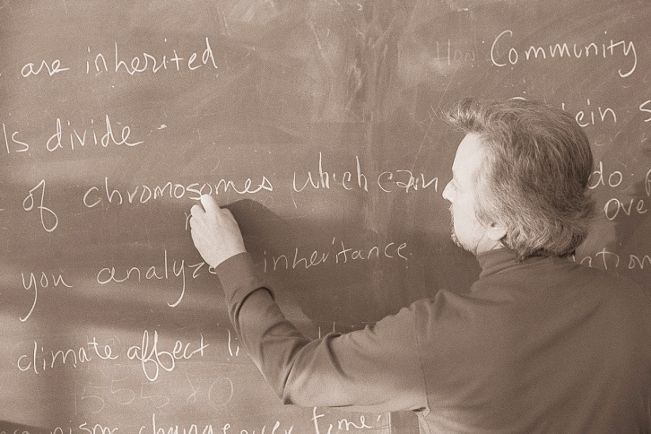
Designing an Effective Podcast
Avoid complex facts and figures that can be hard to explain verbally
Consider including background music if appropriate
Make a transcription of the podcast available
Label podcasts descriptively
  Keep titles consistent for serial podcasts*

Slide 11
Recording an Effective Podcast
Uses voices that are natural and interesting
  Strive for normal speech patterns
  Use a conversational or casual voice
Use an interview style where appropriate to engage the listener
Watch sounds levels when recording to keep volume even
Make edits carefully—they can be heard in headsets*

Slide 12
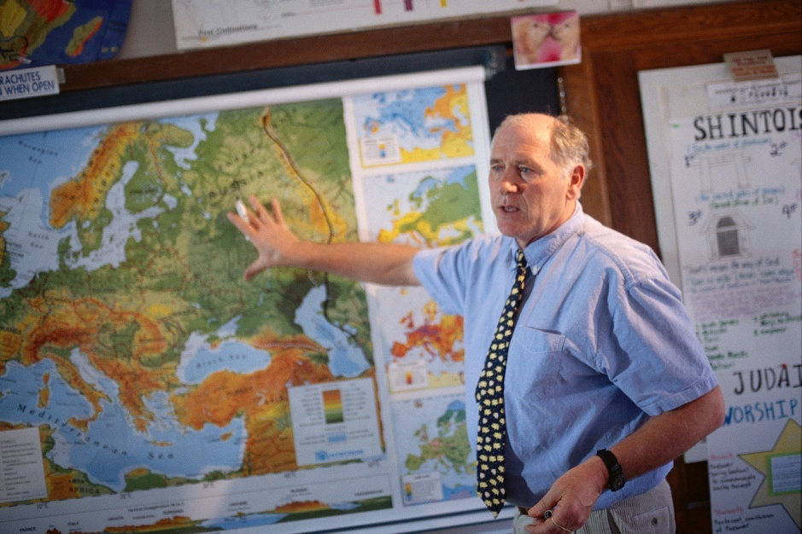
Recording an Effective Podcast
Add humor and personal anecdotes to keep the listener engaged
Concentrate on the concept/content
Avoid divisive personal comments*

Slide 13
Delivering an Effective Podcast
Use an RSS feed to push the content to students
  RSS feed provides an easier access for students who are 21st Century learners
  Logging into the course site takes additional time
  Link can still be posted in the site*

Slide 14
Examples of Appropriate Podcasts
Large lecture classes
  Podcast critical content
  Podcast content students historically have not understood
  Lectures for students with special needs
Mini-lectures
  Podcast mini-lectures outlining lab course information to be used before going to the lab
Tests or other review material
  Podcast review sessions*

Slide 15
Examples of Appropriate Podcasts
Subject matter expert or guest speaker
  Podcast an interview with these individuals
  Use a question and answer session
Languages
  Podcast pronunciations for student practice
  Podcast phrases and sentences for practice
Recruitment
  Podcast pertinent university information to potential students*

Slide 16
Examples of Appropriate Podcasts
Archives
  Use podcasts as an archive of historical information and events
    Example: record podcasts of stories from World War II veterans for use in classes
Student podcasts
  Allow students to podcast content, opinions, and stories which are pushed out to the class through RSS feeds
FAQs
  Podcast focused answers for FAQs*

Slide 17
Examples of Appropriate Vodcasts
Languages
  Review and practice of sign language letters and words
Recruitment
  Vodcast pertinent university information to potential students
Student vodcast
  Allow students to podcast content, opinions, and stories which are pushed out to the class through RSS feeds*

Slide 18
Examples of Appropriate Vodcasts
Learning objects
  Vodcast Flash learning objects for review of critical concepts
Speeches
  Vodcast student speeches for an oral communications course
  Allow students to critique these speeches*

Slide 19
Podcasting websites
http://www.gabcast.com
http://www.podbean.com
http://www.podcast.net
http://podcastalley.com
http://audio.search.yahoo.com/audio
http://speakingofhistory.blogspot.com
http://youthradio.wordpress.com
http://pdtogo.com/smart*

Slide 20
Creating Effective Podcasts
Key point:
  Podcasts must play an integral part in the delivery of critical content and/or concepts
Following these guidelines, an instructor should be able to produce a podcast that has a fair chance of being listened to by students*

Slide 21
Ms. Darla Runyon
drunyon@nwmissouri.edu
Dr. Roger Von Holzen
rvh@nwmissouri.edu
Center for Information Technology in Education
Northwest Missouri State University
http://cite.nwmissouri.edu/presentations

