Slide 1

Moving from Digital Books (PDFs) to eTextbooks: What a True eTextbook Should Look Like
Dr. Roger Von Holzen
Director—Center for Information Technology in Education
Northwest Missouri State University

Slide 2

Presenter’s Environment
Northwest Missouri State University enrolls over 7,000 students
Has provided textbooks to students for over 100 years
  $6 per credit hour fee
Northwest’s Electronic Campus program provides a notebook computer to every student
  $180 per semester fee*

Slide 3
Why Textbooks Matter
The combined print publishing business for the education industry is worth in the range of $12-14 billion per year in North America
Thad McIlroy: http://thefutureofpublishing.com/industries/the-future-of-educational-publishing/

Slide 4
Source: National Association of College Stores

Slide 5

Serway, Faughn and Vuille
College Physics
Cengage
8th Edition
978-0-4953-8693-3
Cengage list price: $231.95
Cengagebrain.com price: $196.99
Cengage eBook price: $115.99
Amazon new: $154.46
Kindle edition: NA
Half.com: $74.94
Amazon used: from $73.95
Chegg.com paper semester rental: $48.46
CourseSmart e-textbook 180 day rental: $115.99
Northwest textbook rental: $18.00
7rd Edition 2006
Amazon “new”: from $50.00
% of List Price
84.9%
50.0%
77.5%
32.3%
31.9%
20.9%
50.0%
7.8%
21.6%

Slide 6
Platforms

Slide 7
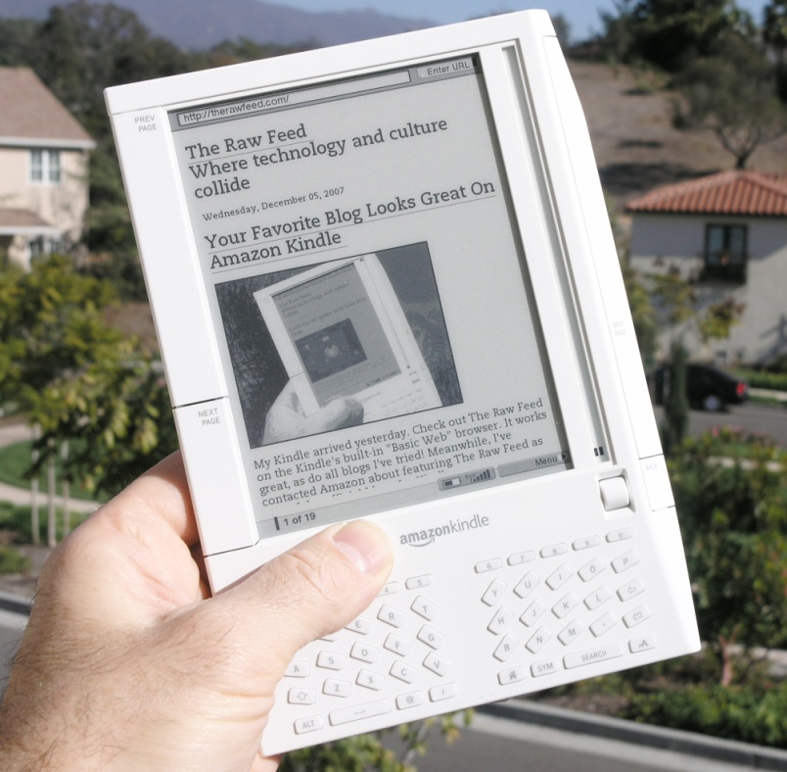
eReaders
Kindle from Amazon.com
  Kindle: $139
  Kindle DX: $379
Sony Reader
  Pocket Edition: $130
Barnes & Noble
  Nook: $148
  Color Nook: $249*

Slide 8
eReaders
Incorporates E Ink technology for great readability
Features low power consumption and long battery life
Most support PDF and ePub formatted textbooks
Have keyword searching and annotating (very important features for students and faculty)
No interactivity possible with online resources and course sites
Generally black/white only
No Flash animation or video
Light weight (10.2 oz to 12.1 oz)
Work best for pleasure reading*

Slide 9

Notebook Computers
eTextbook options:
  Web-based
    integrated in course management system
  Computer-based
    downloaded into VitalSource Bookshelf or CourseSmart Bookshelf software*

Slide 10
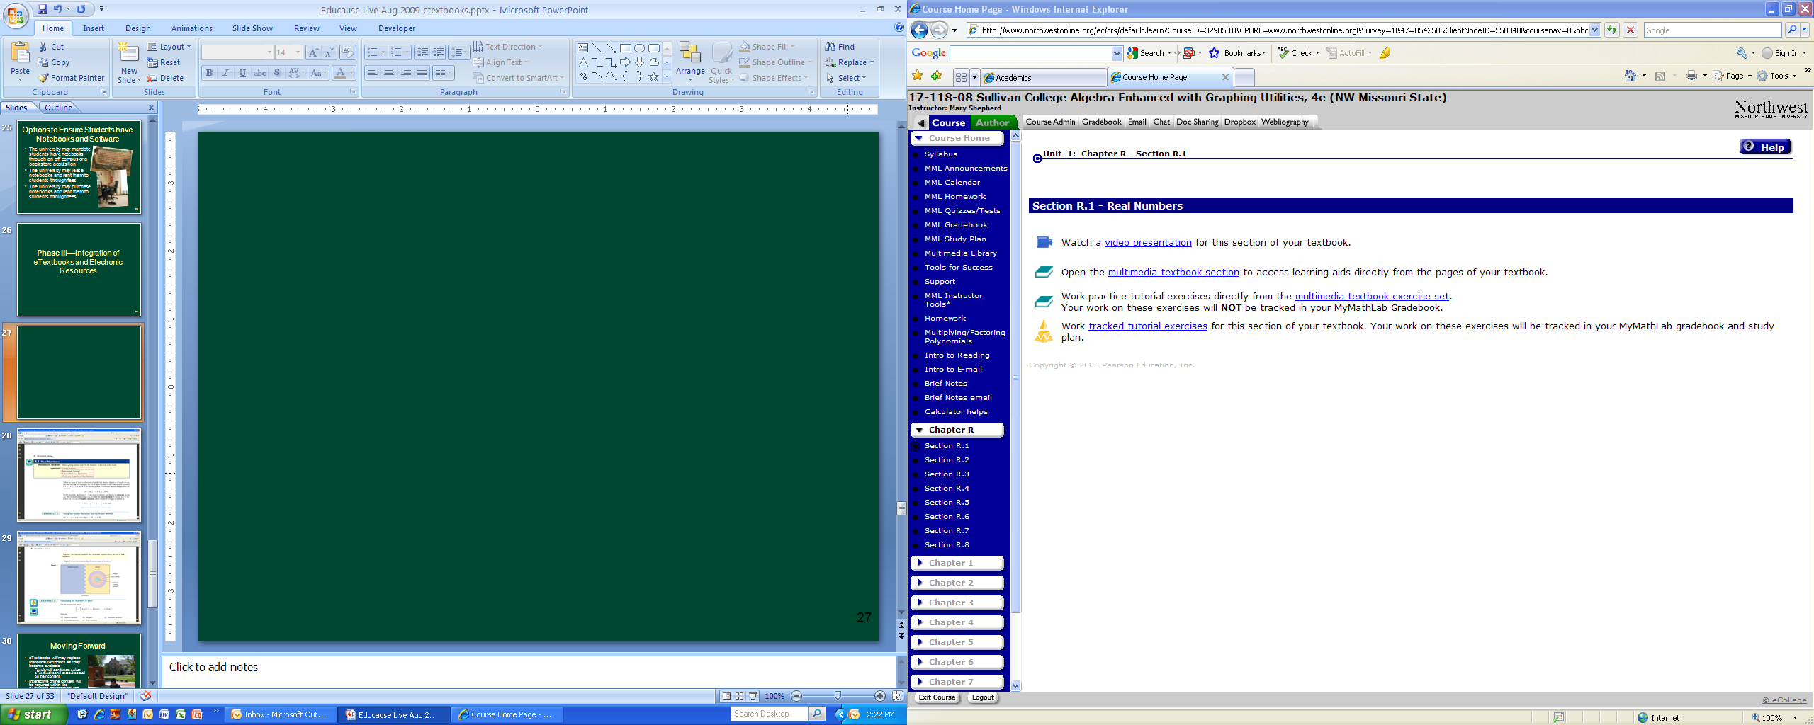

Slide 11
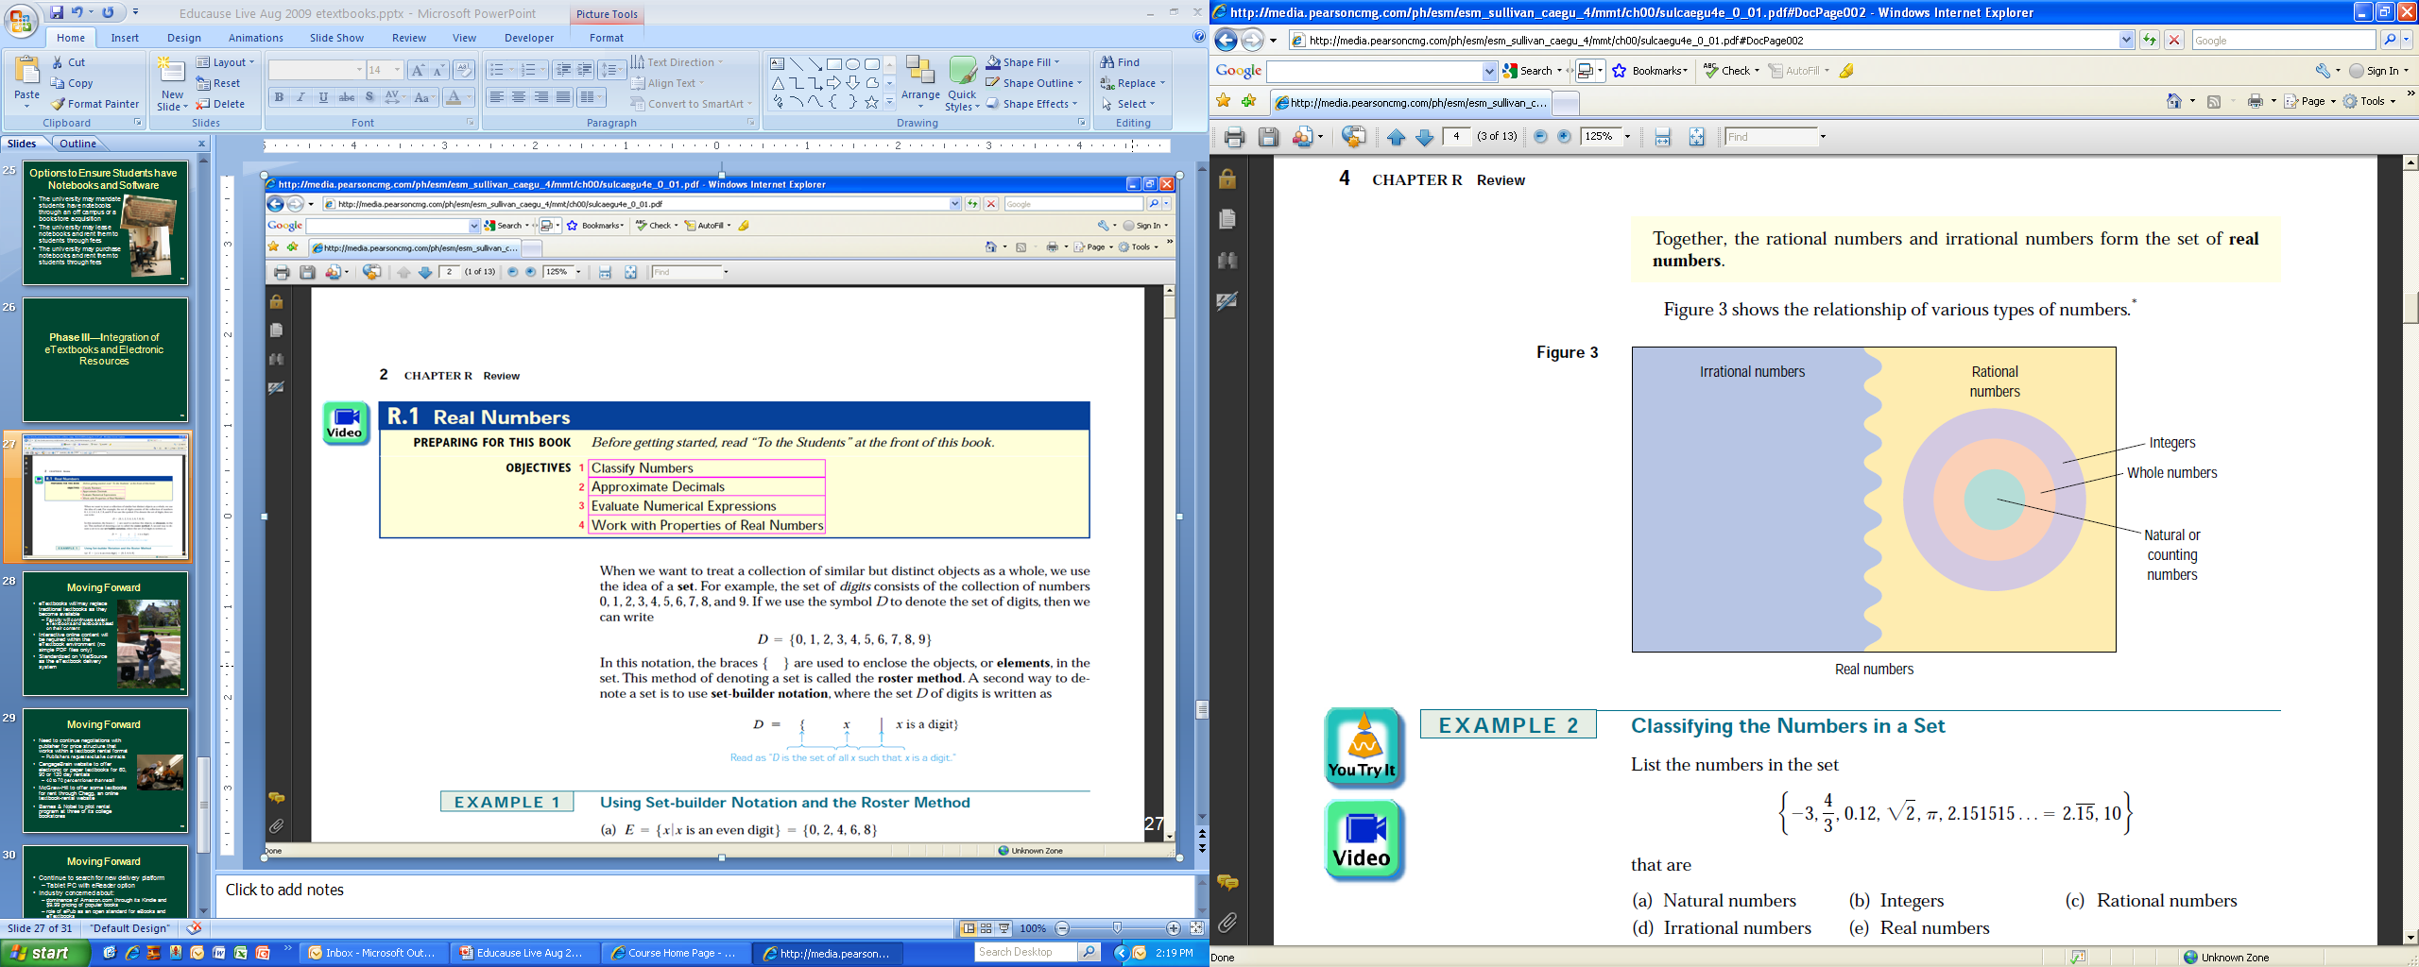

Slide 12
Notebook Computers
Bookshelf software features:
  Pages look identical to print textbook with same pagination or various book layout options
  Easy navigation with linked Table of Contents
  Search specific topics within an eTextbook, a chapter or a page
  Take notes and highlight text
  Copy and paste text
  Print pages, share information with classmates*

Slide 13
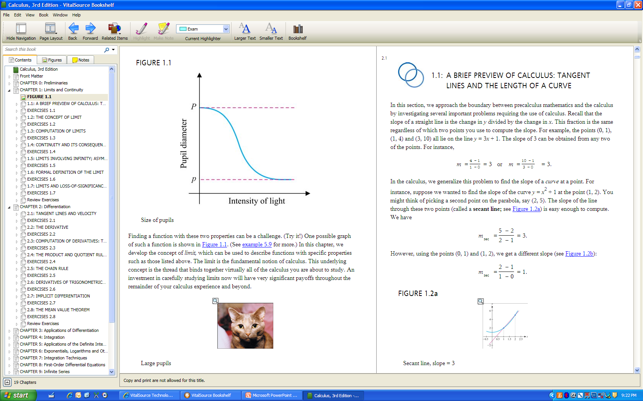

Slide 14
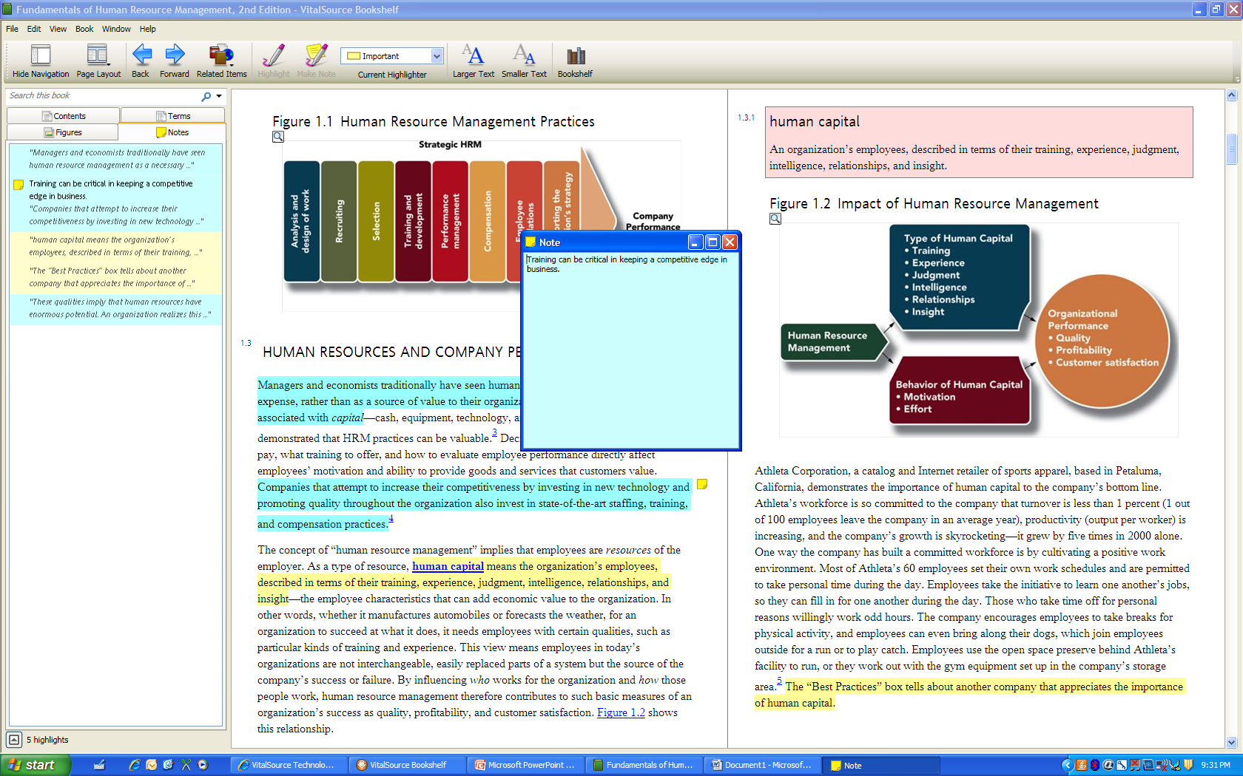

Slide 15
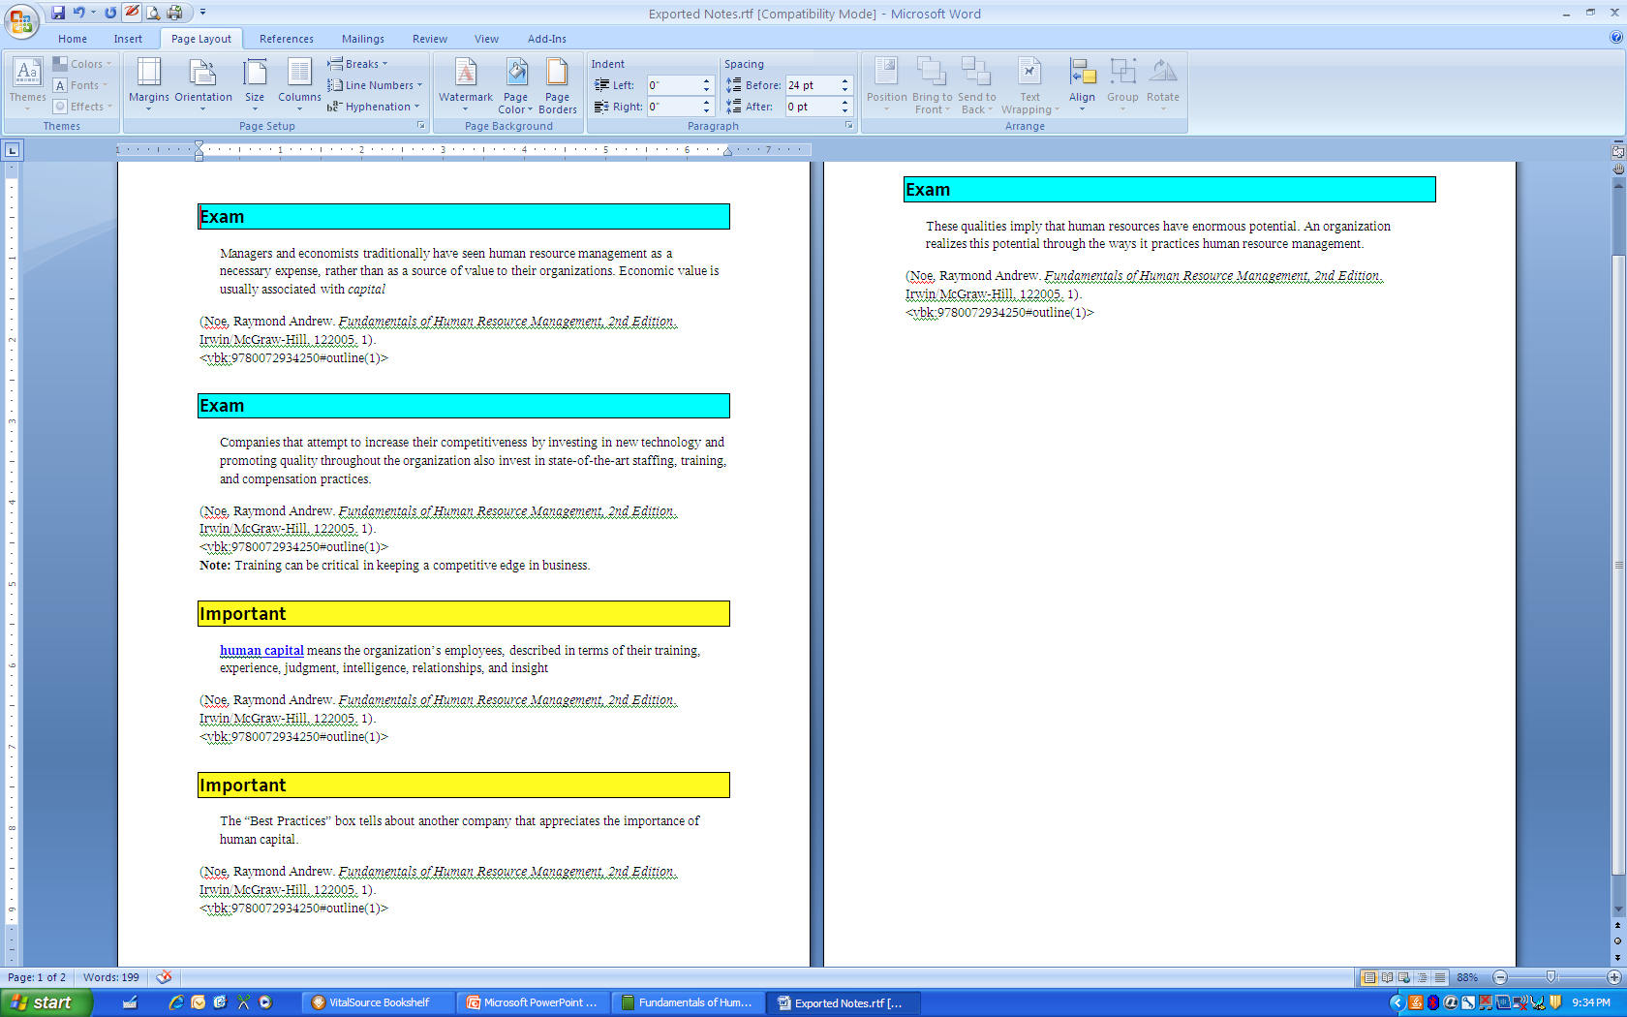

Slide 16
Notebook Computers
Positive features:
  Support PDF and ePub formatted textbooks
  Have keyword searching and annotating
  Interactivity possible with online resources and course sites
  Flash animation and various video formats allowed
  Minimum weight (5-7 pounds)
Issues:
  Display’s reflectivity can impact readability
  Short battery life
  Color display
  Ergonomically not designed for extended reading
    Weight can be an issue*

Slide 17
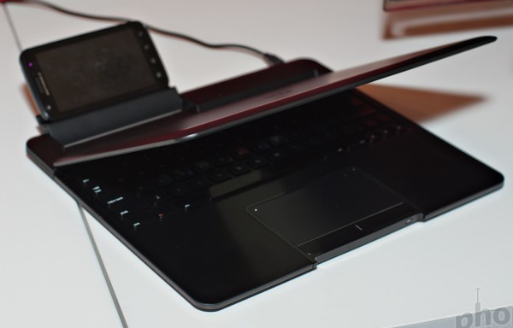
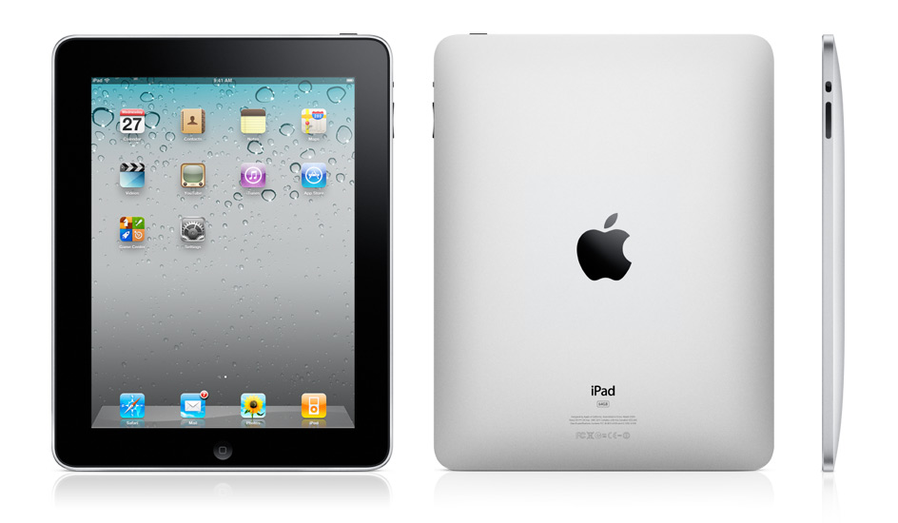
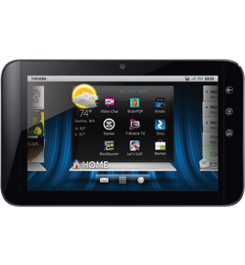
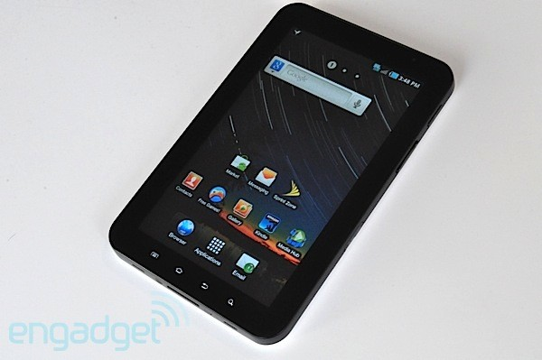
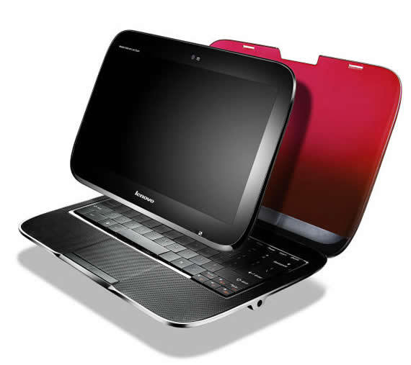
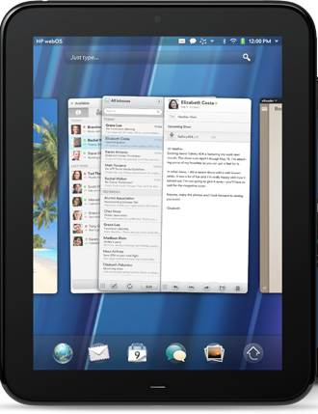
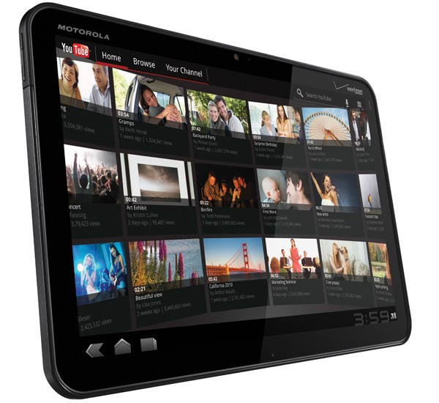
Tablet Computers
Wide array of tablets
  iPad ($500)
  Samsung Galaxy Tab ($600/$250 with contract)
  Dell Streak 7 ($450/$200 with contract)
  Motorola Atrix and Xoom (Atrix from $199)
  Lenovo IdeaPad U1
  HP TouchPad (WebOS)
  Windows 8 tablet from Dell (2012?)*

Slide 18
Tablet Computers
Positive features:
  Color display
  Ergonomically designed to allow extended reading
  Low power consumption and long battery life
  Support PDF and ePub formatted textbooks
  Support keyword searching
  Support annotating and highlighting
  Interactivity possible with online resources and course sites
  Light weight (10 oz to 12 oz)*

Slide 19
Tablet Computers
What’s needed:
  Improved readability
    LED display’s reflectivity can impact readability
  Can be used as a productivity tool
    USB ports
    Stylus input
  Support Flash animation and other video formats
  Support full ADA compliance
  Open to any software
  Competitively priced
  Rugged*

Slide 20
Attributes of Effective eTextbooks
View color images
Conduct keyword searches
Insert notes and annotate text
Add digital bookmarks
Copy and paste text
Print pages and share notes
Change font size while retaining original page numbers*

Slide 21
Attributes of Effective eTextbooks
Provide interactive learning opportunities and feedback
  Flash cards
Integrate grades into course management system
  Quiz results reported to gradebook
View animations of key concepts and themes
View flash and video files of various formats
Follow mastery learning approach to content
View text on smartphones*
The Daily

Slide 22
Present Status
Most “eTextbooks” are PDF in format
CourseSmart
  50-60% off “retail” price for 180 day access
  PDF files with interactive content limited to external course-related web site
Flat World Knowledge
  Only 33 textbooks currently available
  PDF or HTML with few external resources
Sage eTextbooks
  PDF with links to external videos
OER Commons
  Very limited content areas—few standard textbooks
  PDF format*

Slide 23

Pricing Conundrum
eTextbook prices fixed at half the price of printed editions
  Based on PDF format for most eTextbooks
Enhanced, interactive eTextbooks will require additional investment of resources
  Additional costs will increase price of eTextbooks
eTextbook experience should trump pricing
Need for standardized eTextbook format*

Slide 24
Faculty Created eTextbooks
Software available to aid in eTextbook development
  Pages
  SoftChalk
Key concerns:
  Lack of time
  Lack of comprehensive knowledge and publishing skills
  Need for thorough copyright clearance*

Slide 25
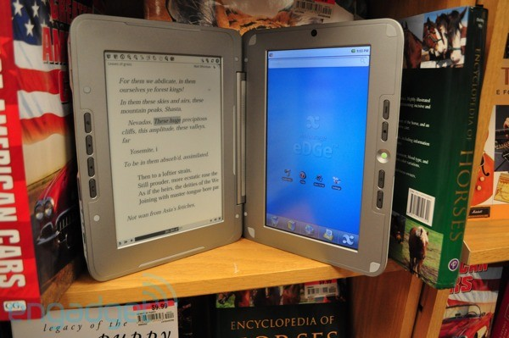
Goal: Integrated Interactive eTextbooks
Provide faculty with guidelines as to expectation for eTextbooks and related supplemental electronic materials
No longer accept PDF-formatted eTextbooks
Push to integrate supplemental materials and eTextbook within course management website
Continue to search for new delivery platform
  Tablet PC with eReader option
    enTourage eDGe*

Slide 26
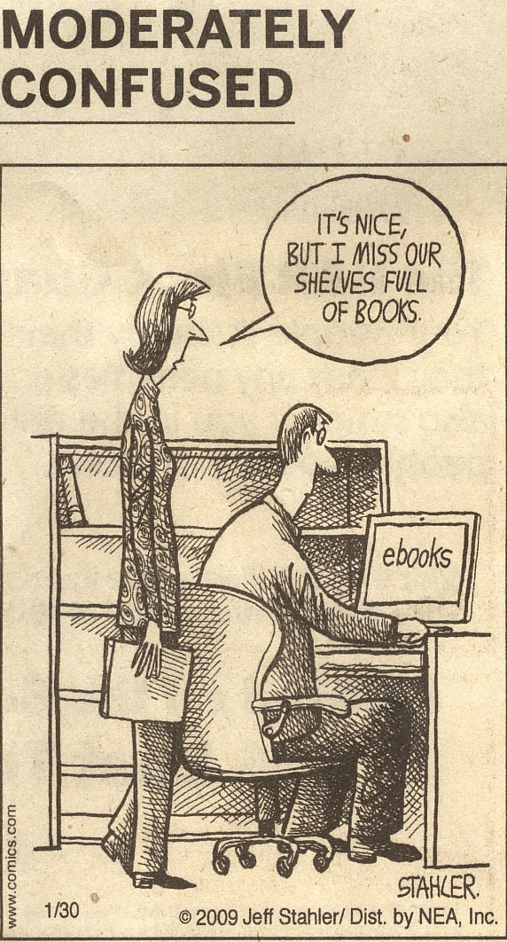
Dr. Roger Von Holzen
rvh@nwmissouri.edu
Presentation available at:
http://cite.nwmissouri.edu/presentations

