Slide 1
Accessing and Using CITI Training
@
Northwest Missouri State University
Notes:
Hi! If you are accessing this, it means you are a member of the Northwest Missouri State University community who, for one reason or another, needs to complete some form of research ethics training. At this time, the university utilizes the CITI program for ethics training, and the Northwest IRB requires that all researchers complete a particular ethics training prior to granting approval of a research project.
This powerpoint will walk you through the steps of registering for, and completing, the trainings required by the Northwest IRB.

Slide 2
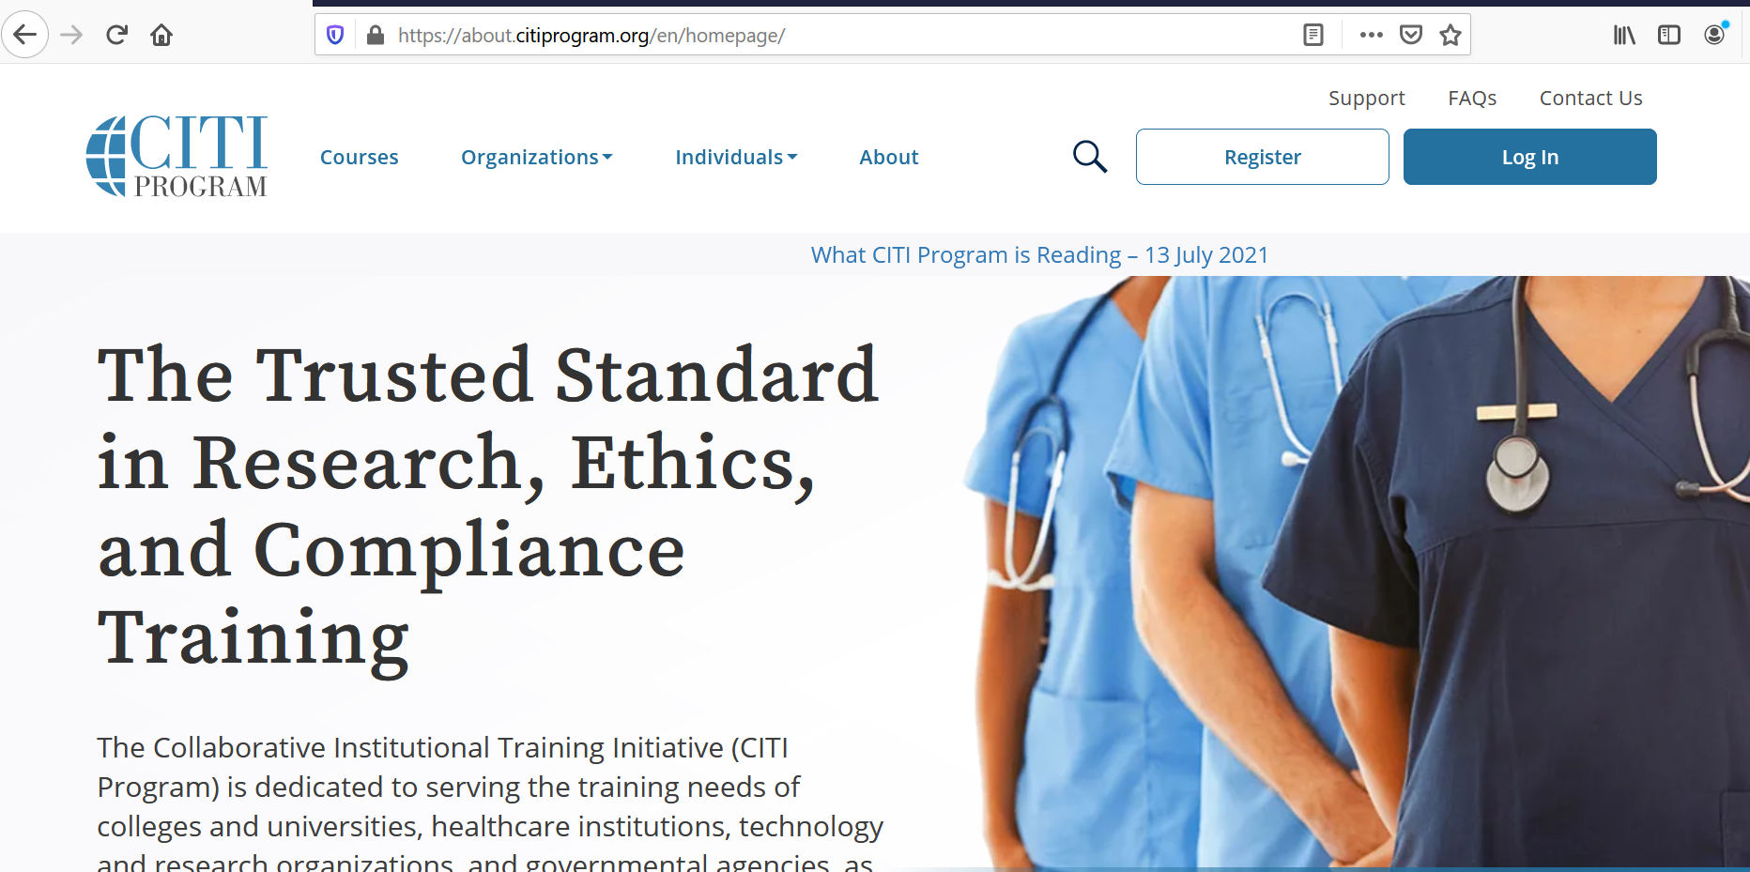
Notes:
The first thing you will need to do is create an account. This is done directly through the CITI program website, which can be accessed at www.citiprogram.org or through the link shown on this slide.
When you get to this webpage, simply click the “register” button.

Slide 3
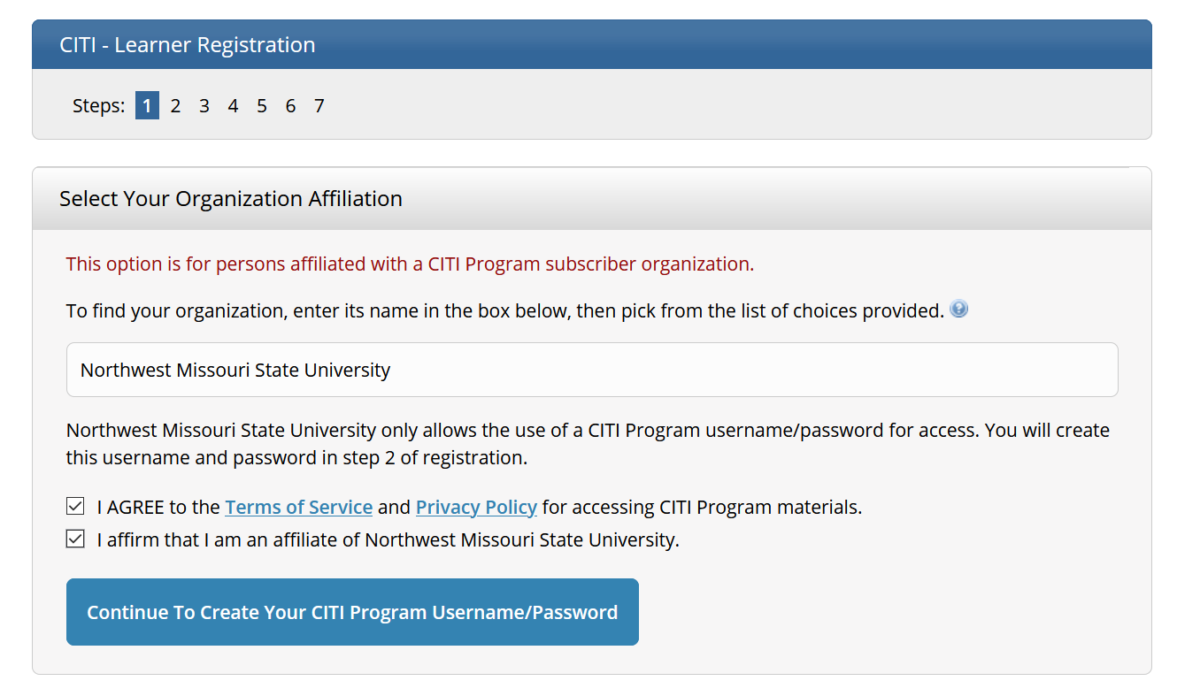
Notes:
The registration process involves seven steps, and this presentation will walk you through exactly what you need to do at each step.
At step 1, you need to tell the system the organization you are affiliated with. Once you’ve selected NWMSU, check the boxes agreeing to the terms of service and affirming that you are affiliated with Northwest, and push continue.

Slide 4
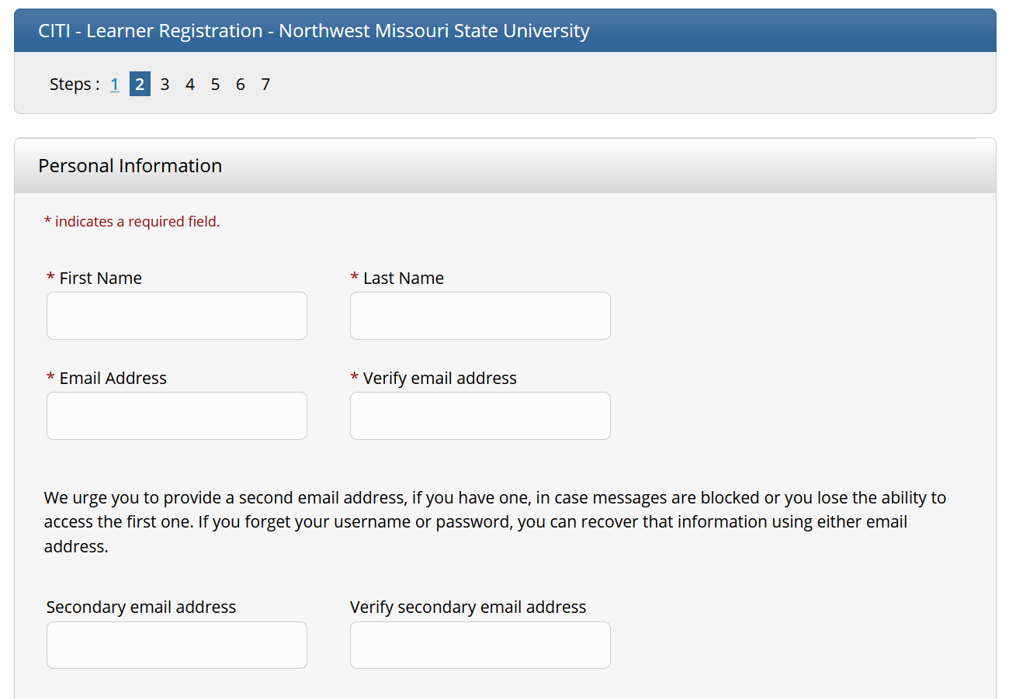
Notes:
In step 2, you provide personal information. Any box with an asterisk next to it is required.
You do NOT have to use your Northwest email address for this registration process if you would prefer not to. It is up to you.

Slide 5
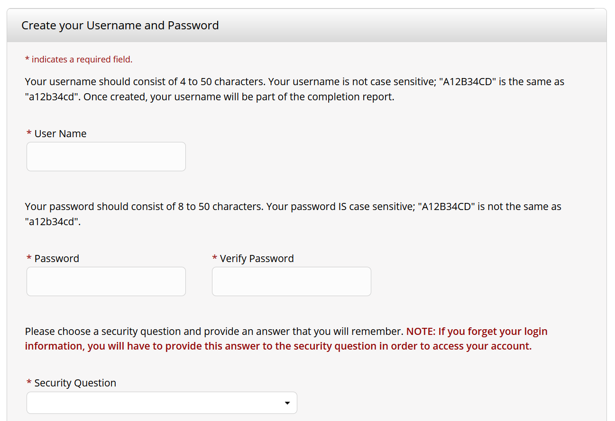
Notes:
In step 3, you will create a username and password for your CITI account.
Your CITI account is independent of your Northwest account, which means you may choose any username and password you would like. You are welcome to use the same ones from your Northwest account (assuming the username is not already taken), but it isn’t required.

Slide 6
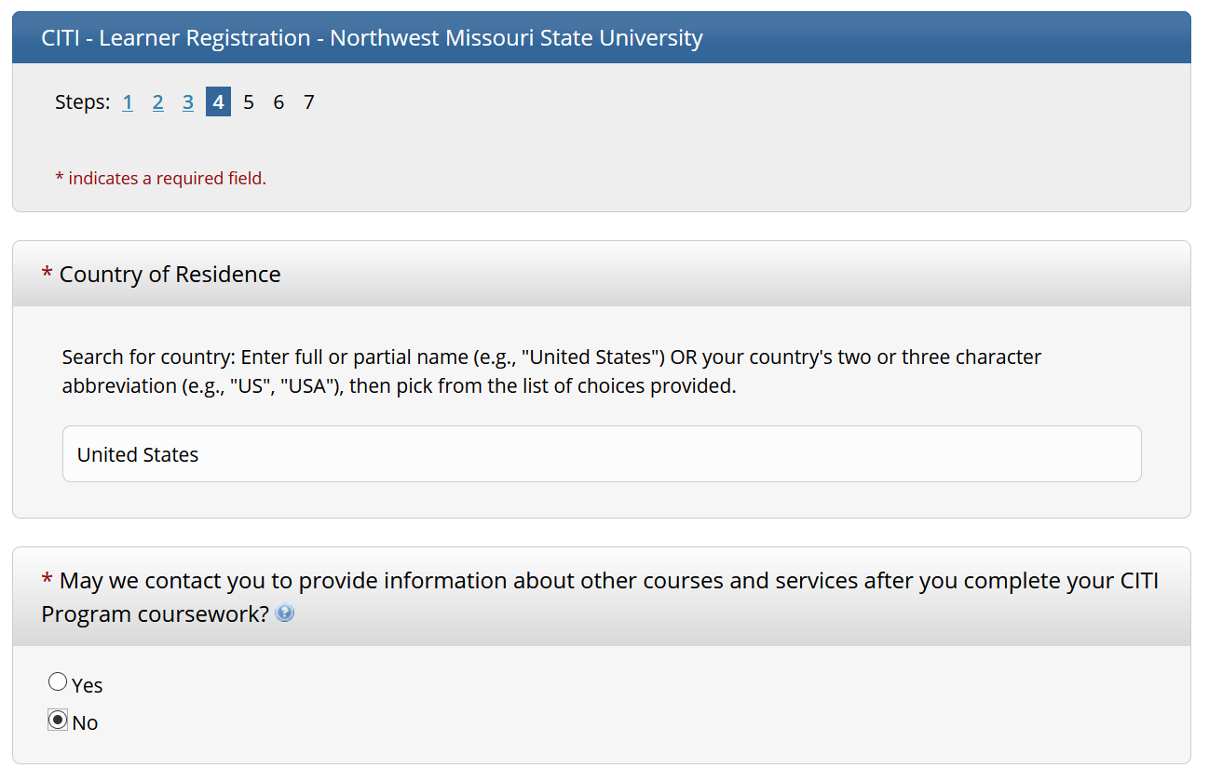
Notes:
- Step 4 is straightforward and simply asks your country of residence and whether you want to give CITI permission to contact you. Feel free to check the “No” box for the contact question if you don’t want to be bothered.

Slide 7
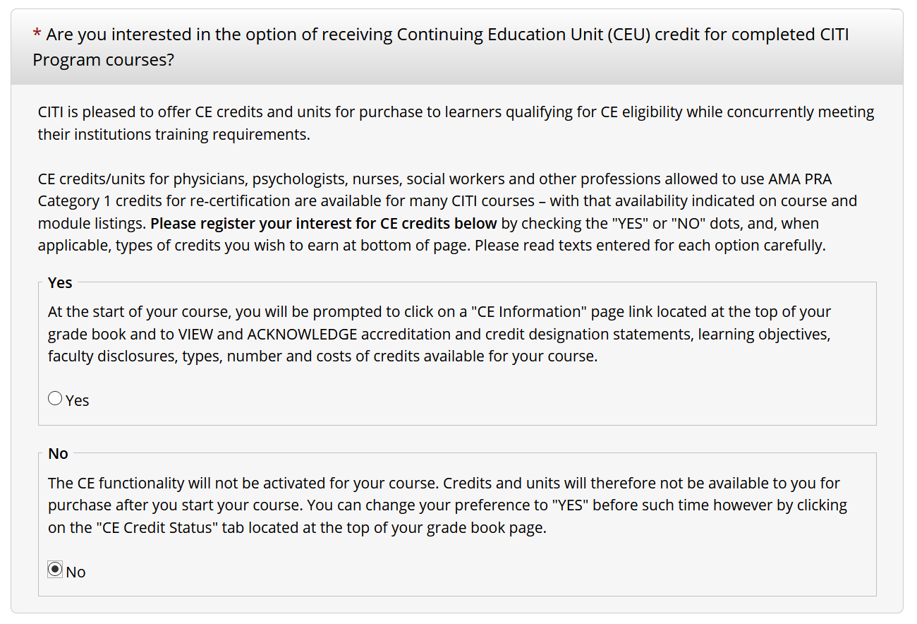
Notes:
Step 5 looks a little confusing, but it’s pretty simple. At this time, NWMSU does not offer the CITI ethics courses for continuing education credits, so most users can simply check the “No” box here. However, if you are also affiliated with another organization that takes continuing education credits, I would recommend contacting that organization directly to see if the CITI program would qualify.
For faculty, note that this is different from professional development credit. The continuing education credits are a paid certification that trainings have been completed. If you plan to use some of the trainings offered by CITI as part of your faculty development, you still do not need to check “Yes”.

Slide 8
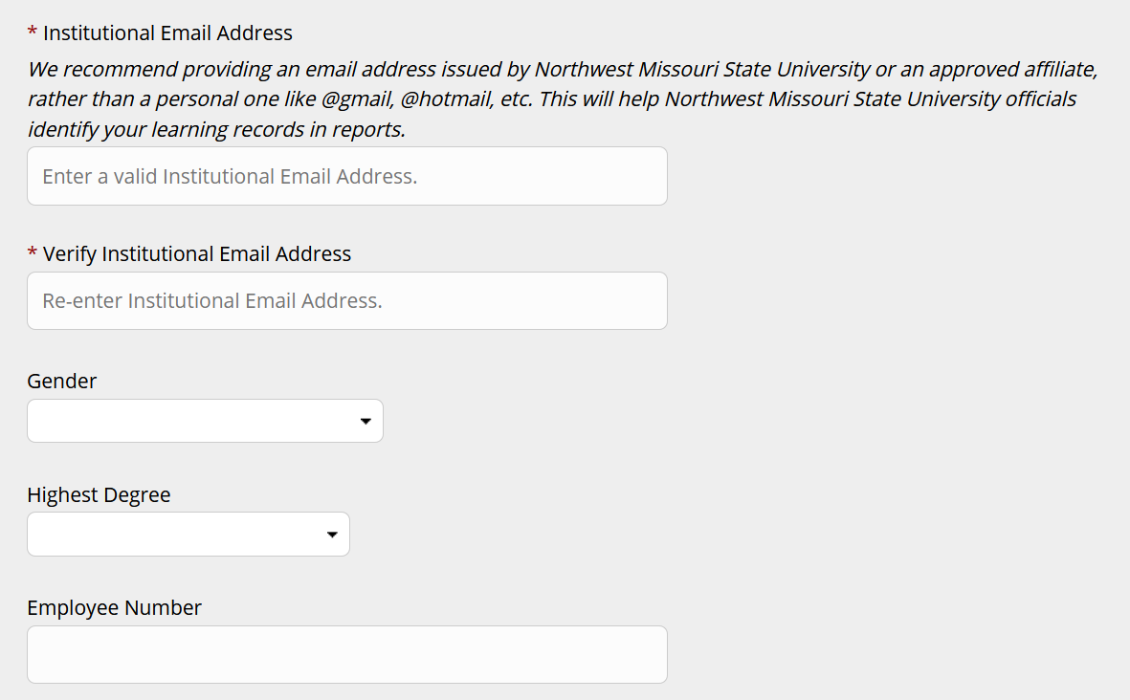
Notes:
This slide and the next one cover step 6 of the registration process.
There are two things of note here. First, CITI requires that you provide an “institutional email address” to help NWMSU verify your affiliation with the university. If you have this address, please provide it. However, some who complete the training may not have a Northwest email address – for instance, a collaborator at another university who needs to complete training for IRB approval. If this applies to you, provide an email address from your primary organization.
Second, the box labeled “Employee Number” can be skipped. While this box appears to ask for users’ 919 numbers, it is not necessary to provide this information.

Slide 9
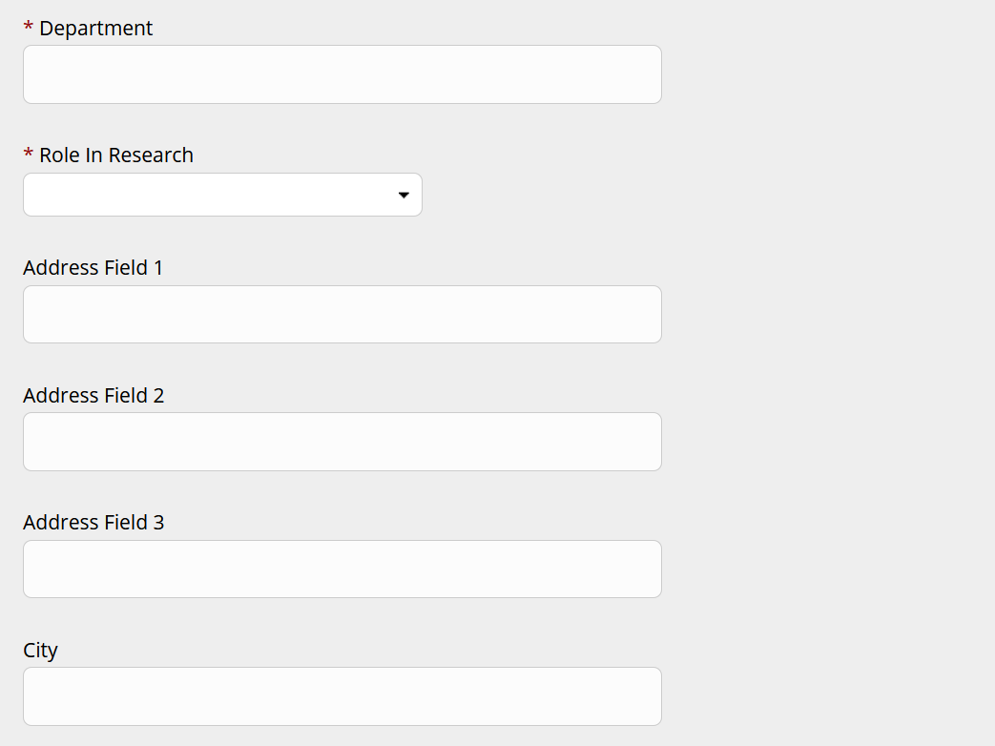
Notes:
There are a few more required boxes in step 6.
For faculty, the “Department” should be clear. For students, put the department that your major is housed within or the department that your research project is affiliated with.
There are many options in the “Role in Research” drop-down box. Choose the one that most closely aligns with your role. For students, it is recommended that you choose one of the two “Student Researcher” options.

Slide 10
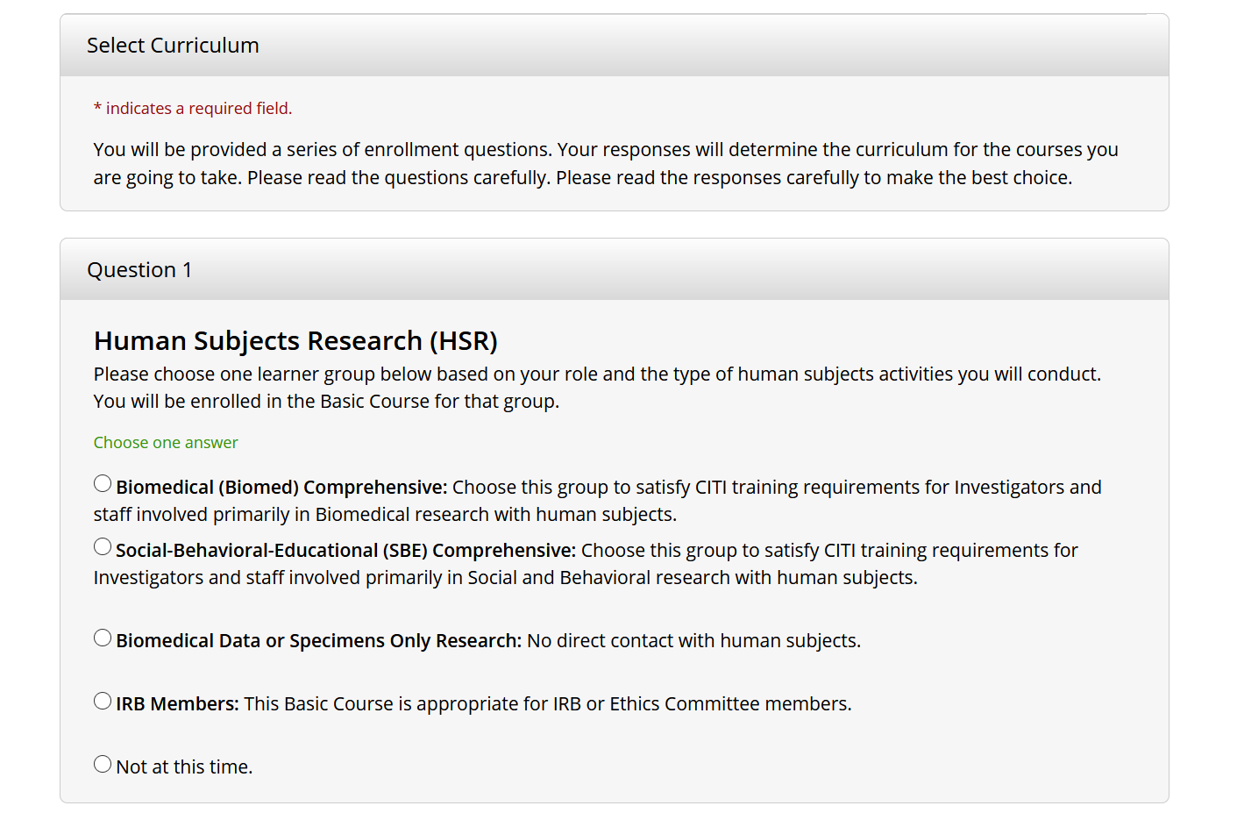
Notes:
Step 7 is the most important of all, because it is where you tell the system which ethics trainings you would like to be signed up for. There are a lot of options provided on this webpage, and you may be interested in completing several of the trainings. However, this help guide is intended to help researchers completed required training for obtaining IRB approval at Northwest.
For the purposes of the Northwest IRB, all researchers must specifically complete the SBE Comprehensive course.
To be signed up for the course, simply click the box next to the SBE Comprehensive training.
The rest of the questions in step 7 can be skipped unless you have been instructed to complete a different course by your organization, instructor, or group.
Some researchers will also need to complete the Biomedical Comprehensive course to obtain IRB approval. There are instructions further in this help guide to show how to sign up for a course after completing registration.

Slide 11
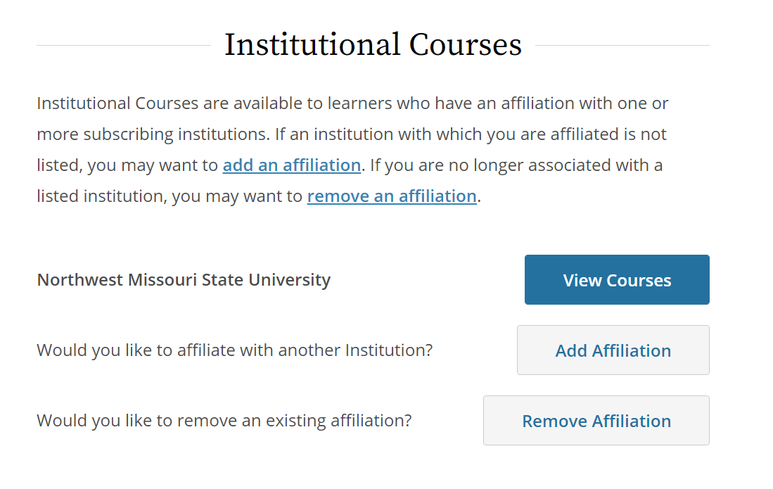
Notes:
If you’ve made it this far, congratulations – you’ve finished registration! Now, it’s time to access and complete those courses.
To find courses you’re enrolled in, you should click the “My Courses” button at the top of any page, and then click “View Courses” on that page.

Slide 12
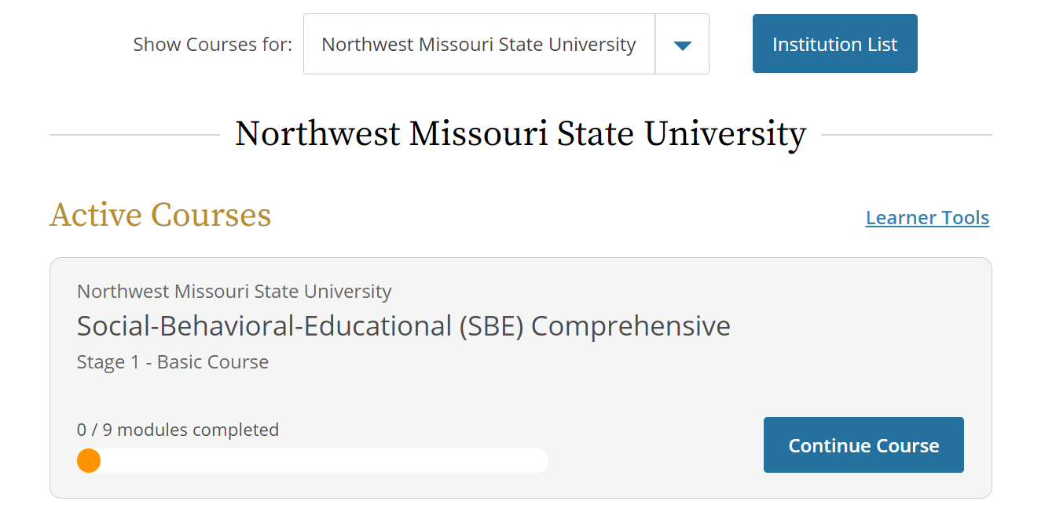
Notes:
After clicking “View Courses”, you will be directed to a list of all courses you have been signed up for, sorted by whether they are not started, in progress, or completed.
The example on this screen shows that the SBE Comprehensive course is active for the user and can be continued by clicking the “Continue Course” button. You can also see the progress of the course – currently, this user has completed none of the nine modules.

Slide 13
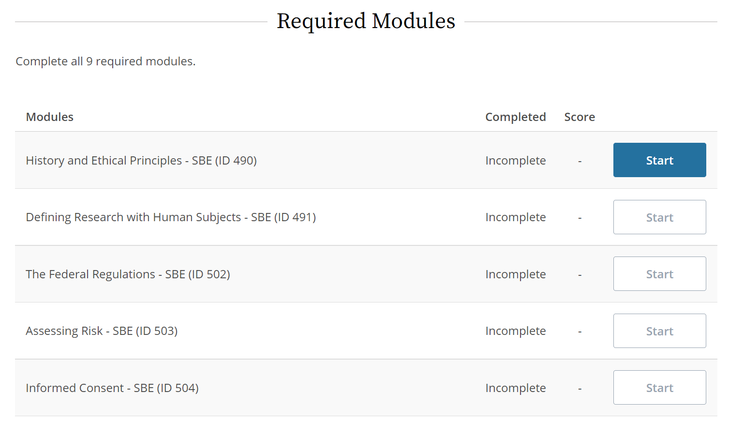
Notes:
Upon clicking the “Continue Course” button, you will see a list of all modules associated with the course. All required modules must be completed in order to complete a course.
To start or continue a module, just press the “Start” button. Note that in most cases, you cannot start later modules of a course before completing earlier ones.

Slide 14
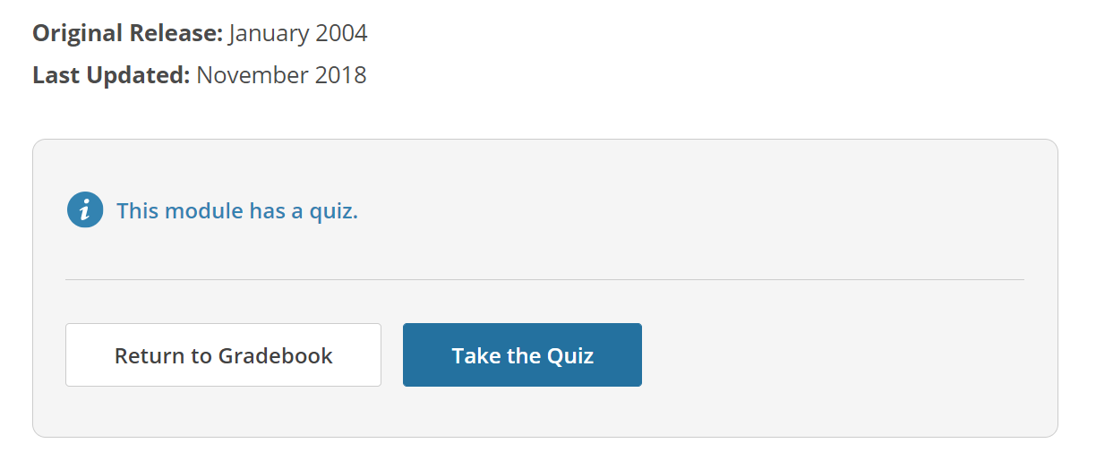
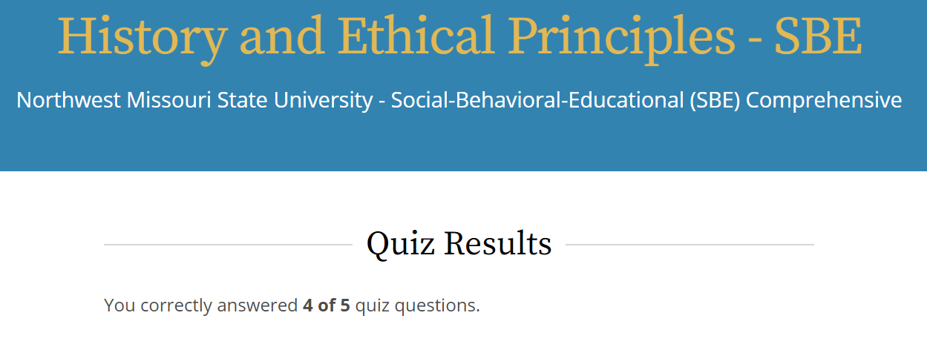
Notes:
Each module of a course consists of information about the module’s topic, followed by a quiz.
You are usually given two options for accessing the module information. One option lets you read through the information and click links on your own; the other option presents the information as a set of narrated slides. It doesn’t matter which option you choose.
To start the quiz, just click the “Take the Quiz” button at the end of the module.
You must receive at least an 80% on each quiz in the course in order to pass the full course. As you can see, this user received a 4 out of 5, which would be considered a pass for the module.

Slide 15
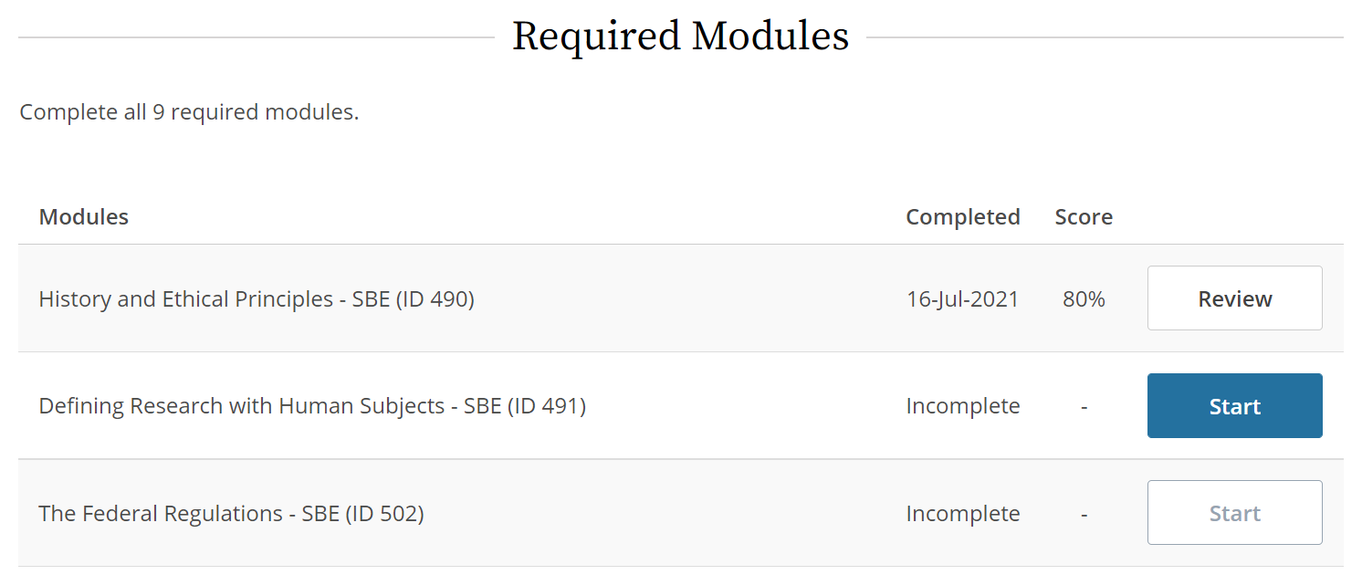
Notes:
Once you’ve completed a module, the “Start” button should be accessible for the next module.
As mentioned previously, all required modules must be completed in order to receive a certificate for the course.
It’s worth mentioning that you do NOT have to complete the course in one sitting. CITI saves your progress, so you can close the training at any time and pick up from where you left off at a later date.

Slide 16
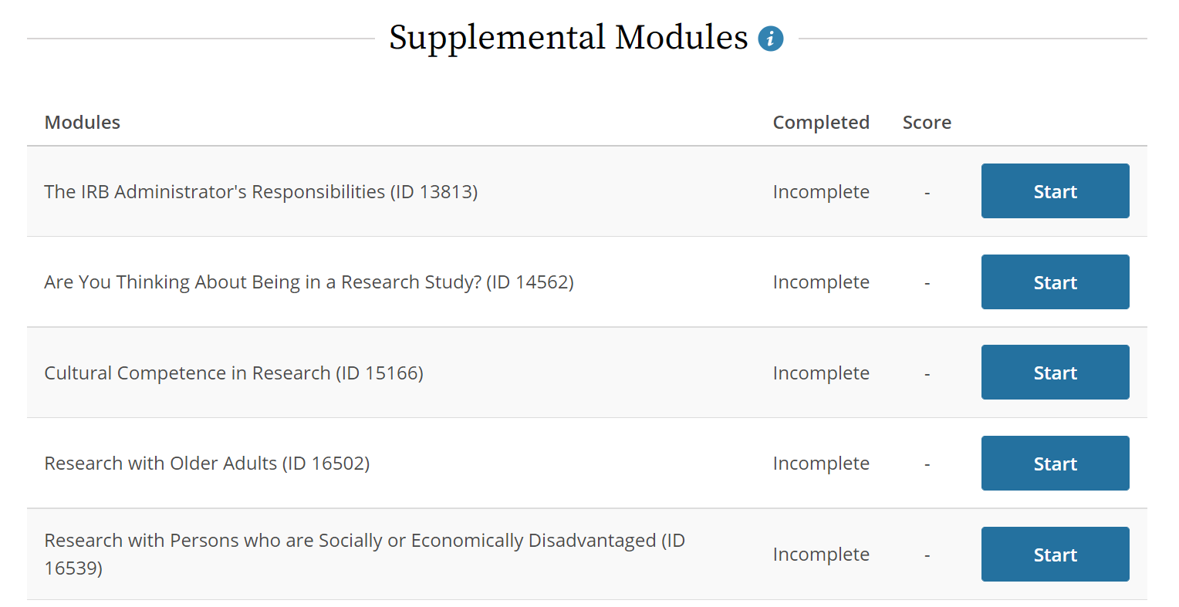
Notes:
Most courses have a set of supplemental modules along with the required modules. On this slide are some of the supplemental modules associated with the SBE Comprehensive course.
You do not need to complete any of the supplemental modules in order to receive a course completion certificate. However, if you feel that the supplemental modules for a course sound interesting or useful to you, you are welcome to complete them.

Slide 17
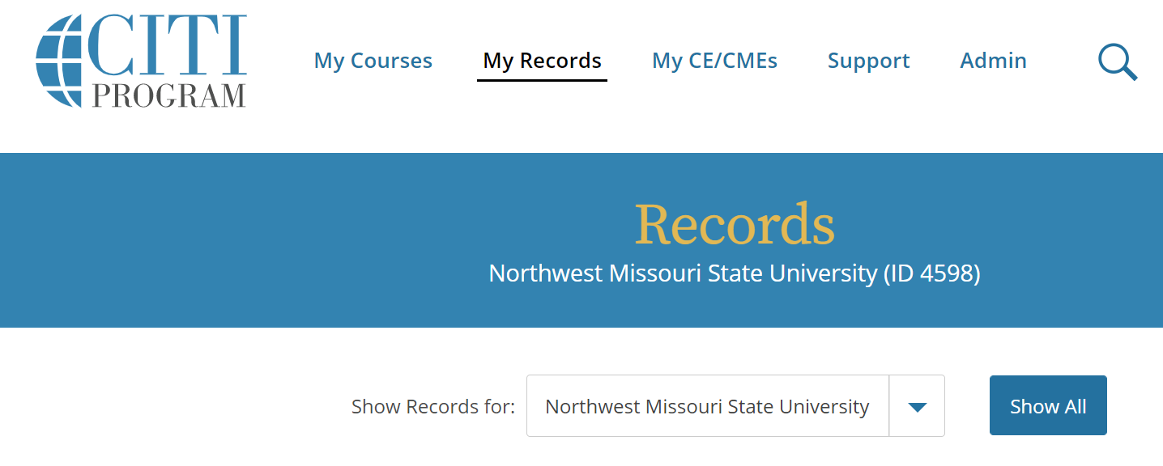
Notes:
Let’s assume that you eventually complete a CITI course and would like to access your certificate. For example, if you are completing a training as part of your IRB application, you will need to download your certificate and submit it along with the rest of your application.
To access certificates and your list of completed courses, click the “My Records” button at the top of the screen.
An example of what this webpage looks like is shown on this slide. As you can see, this user has completed the Social and Behavioral Responsible Conduct of Research course.
To view and download the certificate for a course, you’ll need to click the “View-Print-Share” button next to the course in the records.

Slide 18
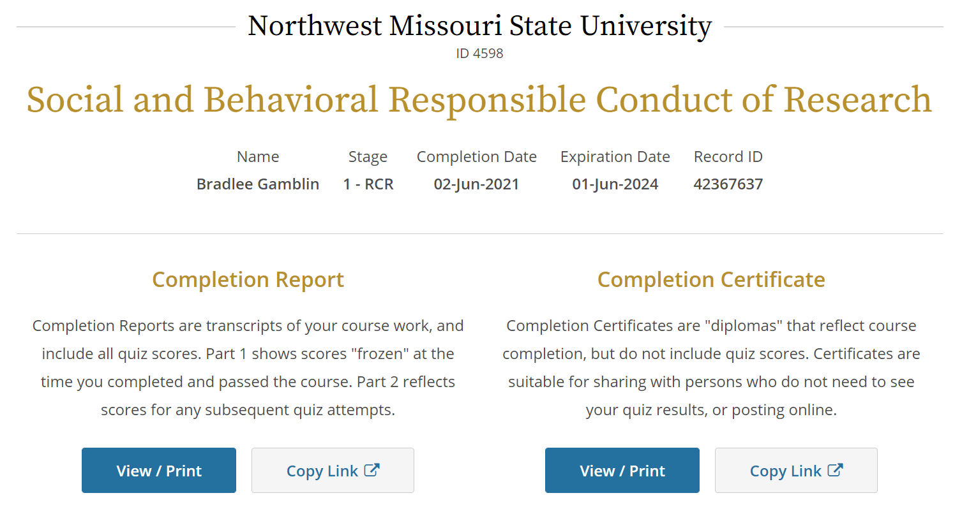
Notes:
After clicking the “View-Print-Share” button, you will be taken to a page similar to this.
Typically, administrators or instructors will ask for the completion certificate associated with a course. This webpage is NOT the completion certificate.
In order to access the certificate, you’ll need to click the “View/Print” button on the right side of the page, under the Completion Certificate section. When the certificate loads, you should be able to save it as a PDF.
An alternative is to click the “Copy Link” button, which will provide a hyperlink to view the certificate as a webpage.
As part of the Northwest IRB application process, you’ll need to submit a PDF copy of your completion certificate for the SBE Comprehensive (and possibly for the Biomedical Comprehensive) courses. You may notice that the example on this slide is for a different course – if a researcher submitted this certificate to the IRB, it would not be accepted as fulfilling the required training.

Slide 19
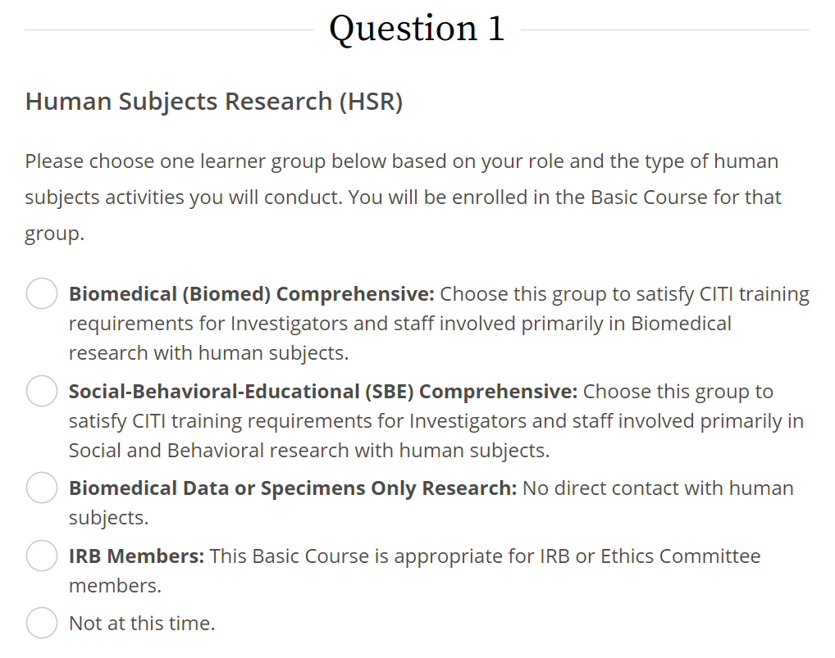
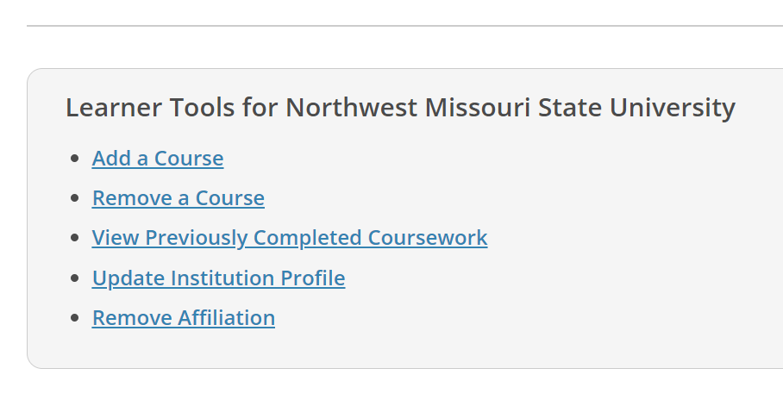
Notes:
Finally, you may wish to add a course to your list after completing the registration process. The most likely reason you may need to do this is if you are conducting biomedical research, in which case you must complete both the SBE Comprehensive and the Biomedical Comprehensive trainings as part of the IRB application process.
To add a course, head to the My Courses tab, click the “View Courses” button, and scroll to the bottom of the screen. At the bottom, you should see several options. What you are looking for is the “Add a Course” button.
When you click this button, it’ll take you to a page very similar to step 7 of the registration process. Simply find the training you need to sign up for on this page, click the button next to it, and push submit at the bottom of the page. You should now see the course listed under “My Courses”.

