Slide 1
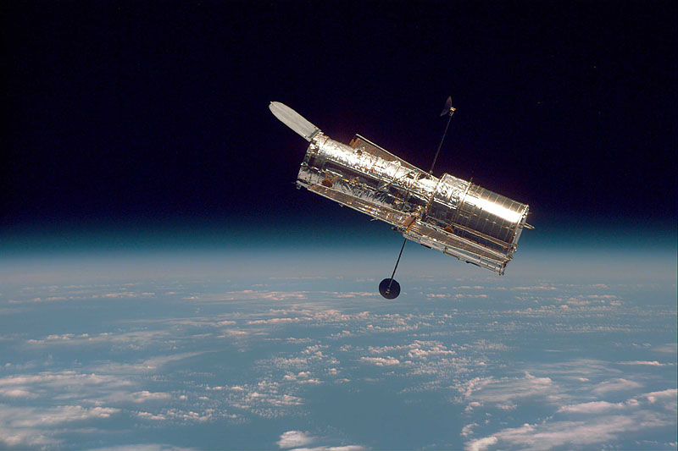

Slide 2
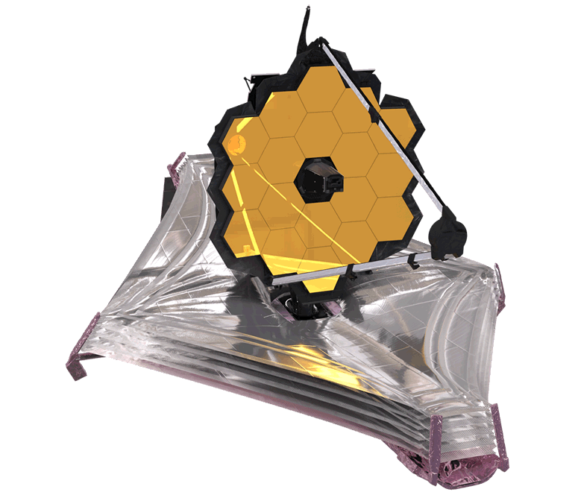

Slide 3
James Webb Space Telescope
Launched December 25, 2021
6.5 meter diameter mirror (12 ft) made of gold plated beryllium (Hubble’s mirror is 2.5 meters in diameter)
Webb observes red through mid-infrared light (0.8 -2.5 micrometer wavelength) (Hubble observes near ultraviolet, visible and near infrared light)
18 hexagonal mirror segments positioned by 132 motors
A 5-layer sunshield made of Aluminum coated Kapton E film keeps the telescope at a temperature of 50 Kelvin (-370 Fahrenheit)

Slide 4
Space Telescopes
The first telescope put into space was the Gamma Ray telescope Proton-1 by the USSR in 1965.
The first visible light space telescope was the Hipparcos by EAS in 1989.
Hubble was a joint NASA, EAS mission launched in 1990. The mirror was corrected in 1993.
NASA launched the Chandra X-Ray telescope in 1999.
NASA launched the Compton Gamma Ray Observatory in 2000.
NASA launched the Spitzer Infrared telescope in 2003.
NASA launched the Kepler visible light photometer telescope in 2009. It found 2662 planets in other solar systems.
There have been over 20 space telescopes.

Slide 7
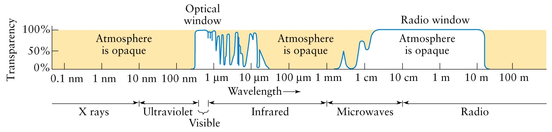
The atmosphere is transparent to only certain wavelengths of light as shown below.

Slide 8
The following information can be determined from the spectrum of a star:
The surface temperature of the star
The power radiated per unit area from the surface of the star
The chemical composition of the atmosphere of the star
Whether the star is moving towards us or away from us and at what speed

Slide 9
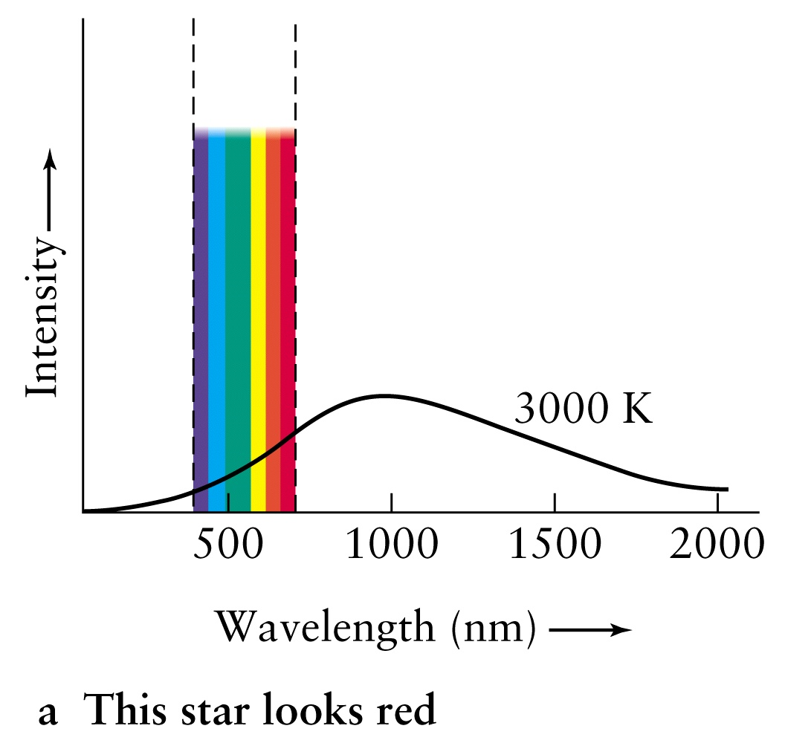

Slide 10
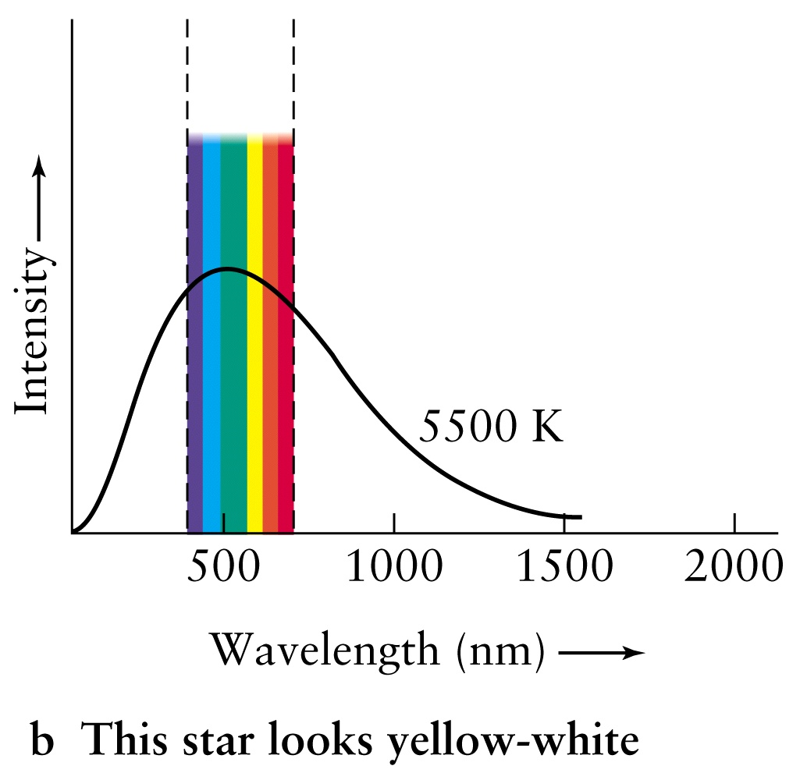

Slide 11
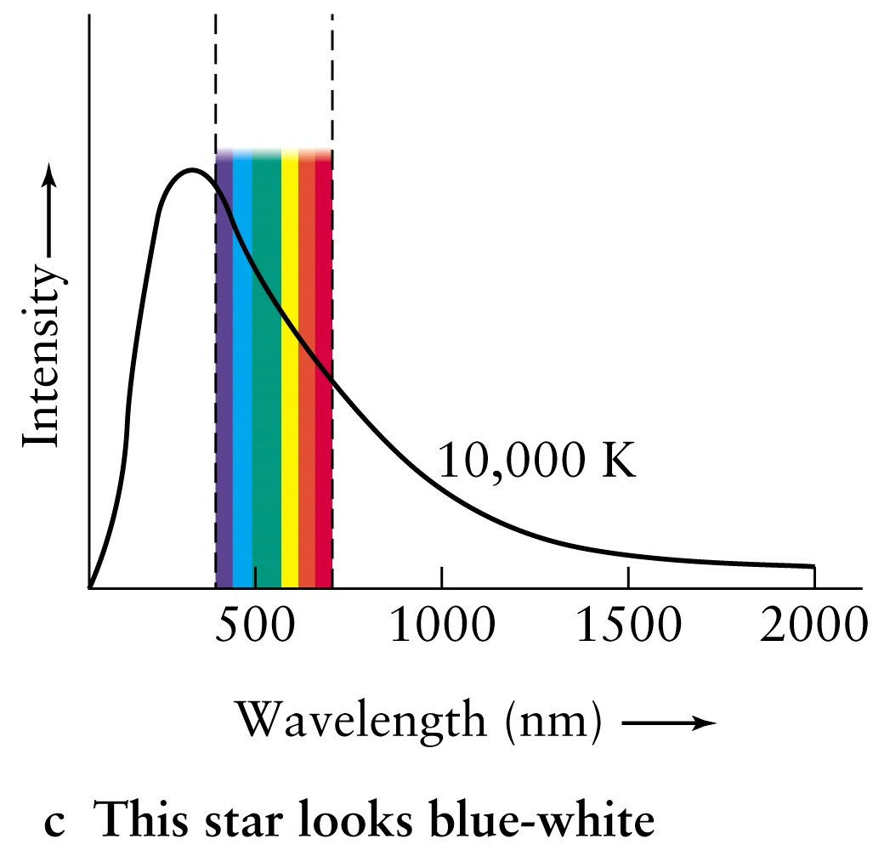

Slide 12
Primary Mission of Webb Telescope
Webb can collect light from 180 million years after the Big Bang whereas Hubble can see back to 400 million years after the Big Bang. The earliest stars are estimated to have formed 100 to 180 million years after the Big Bang and galaxies formed about 270 million years after the Big Bang.
Webb’s infrared spectroscopy will be able to detect if there is water in the atmosphere of extra-solar planets. This would be one condition for life to exist on other planets.

Slide 13
Water Absorption Spectra
Strong water vapor absorption bands occur at wavelengths around 2500, 1950 and 1450 nanometers (nm), with weaker absorption around 1200 and 970 nm, and three additional sets of water-vapor absorption lines near 930, 820, and 730 nm, all in the infrared spectrum.

Slide 15
James Webb Space Telescope Instruments
Mid-Infrared Instrument (MIRI)
Near-Infrared Instrument (NIRCam)
Near-Infrared Spectrograph (NIRSpec)
Near-Infrared Images and Slitless Spectrograph/Fine Guidance Sensor (NIRISS/FGS)
All four of these instruments have spectrographs while three of them have cameras.

Slide 16
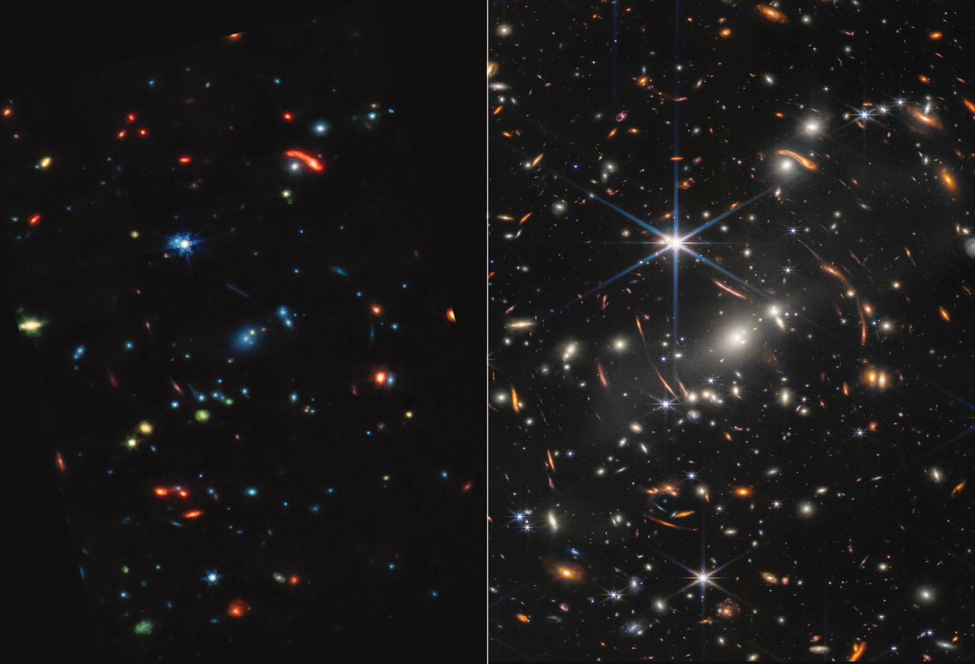

Slide 17
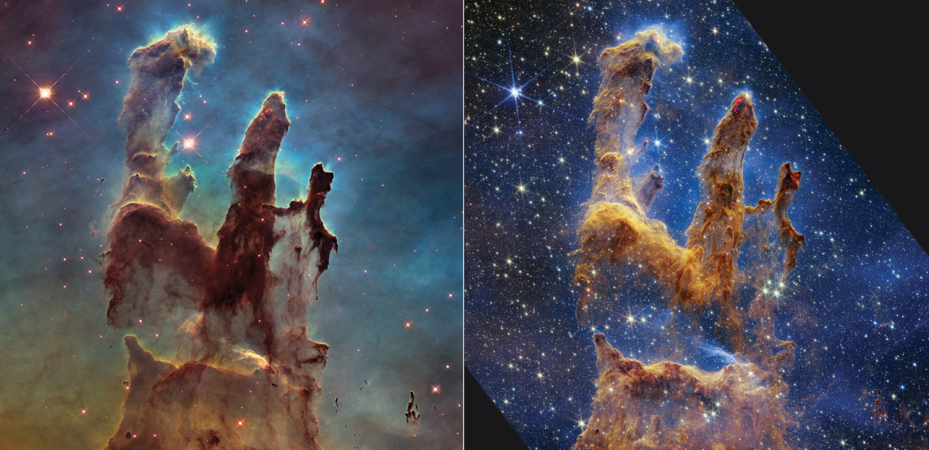

Slide 18
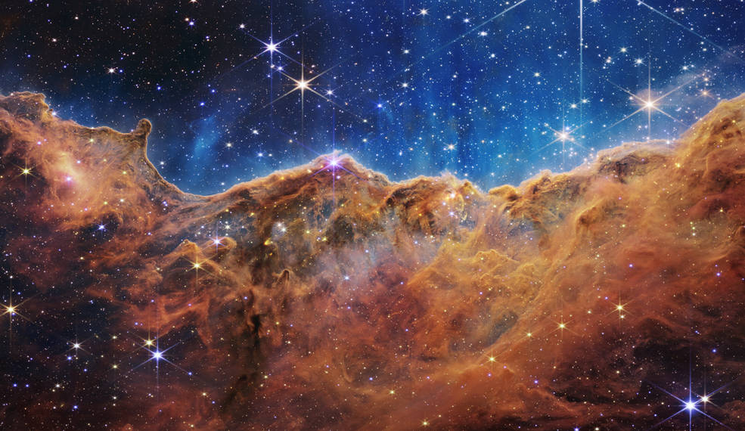

Slide 19
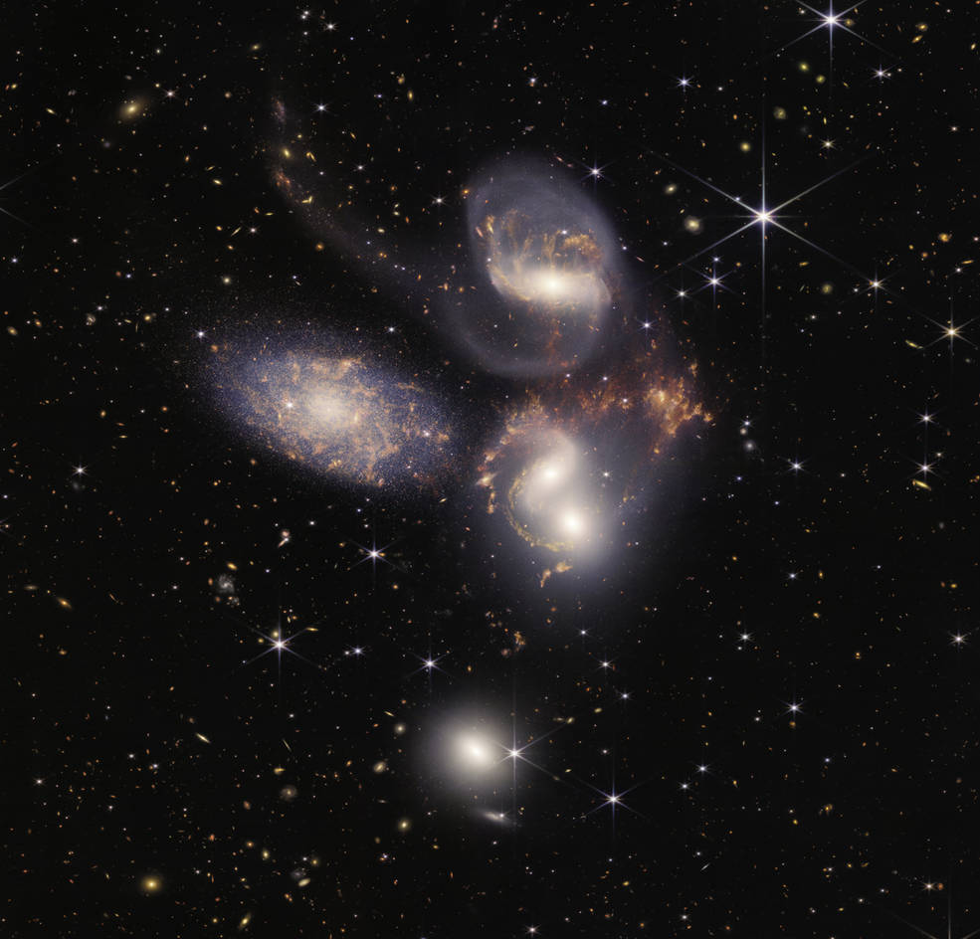

Slide 20
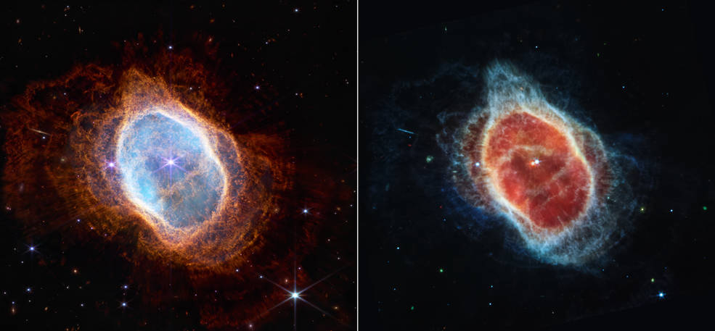

Slide 21
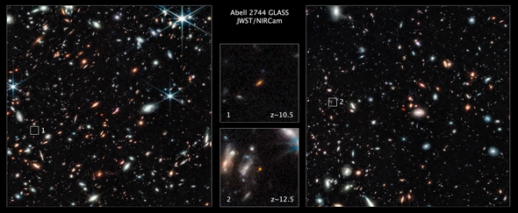

Slide 22
