Slide 1
eTextbooks: The Future of eLearning
Dr. Roger Von Holzen
Ms. Darla Runyon
http://cite.nwmissouri.edu/presentations

Slide 2
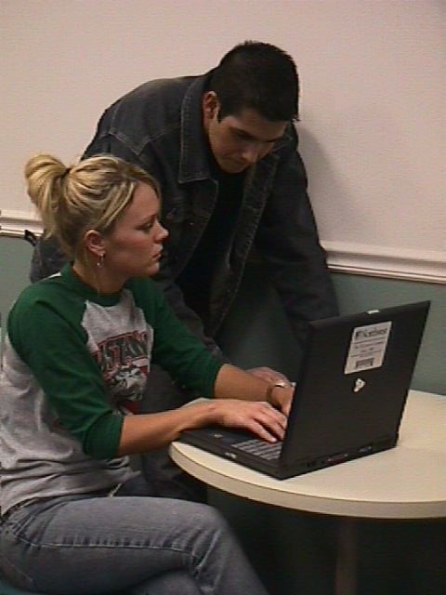
Introduction
A Northwest goal is to ensure that graduates have strong computer competencies
Northwest has provided textbooks to students for over 100 years
Northwest provides a notebook computer to every student
Northwest’s eTextbook initiative is the natural next step forward for its Electronic Campus*

Slide 3
Notebook Compuers and Textbooks
2008
Marketing
Survey
Northwest students and graduates value the cost savings of the rental programs

Slide 4
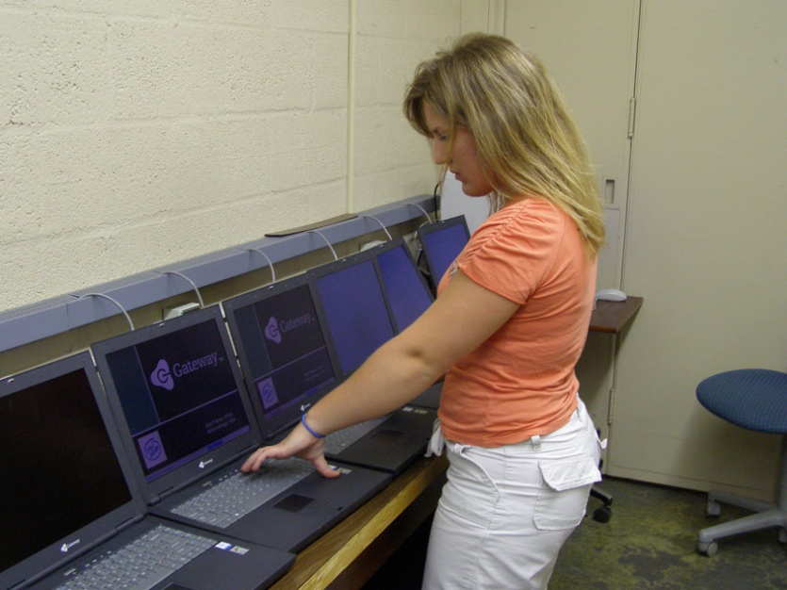
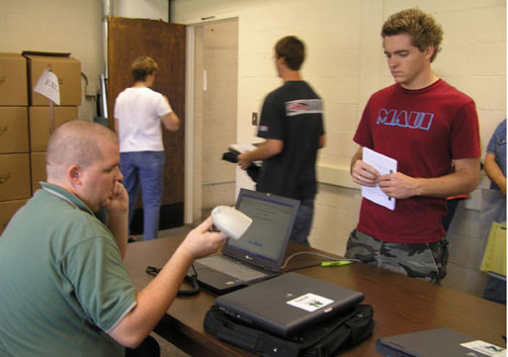
Costs for Notebook Computers and Textbooks
Most Notebook Universities require students to purchase a notebook computer
A smaller number of schools lease computers and charge students about $700 to $1000 per year
Northwest charges students about $300 per year for a notebook computer
Most college students have to purchase textbooks at a cost of about $1,000 per year
Northwest charges about $180 per year ($6/sch) for students to rent their textbooks*

Slide 5
Northwest’s eTextbook Project
Initiated by President Hubbard after acquiring a Kindle for personal use
Proposed to faculty in August 2009
Over 20 faculty members volunteered to participate in project
Pilot project encompassed three phases
Phase I—use of eReaders
Phase II—use of notebook computers
Phase III—full integration of eTextbooks and electronic learning resources*

Slide 6
Phase I—eReaders

Slide 7
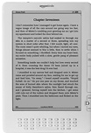
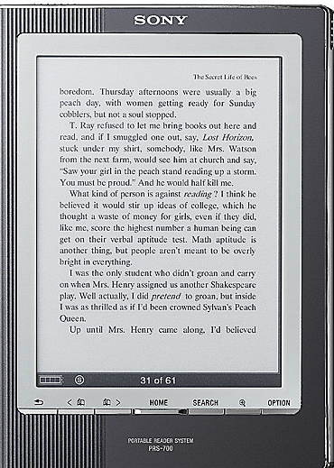
eBooks and eReaders
Kindle from Amazon.com
Kindle: $299 plus shipping
Kindle DX: $489 plus shipping
Conducting pilot study with 7 universities
Sony’s eReader
$250
available at Target*

Slide 8
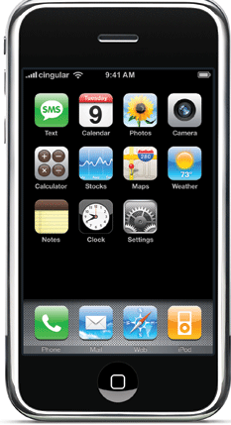
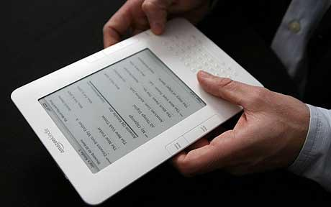
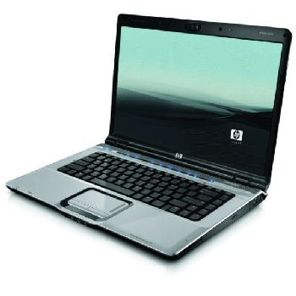
eBooks and eReaders
Plastic Logic
iPhones from Apple
Personal computers

Slide 9
Using a Sony Reader
Device has 6-inch display
Utilizes E Ink technology
almost paper-like
easy to read even in bright sunshine
allows for high contrast and high resolution, with a near 180° viewing angle.
Text can be changed between three different sizes
One touch buttons to move backward and forward through book pages*

Slide 10
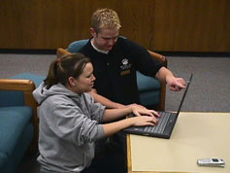
Loading a Sony Reader
eTextbooks are first downloaded from the publisher web site to the student’s notebook computers
Transfer eTextbooks to the Sony Reader via a USB connection
Reader is recharged through the USB connection to the notebook computer
Possible to install Sony library software to purchase and manage eTextbooks and eBooks from The eBook Store from Sony*

Slide 11
Phase I Findings
There are multiple components to a textbook, including graphs and images, with all having separate copyrights
The formatting of content for eReaders can require weeks to complete
For campus-wide deployment there are currently not enough eReader-compatible eTextbooks
Most eTextbooks are available only through notebook computers and/or web access
PDF formatted textbooks have restrictive and slow navigation options*

Slide 12
Phase I Findings
Students have a high affinity for handheld electronic devices
Students like the idea of not having to carry 20 or 30 pounds of textbooks in their backpacks
Keyword searching and annotating are very important features for students and faculty
The enthusiasm quickly waned for eReaders without the needed search and annotation features
Students found the eReaders were attention getters but were not attention keepers*

Slide 13
Phase I Findings
eReaders work only for pleasure reading
Incorporates E Ink technology for great readability
Features low power consumption and long battery life
Black/white only
No Flash animation or video
No interactivity possible with online resources and course sites*

Slide 14
Phase II—Notebook Computers

Slide 15
Notebook Computers as eTextbook Readers
Integrates textbooks with other software and services including email and web access
Most schools already employ staff and/or students to assist users
Delivery of eTextbooks to the students is extremely efficient*

Slide 16
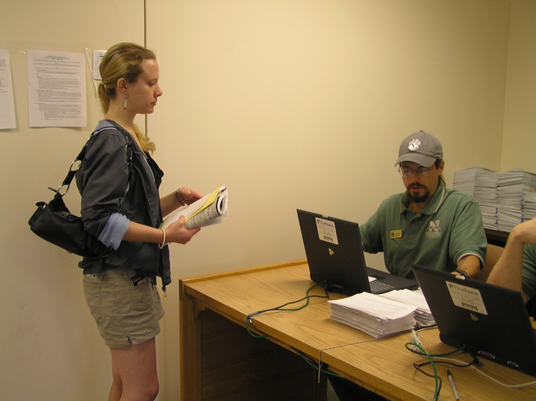
Northwest Notebook Check-out and eTextbook Loading
Students pick up their notebook computers prior to the first week of classes
Students are given eTextbook access codes
The Electronic Campus Support Center is open for any hardware/software repair
Assist students to download and activate VitalSource Bookshelf
Assist students to download eTextbooks *

Slide 17
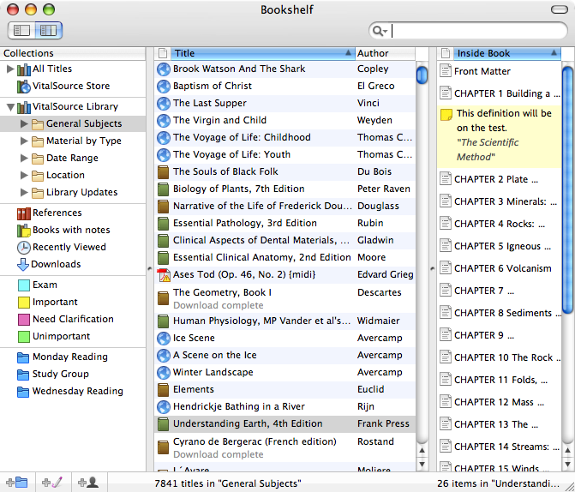
VitalSource Bookshelf
Promotes one standard on campus and not multiple standards
eTextbook web connection on campus software loadset
Bookshelf files are download to the student’s computer
Can be integrated with single sign-on with course management system
Students may:
customize their page views
search single books or any group of books
Highlight, take and share searchable notes
print and copy-and-paste with bibliographic support*
Video

Slide 18
Phase II Deployment
Goal: evaluate eTextbooks designed for use on student notebook computers
Phase II was completed during the spring semester of 2009
Concentrated on the deployment of eTextbooks provided by five publishers
Eleven of a possible 19 academic departments volunteered to participate
Twenty classes, across the 11 departments, were selected to use eTextbooks
Approximately 500 students were involved in Phase II*

Slide 19
Sample Cost Comparisons
Pilot Course Title | Cost of Traditional Textbook | Approx. Cost of eTextbook
Fundamentals of Business Finance* | $168.00 | $72.25 (VitalSource)
Human Resources Management* | $130.00 | $68.75 (VitalSource)
Intercultural Communication* | $95.00 | $51.48 (Coursemart – 180 day subscription)
Management Information Systems* | $140.00 | $71.49 (Coursemart – 180 day subscription)
Introduction to Psychology | $121.00 | $62.95 (Coursemart – 180 day subscription)

Slide 20
Phase II Findings
The delivery of eTextbooks to students via their notebook computers was a simple and very efficient process
Students were able to complete the downloading of eTextbooks with little assistance from university support staff
Several publishers were able to provide enhanced eTextbooks with quizzes and shared notes
The need for standardized reading features appeared useful as some students used multiple eTextbooks
Students could continue to see the potential for carrying backpacks that weighed less
Some eTextbook features, if used in the classroom, need additional Wi-Fi connectivity*

Slide 21
Advantages of eTextbooks
Facilitates integrated learning resources for the student
Content provided by publisher can be placed within the CMS
Conveys lower costs into lower charges to students
Textbook publishers have shown a substantial commitment to research in order to develop a new vision for eTextbooks*

Slide 22
Options to Ensure Students have Notebooks and Software
The university may mandate students have notebooks through an off campus or a bookstore acquisition
The university may lease notebooks and rent them to students through fees
The university may purchase notebooks and rent them to students through fees*

Slide 23
Phase III—Integration of eTextbooks and Electronic Resources

Slide 24
Moving Forward
eTextbooks will/may replace traditional textbooks as they become available
Faculty will continue to select eTextbooks and textbooks based on their content
Interactive online content will be required within the eTextbook environment (no simple PDF files only)
Standardized on VitalSource as the eTextbook delivery system*

Slide 25
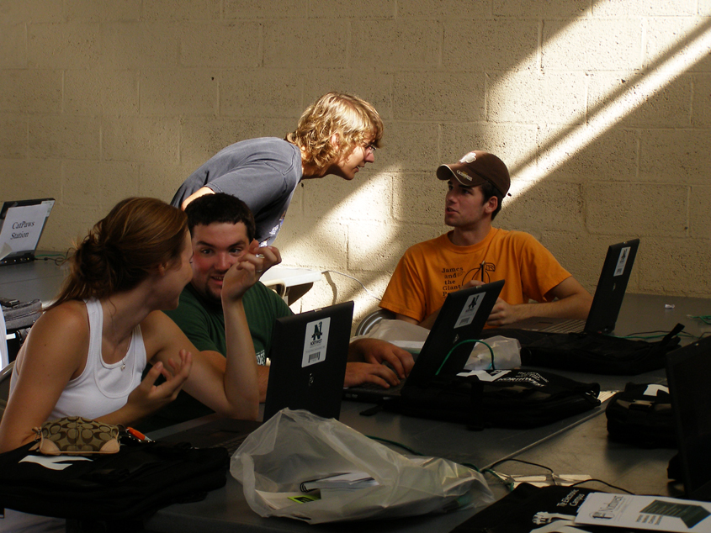
Moving Forward
Need to continue negotiations with publisher for price structure that works within a textbook rental format
Publishers request exclusive contracts
Continue to search for new delivery platform
Tablet PC with eReader option*

Slide 26
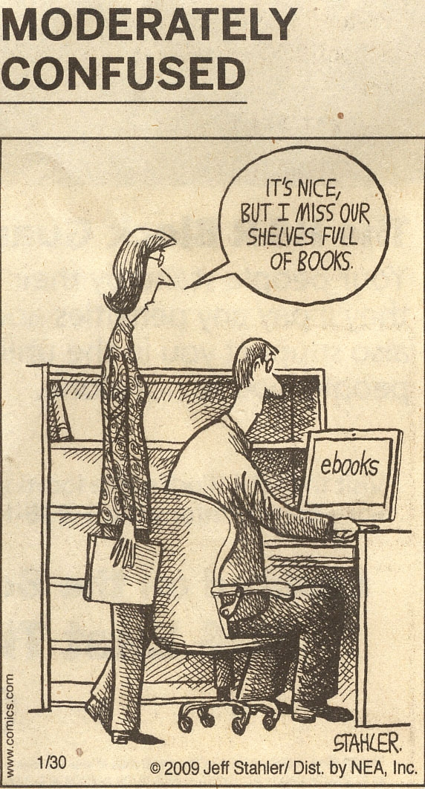
Roger Von Holzen: Director—CITE
rvh@nwmissouri.edu
Darla Runyon: Assistant Director/Curriculum Specialist—CITE
drunyon@nwmissouri.edu
http://cite.nwmissouri.edu/presentations

