Slide 1
Dealing with the Changing World of eTextbooks
David W. Lewis
Dean of the University Library
Indiana University-Purdue University Indianapolis
Dr. Jon Rickman
Vice President for Information Systems
Northwest Missouri State University
Dr. Roger Von Holzen
Director—Center for Information Technology in Education
Northwest Missouri State University

Slide 2
Why Textbooks Matter
Retail spending on new college textbooks last year (2008) was about $4.7 billion.
— www.solutionsforstudentsuccess.org/

Slide 3
Rip-off 101: How The Current Practices Of The Textbook Industry Drive Up The Cost Of College Textbooks, State PIRG’s Higher Education Project, February 2005. Available at: http://www.uspirg.org/higher-education/affordable-textbooks

Slide 4
Stephen E. Lucas
The Art of Public Speaking
McGraw-Hill
10th Edition 2008 paperback
978-0-07-730629-8
List Price: $117.75
Used Campus Bookstore: $93.70
Amazon : $91.21
Kindle edition: $80.00
Half.com unopened: $70.00
Amazon used: from $59.99
Chegg.com paper semester rental: $47.69
CourseSmart e-textbook 180 day rental: $40.88
9th Edition 2006
Amazon “new”: from $19.98
Half.com “like new”: from $8.09
% of List Price
79.6%
77.5%
67.8%
59.9%
50.9%
40.5%
34.7%
17.0%
7.7%

Slide 5
“This semester (Spring 2009) the average student bought 5.3 textbooks (2.2 new and 3.1 used) spending an average of $333 for both new and used textbooks. (Source: Student Monitor 2009).”
— www.solutionsforstudentsuccess.org
“While this information varies based on factors such as course load and subject matter, students estimated spending an average of $702 on required course materials during the 2006-07 academic year according to NACS’ Student Watch™ 2008 report.”
— nacs.org/advocacynewsmedia/faqs/faqontextbooks.aspx
“Students spend an average of $900 a year on textbooks—20 percent of tuition at an average university and half of tuition at a community college.”
— uspirg.org/higher-education

Slide 6
Where New Textbook $ Goes
4.5%
11.7%
7.0%
19.2%
57.6%

Slide 7
Where $4.7 Billion Goes
$211 Million
$550 Million
$329 Million
$902 Million
$2.7 Billion

Slide 8
Faculty Interest - $550 Million
Academic inventions in medicine, plant genetics, and alternative energy helped to spur the creation of a record 549 new university spinoff companies in the 2008 fiscal year, while generating more than $2.4-billion in licensing revenue for 156 institutions and their inventors, according to a survey released on Monday.
“University Inventions Sparked Record Number of Companies in 2008,” February 15, 2010 http://chronicle.com/article/University-Inventions-Spark/64204/
Author royalties are 23% as large as licensing revenues. If colleges and universities took half they would generate $275 million annually.

Slide 9
Issues
Print vs Digital
With good print-on-demand and reasonable reading devices this distinction become less important
Economic Model
Open vs Proprietary
Who Pays? Student or University
Item-by-Item vs Site License

Slide 10
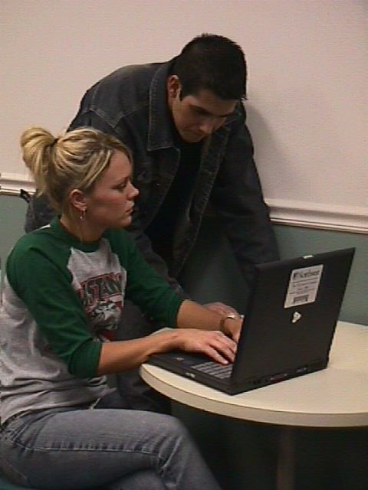
Presenters’ Environment
Northwest Missouri State University enrolls over 7,000 students
Has provided textbooks to students for over 100 years
$6 per credit hour fee
Northwest’s Electronic Campus program provides a notebook computer to every student
$180 per semester fee

Slide 11
The Digital Learning Environment
eTextbooks
eContent
Course
Evaluation
e-Library
e-Testing
Course
Enrollment
Manager
Pen Markup
Word Processor
Blog
E-Mail
Keystone
Search
Engine
Wireless
Browser
LAN
WAN
Internet

Slide 12
Northwest’s eTextbook Project
Pilot project encompassed three phases
Phase I—use of Sony eReaders
Phase II—use of notebook computers
Phase III—full integration of eTextbooks and electronic learning resources

Slide 13
Phase I—Sony eReaders

Slide 14
Phase I Findings
Incorporates E Ink technology for great readability
Features low power consumption and long battery life
PDF formatted textbooks have restrictive and slow navigation options
Students prefer paper to PDF
Lacked keyword searching and annotating
very important features for students and faculty
No interactivity possible with online resources and course sites
Black/white only
No Flash animation or video

Slide 15
Phase I Findings
Students have a high affinity for handheld electronic devices
Students like the idea of not having to carry 20 or 30 pounds of textbooks in their backpacks
The enthusiasm quickly waned for eReaders due to lack of search and annotation features
Students found the eReaders were attention getters but were not attention keepers
eReaders work best for pleasure reading

Slide 16
Phase II—Notebook Computers

Slide 17
Phase II Deployment
Goal: evaluate eTextbooks designed for use on student notebook computers
VitalSource Bookshelf
Promotes one standard on campus for eTextbooks
eTextbook web connection on campus software loadset
Bookshelf files are download to the student’s computer

Slide 19
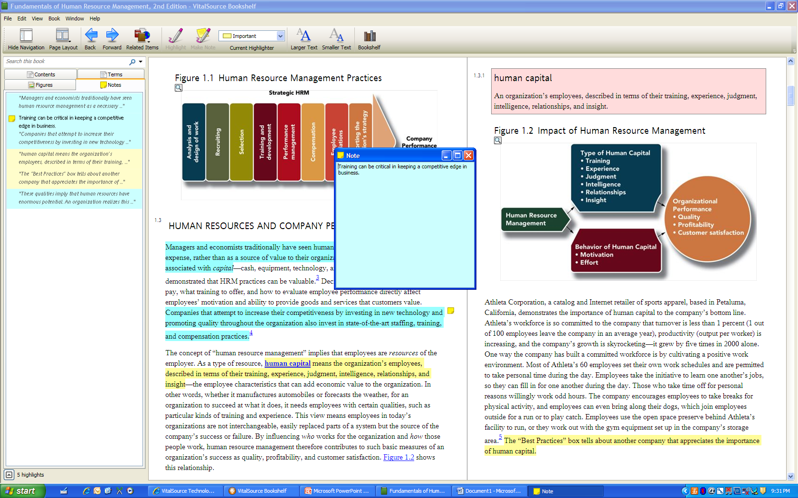

Slide 20
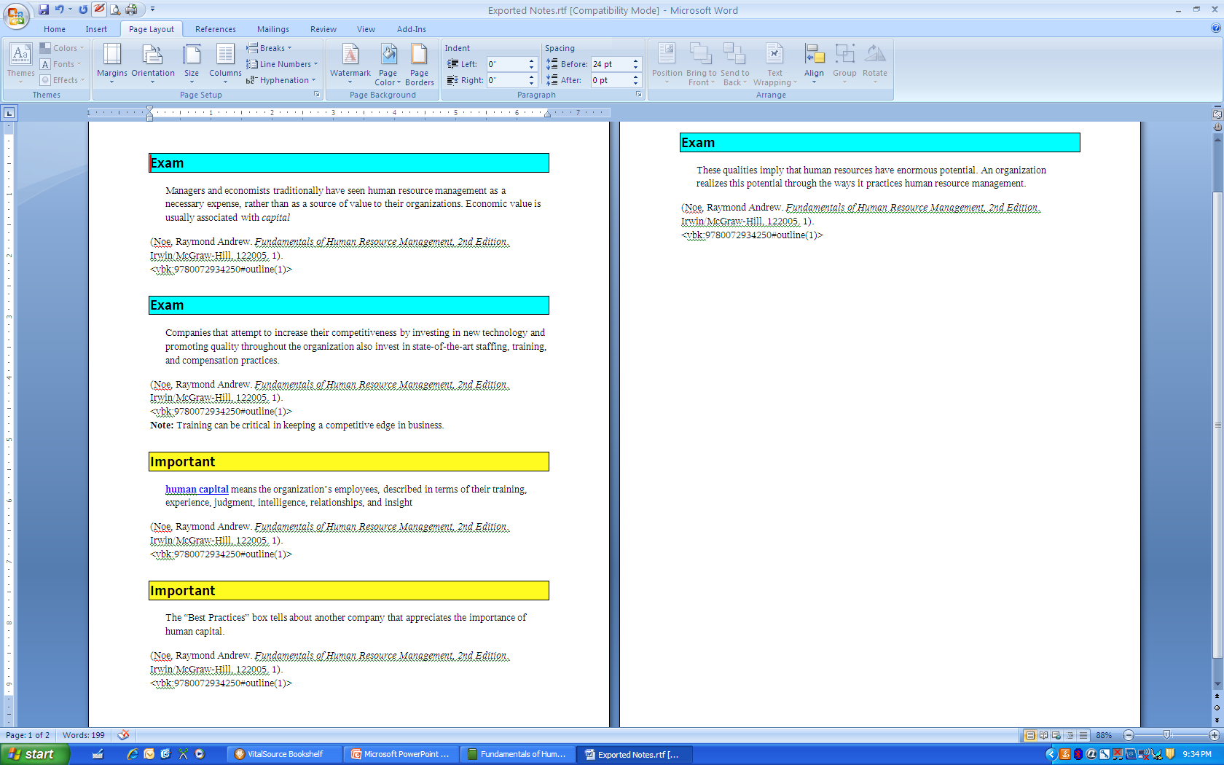

Slide 21
Phase II Findings
The delivery of eTextbooks to students via their notebook computers was a simple and very efficient process
Students were able to complete the downloading of eTextbooks with little assistance from university support staff
The need for standardized reading platform and features across all publishers
Notebooks work better than eReaders for complex interactions

Slide 22
Phase III—Integration of eTextbooks and Electronic Resources

Slide 23
Present Status
Most “eTextbooks” are PDF in format
CourseSmart
50-60% off “retail” price for 180 day access
PDF files with interactive content limited to external course-related web site
Flat World Knowledge
Only 29 textbooks currently available
PDF or HTML with few external resources
Sage eTextbooks
PDF with links to external videos
OER Commons
Very limited content areas—few standard textbooks
PDF format

Slide 24
Goal: Integrated Interactive eTextbooks
Provide faculty with guidelines as to expectation for eTextbooks and related supplemental electronic materials
No longer accept PDF-formatted eTextbooks
Push to integrate supplemental materials and eTextbook within course management website

Slide 26
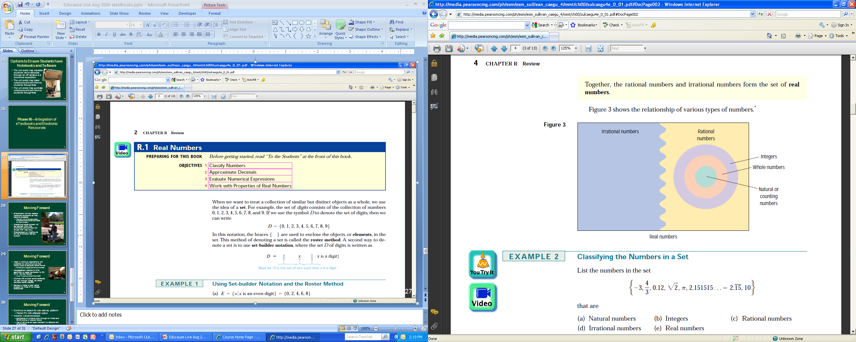

Slide 27
Moving Forward
Continuing issues of pricing of eTextbooks
Continue to search for new delivery platform
Tablet PC with eReader option
enTourage eDGe
Need for standardized eTextbook format
Apple’s iPad’s impact on the market
Touch screen/gesture recognition functionality
Limited functionality as a notebook computer replacement device
Impact of completing tablets on the market

Slide 28
Indiana University Study
Courseload LLC
Economic Model
Negotiated agreements with publishers
60% to 70% savings, all students pay
Reasonable printing
Access for IU career
Browser-based with annotation and note taking, both can shared

Slide 29
Indiana University Study
Spring semester 2010
Available through CMS
350 students
Five Courses
Three information technology
One operations management
One freshman astronomy

Slide 30
Indiana University Study
41% of student primarily printed text and read on paper
Students of primarily read on computer printed 14% of the book
Students who primarily read on paper read 31% of the book on a computer
Ease of use, download speeds, and printing were not issues

Slide 31
Indiana University Study
Students claimed read more and to use notes and annotation somewhat more than they would have with a printed book
Students really like it when faculty annotated and shared notes
The most important factor favoring e-textbooks was cheaper price

Slide 32
Indiana University Study
Grades
Lower grades for students with lower unique and total page views
Use of annotation and notes correlated with higher grades
Whether students shared or the depth of their use did not matter

Slide 33
Indiana University Study
“Going Green” is valued by students
eTextbooks are used in a “distracting” environment — the Facebook temptation
Faculty generally supportive, but have yet to adapt teaching to new technology

Slide 34
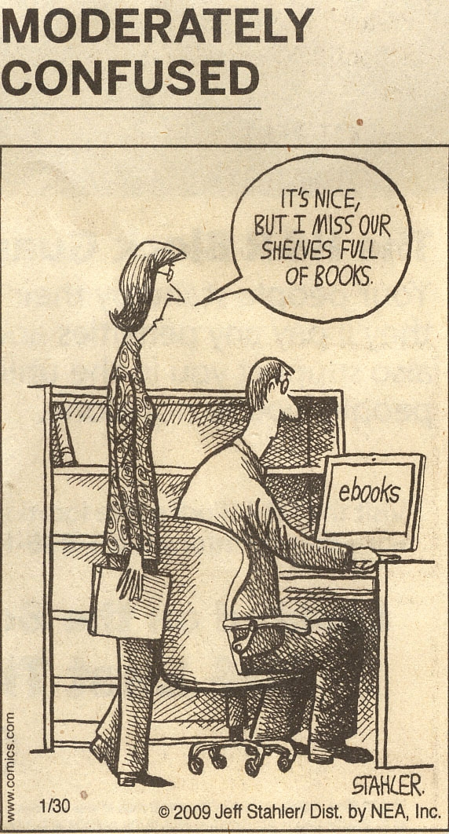
David W. Lewis
dlewis@iupui.edu
Dr. Jon Rickman
rickman@nwmissouri.edu
Dr. Roger Von Holzen
rvh@nwmissouri.edu

