Slide 1
Bearcat Equity

Slide 2
About the Project
Northwest Missouri State University is committed to providing a welcoming and safe experience. This project is part of the initiative to assist with providing bias-free and discrimination-free community.
Bearcat Equity is a mobile application which allows the students, faculty and staff of Northwest to report any prejudice from their mobile devices.
This application has three roles :
Standard User( Student, Faculty, Staff).
Committee Member User
Administrator
After a concern is raised, the Bias Response Team Committee will generate an action response. Based on the action response, a formal investigation is conducted by the University Police Department or concerned authorities.

Slide 3
Development Tools
Backend : NodeJS
Frontend : VueJS, Ionic
Database : MySQL
Framework : Ionic Framework
Cross-Platform Native Runtime: CapacitorJS

Slide 4
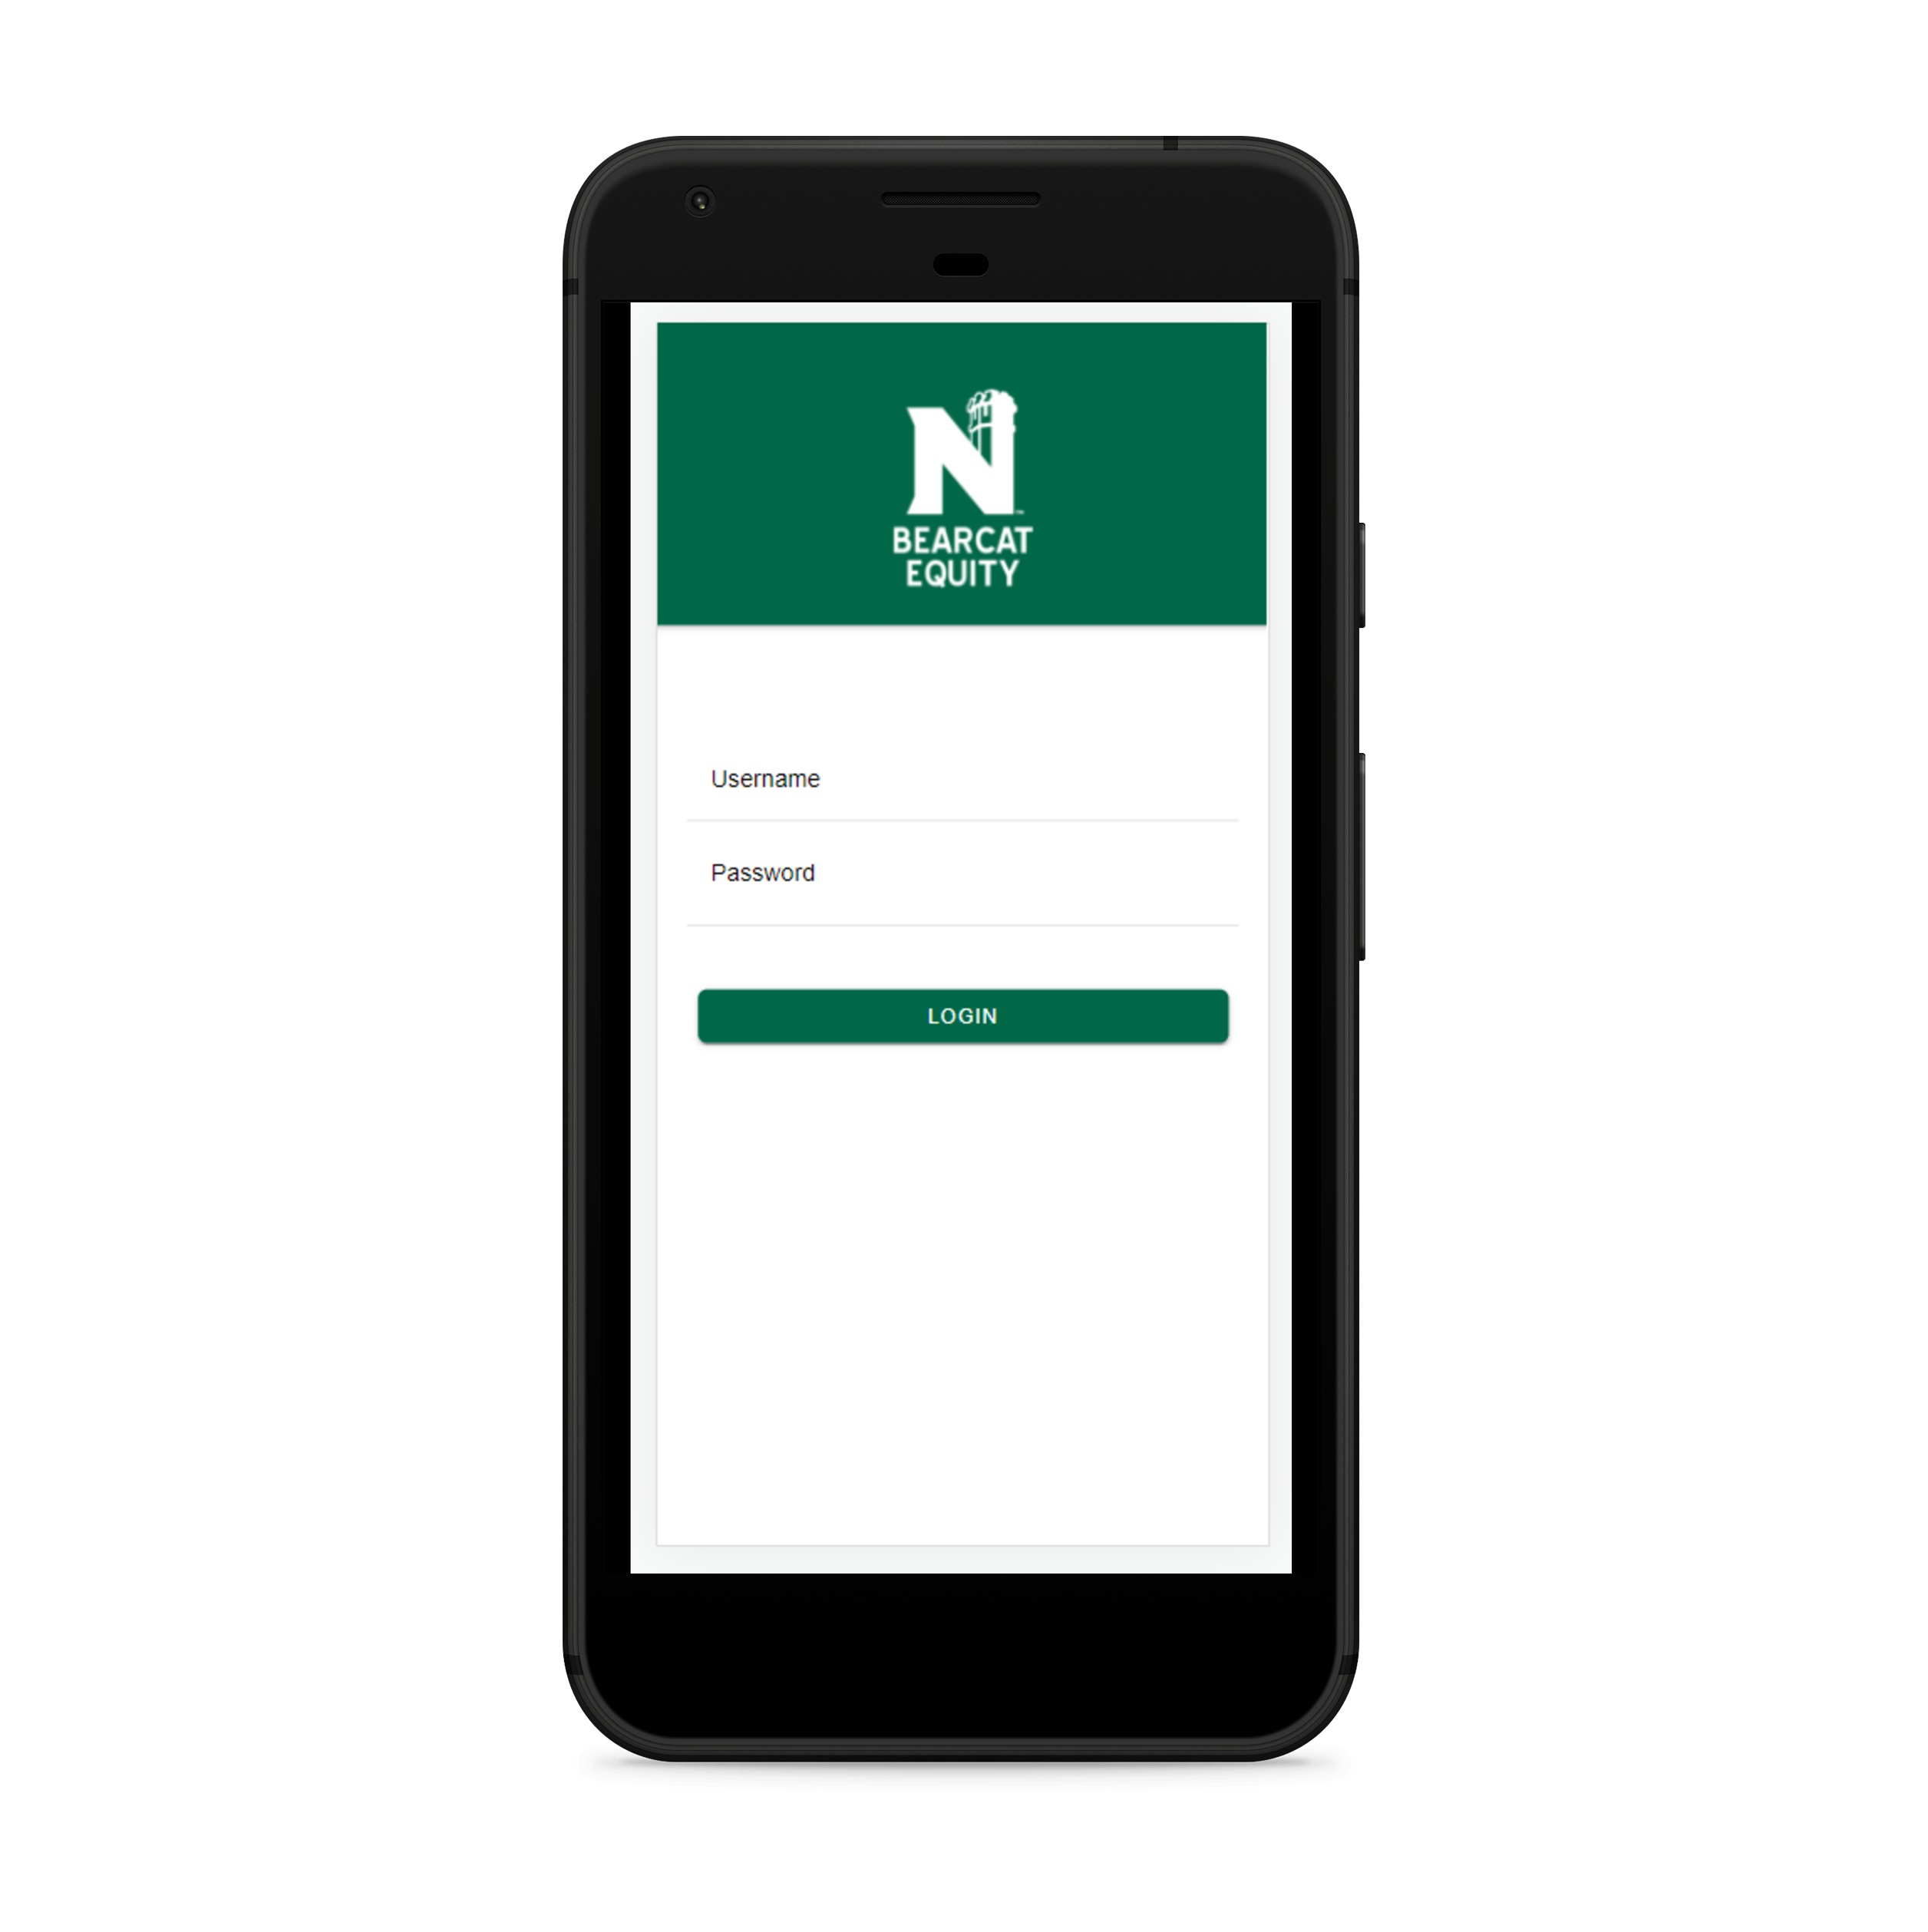
Login

Slide 5
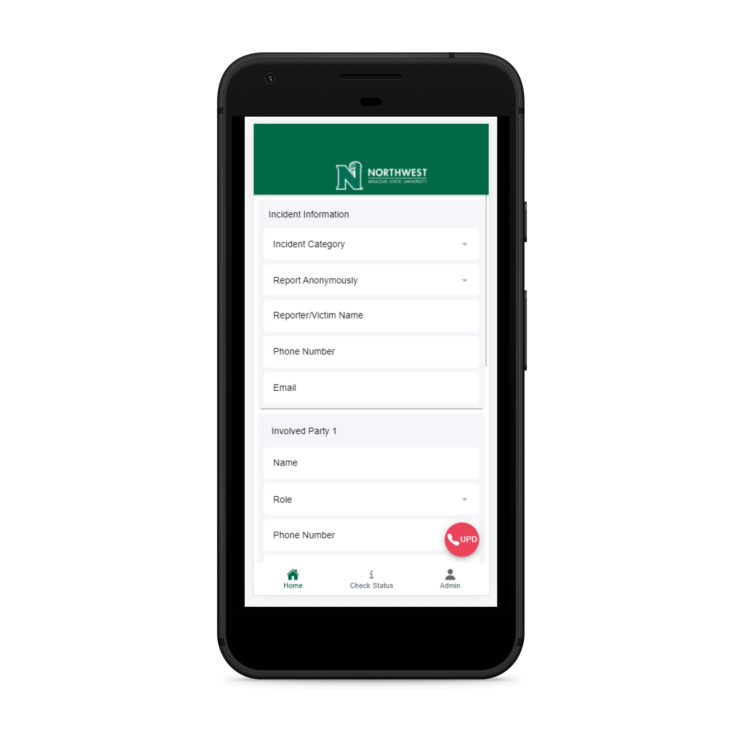
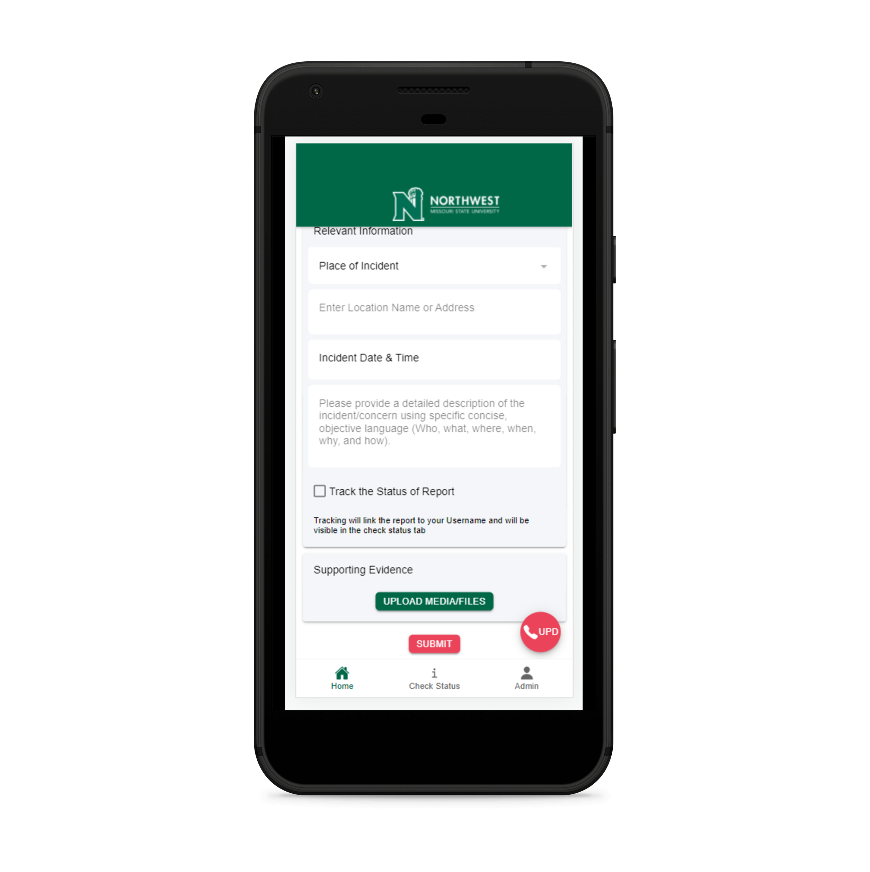
Home

Slide 6
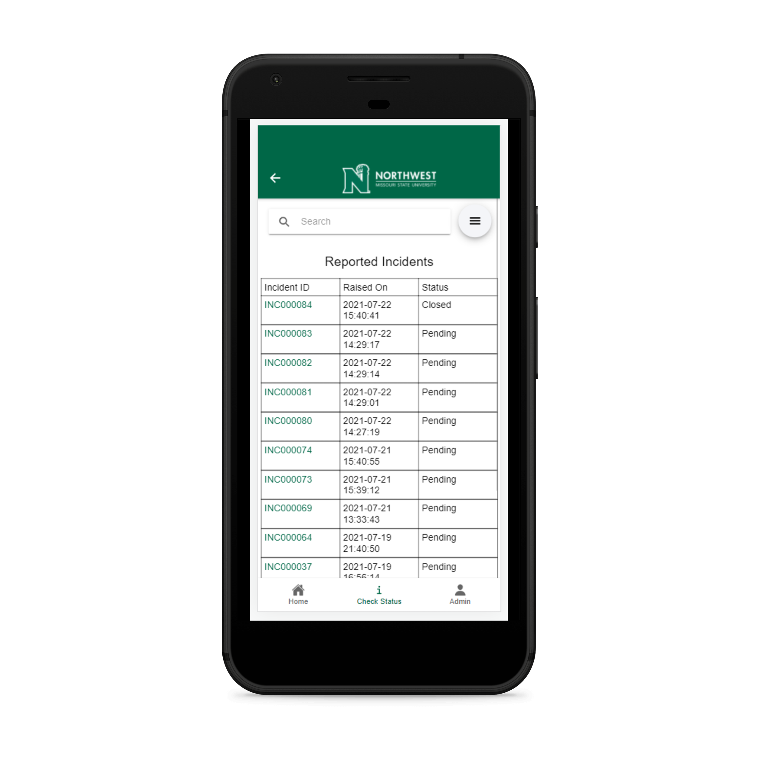
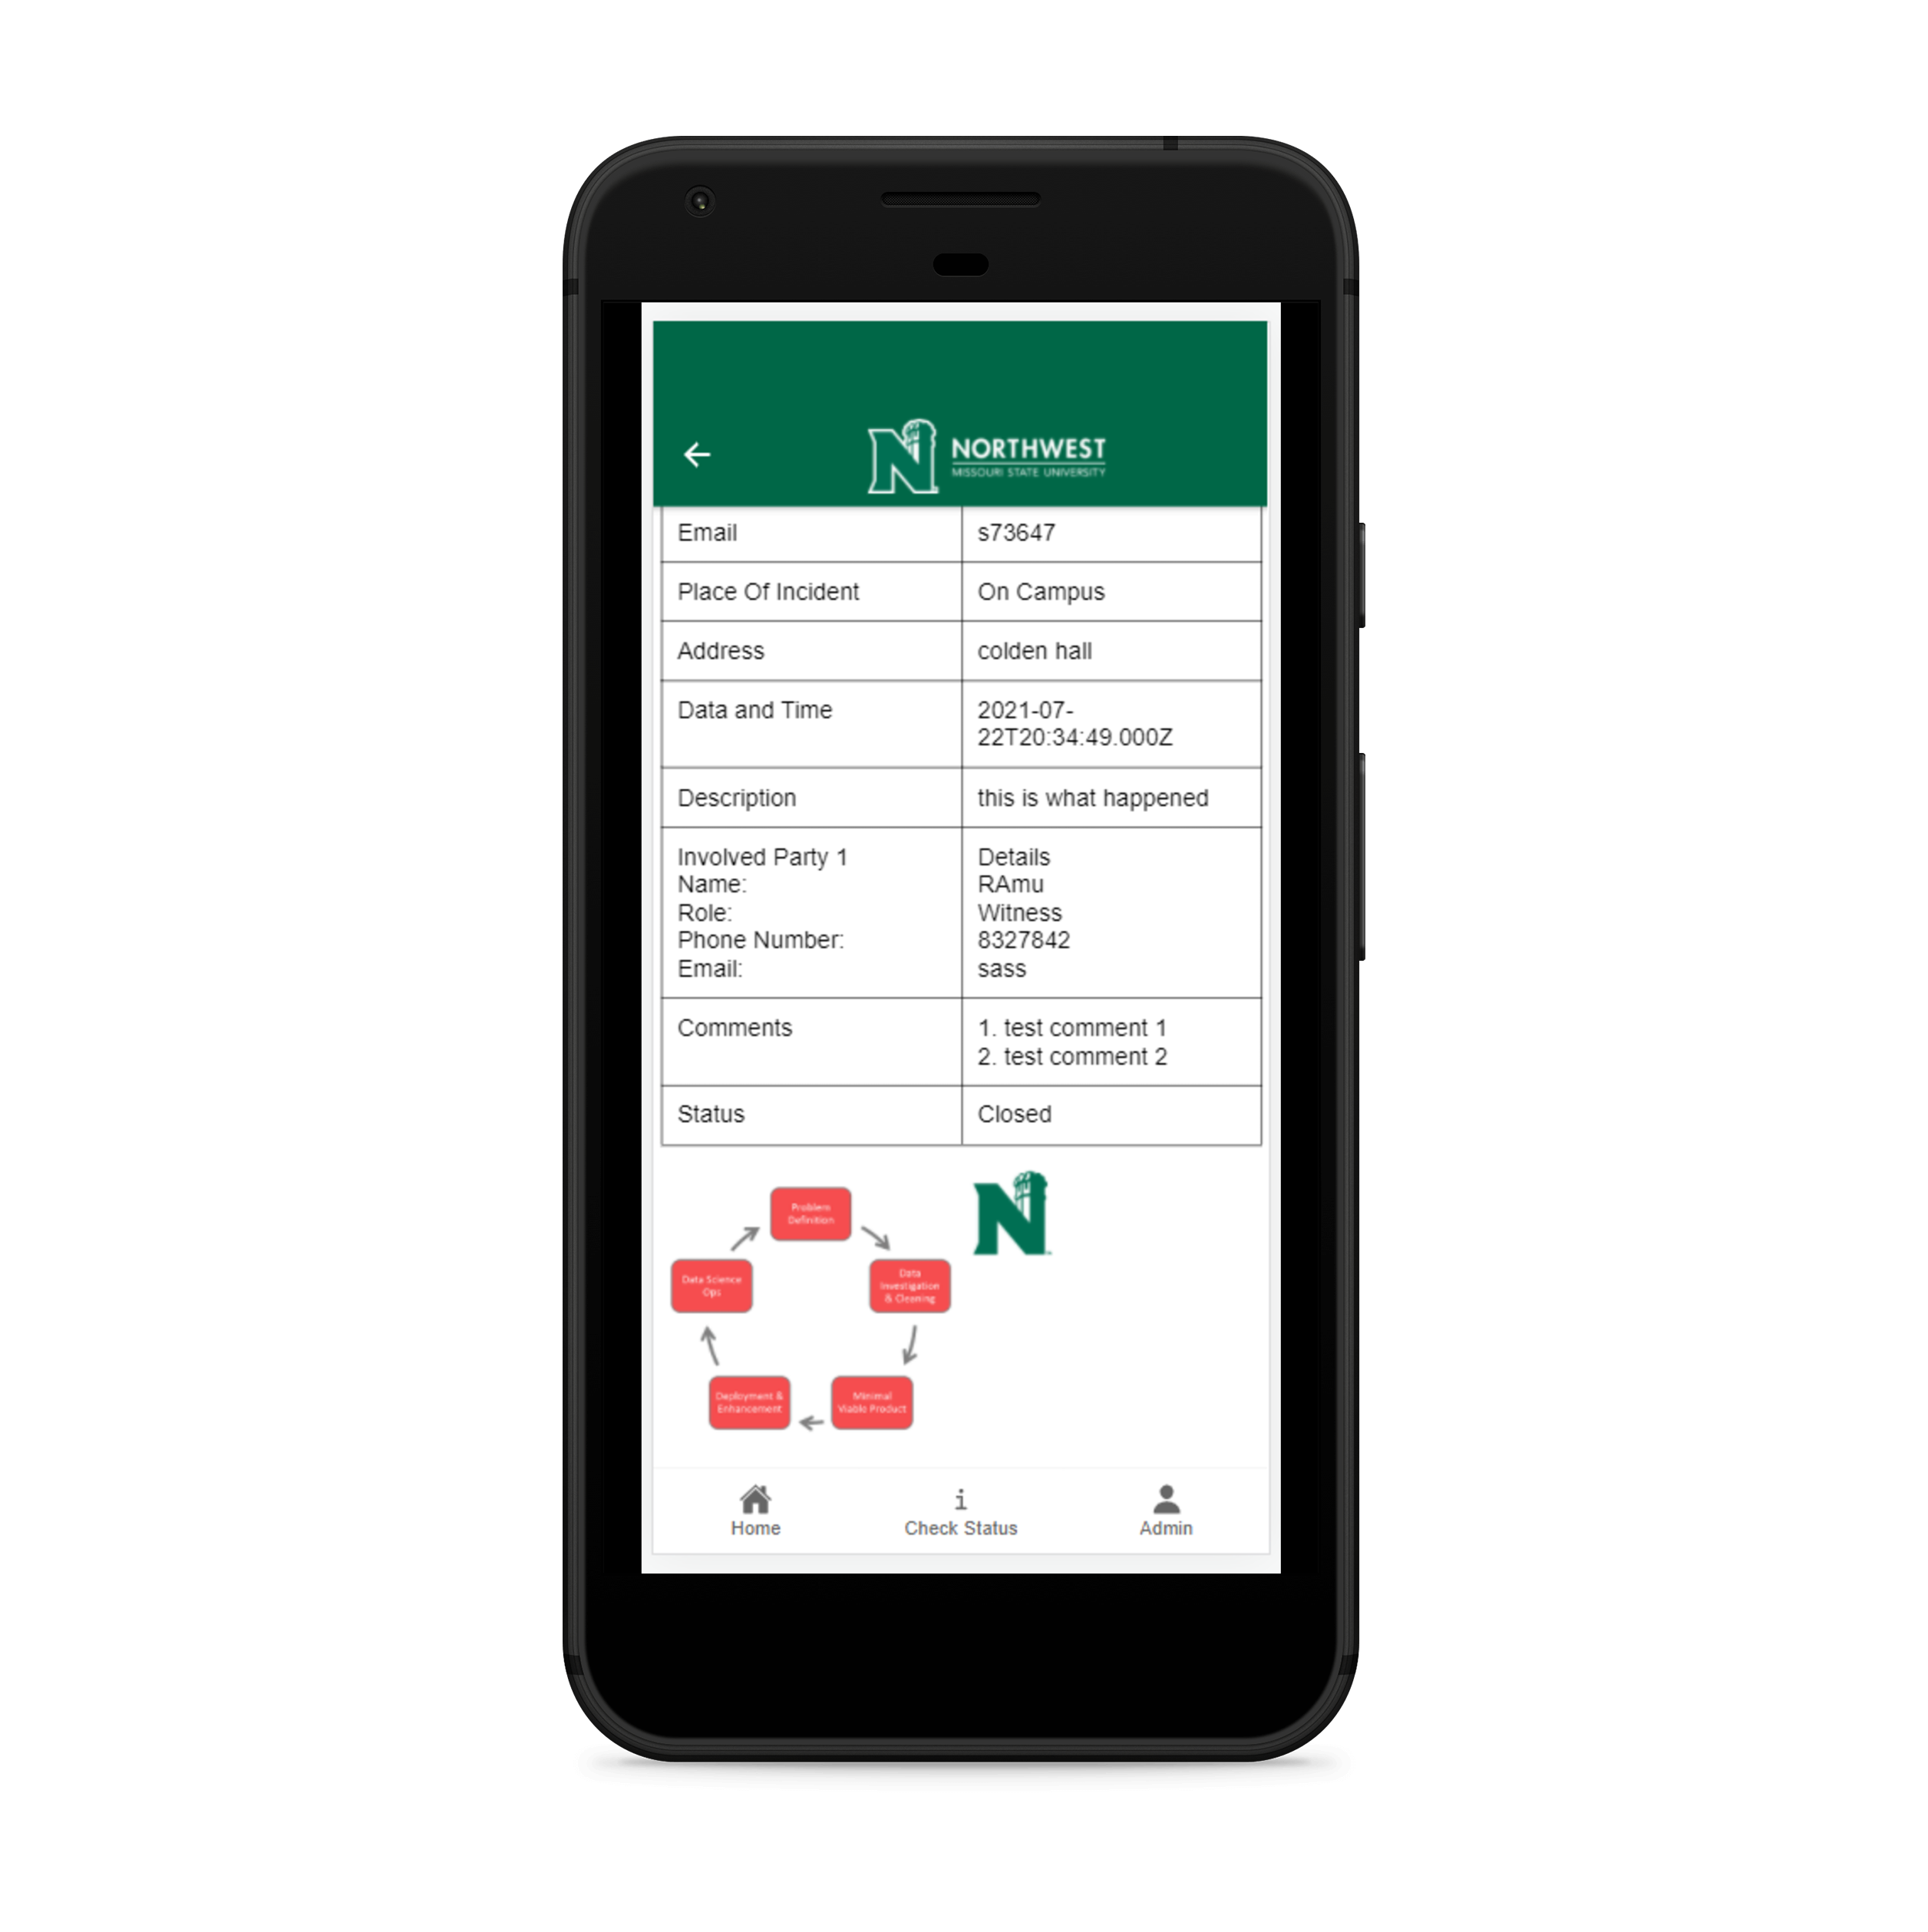
Check Status Tab
User Report

Slide 7
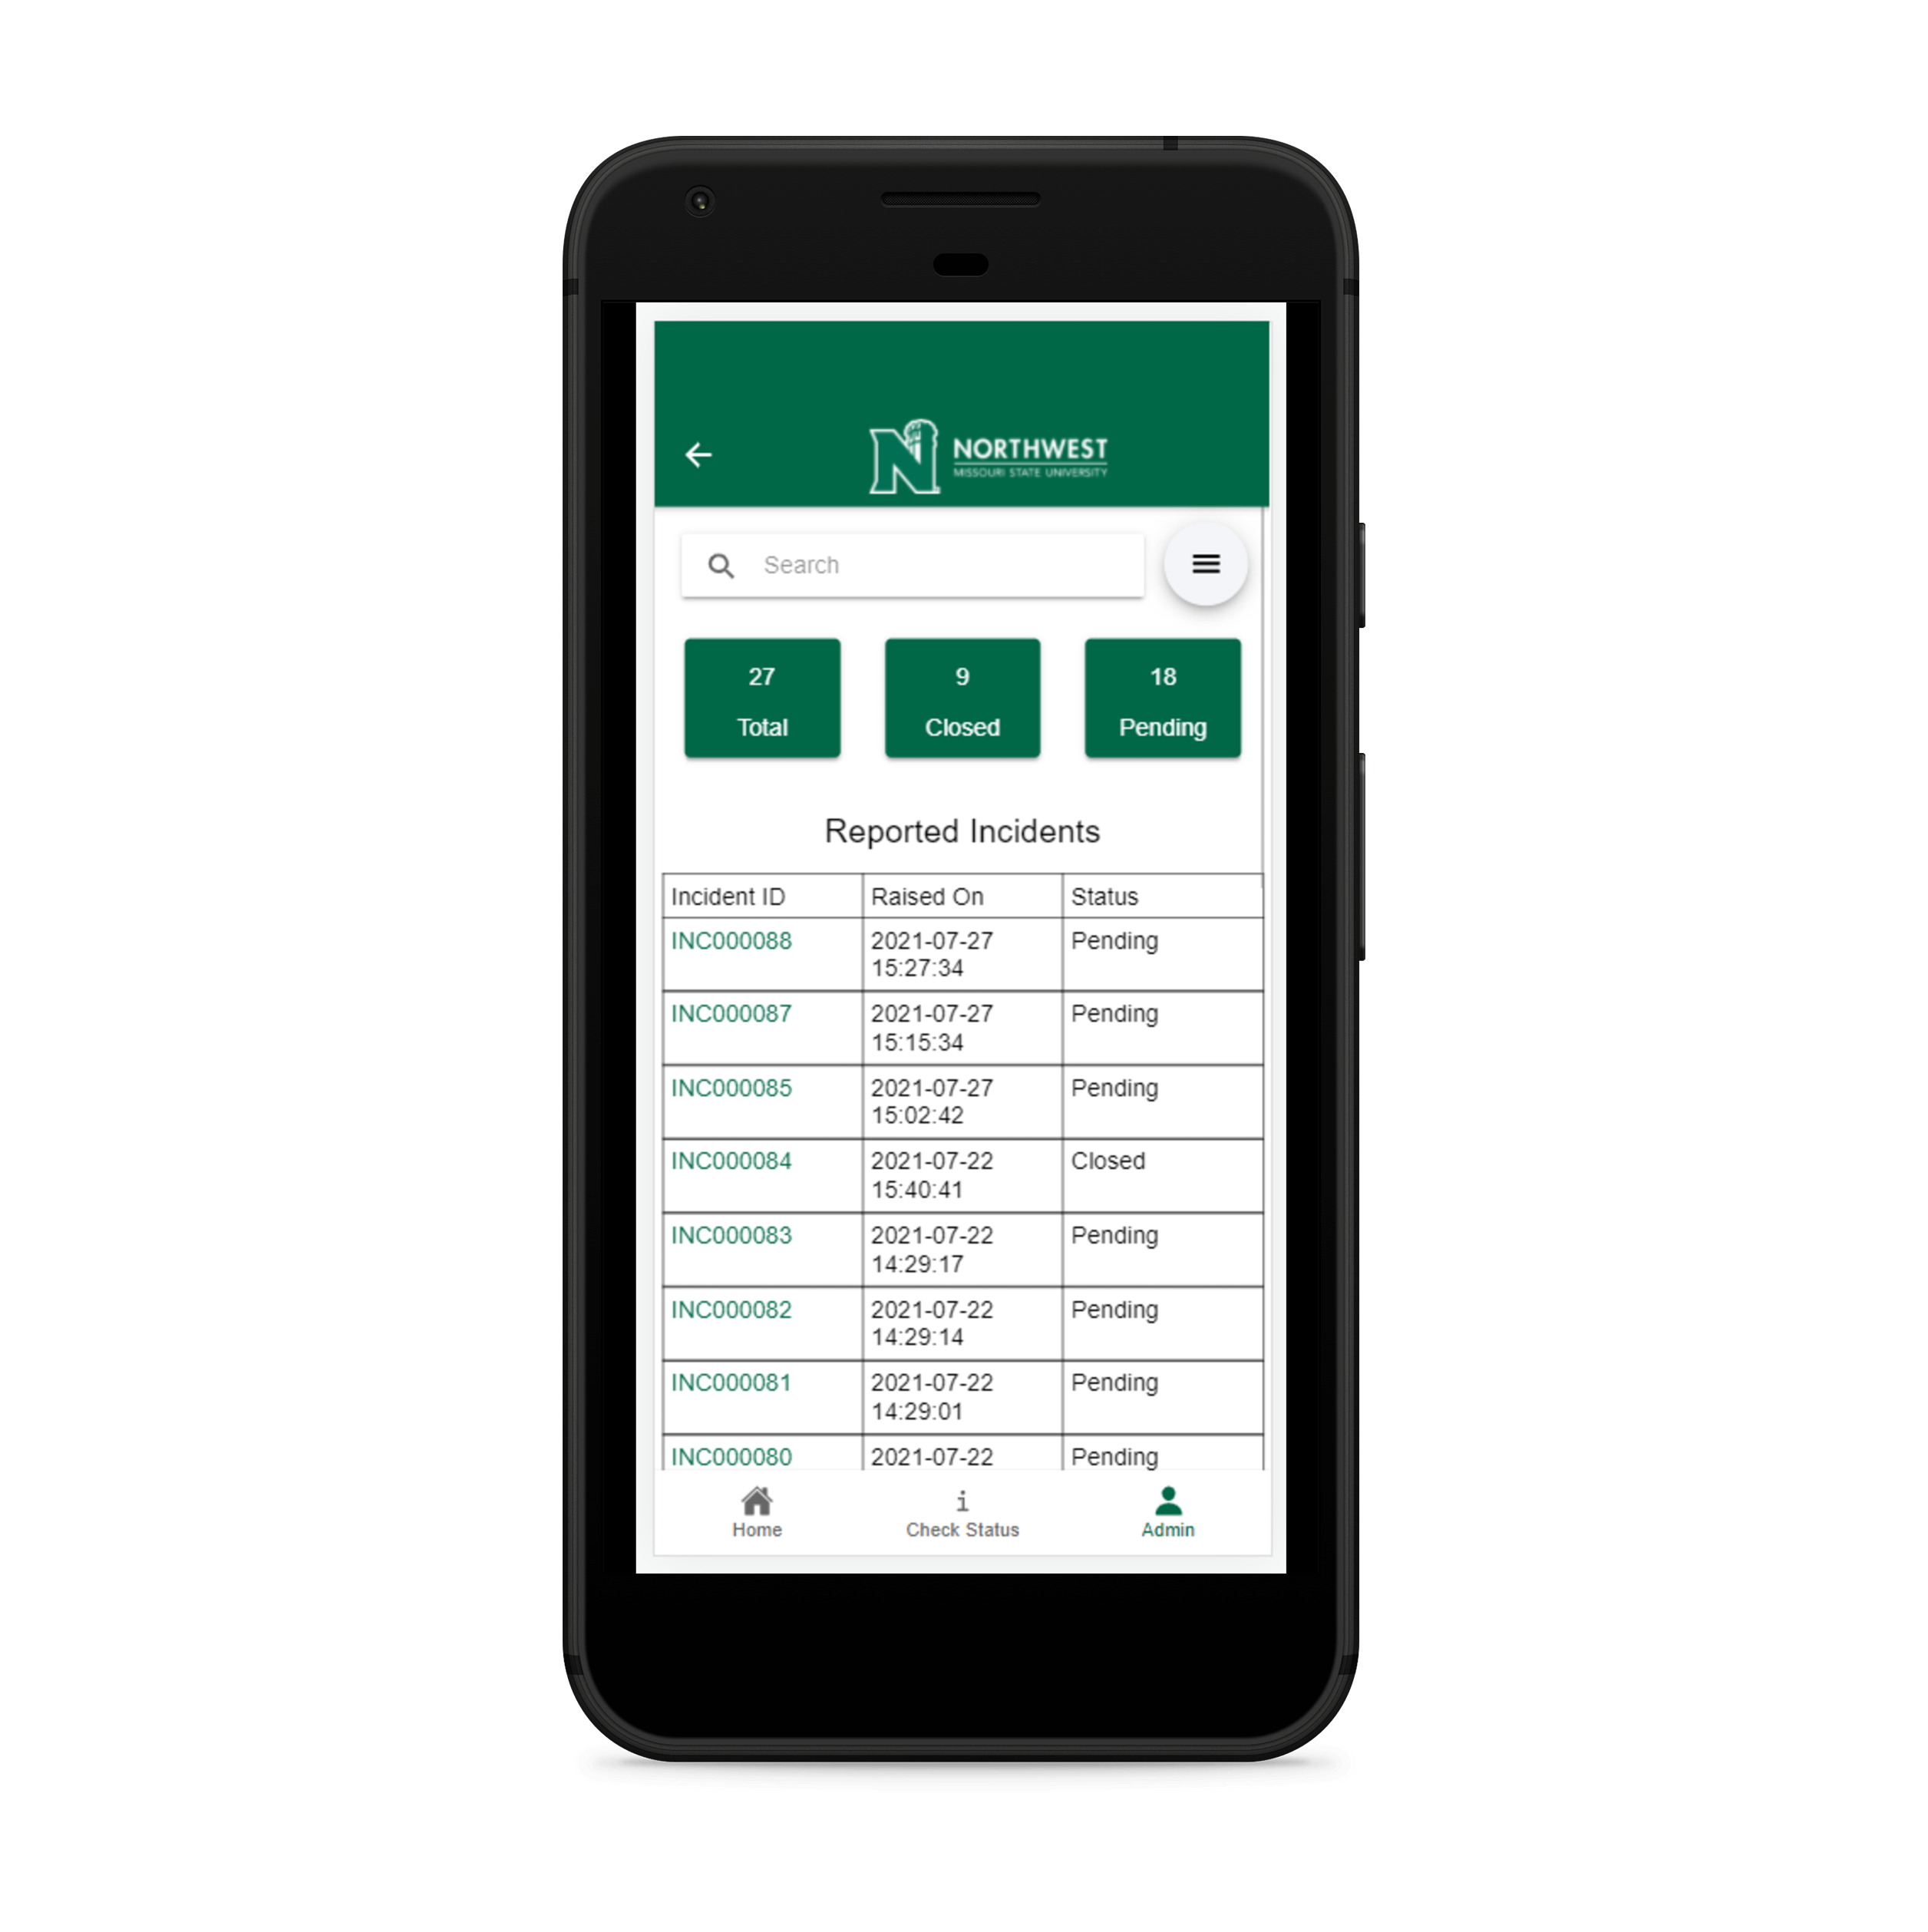
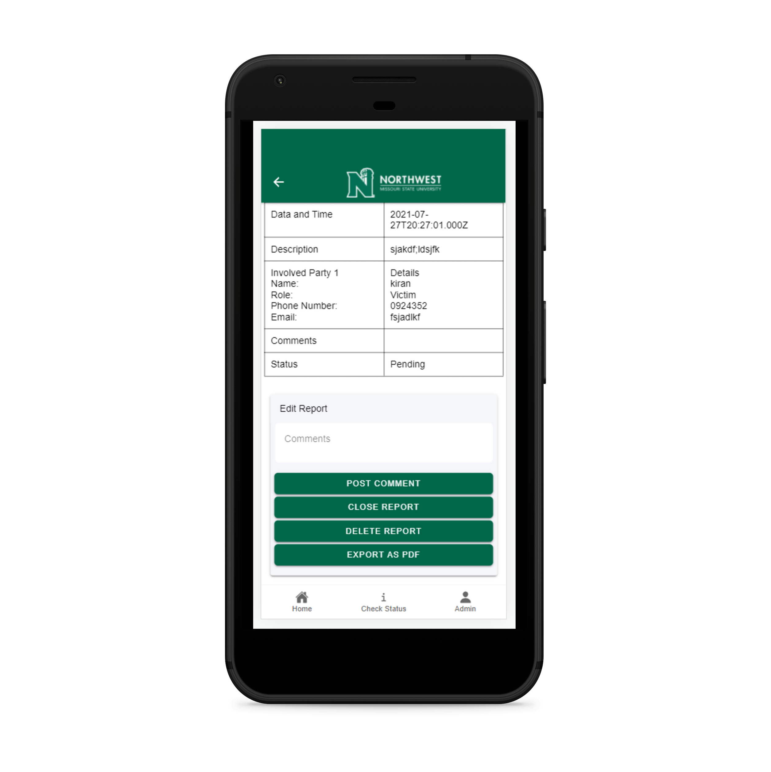
Admin Tab
Admin Report Details

Slide 8
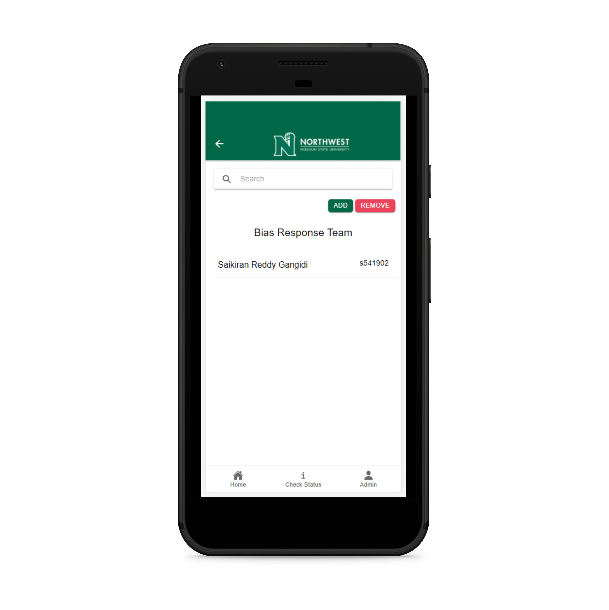
Manage Members

